Slide 1
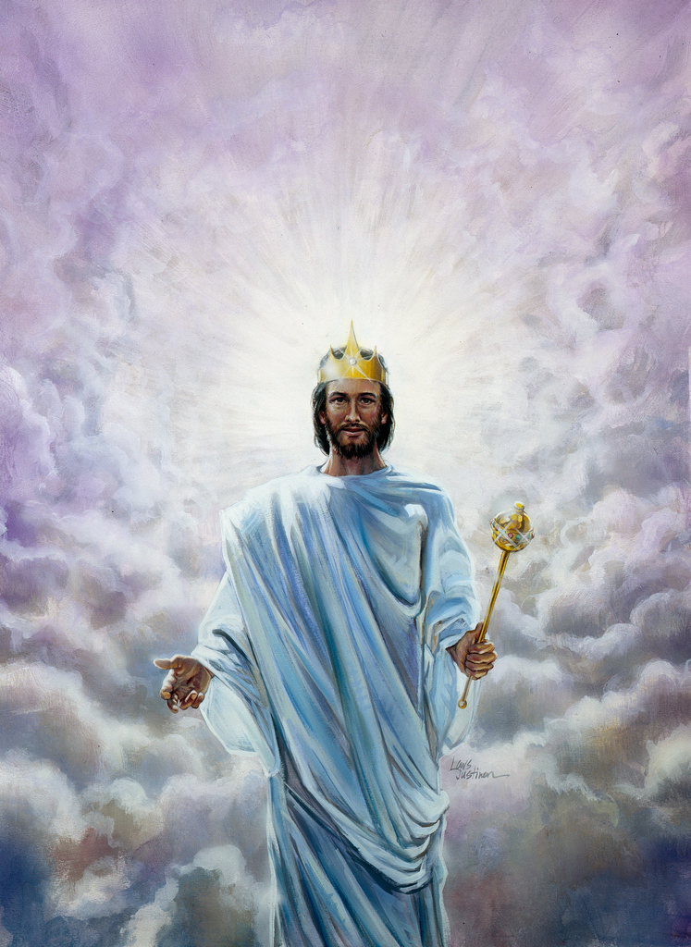

Our Blessed Hope
1000 Years & Beyond
Notes:
Introduce the Channel and the Slogan
Introduce Myself
Explain today's topic
Prayer
Begin

Slide 2
Recap
At the end of our previous Bible Study on the Second Coming we noticed a few important things, such as:
The Second Coming of Christ will be universally visible. Every eye upon the earth at that time shall see Him as He comes with the retinue of all His angels-Both the righteous and the wicked; the sealed and the marked.
It will be universally audible. Christ shall come with a loud shout; the 7th trumpet shall be blown, and both the heavens and the earth shall be shaken mightily.
The dead saints shall be resurrected, clothed in their glorious, immortal bodies and the living saints, who have endured faithfully until the end, shall be also be glorified, and all the saints together shall be caught up to meet Christ in the air to commence their journey through the universe to Heaven.

Slide 3
Recap
The living wicked, who have bowed to Babylon and received her mark and are consumed by the brightness and glory of Jesus at His Coming. They run to the mountains & rocks to hide but in vain.
But the question remains, what happens to those wicked who have had been dead before Christ returned? What has happened to them?
Scripture teaches us that along with the living wicked who died at the Second Coming of Christ, those who were already dead and did not have a part in the first resurrection [resurrection of the just], all remain dead, and the earth is left in a desolate state for a period of 1000 years.
A number of events also take place during this time period and we are going to take a look at them all during this study.

Slide 4
Foundation
Read the below and pay attention to the condition of the earth.
Revelation 16:17-21
Isaiah 34:1-4
Isaiah 13:9-13
Isaiah 24:1-3,6
Jeremiah 4:23-27; 25:30-33
In all the examples above, we noticed that at the Second Coming of Christ, when the righteous have been taken up and the living wicked have been destroyed, the earth is left in a state of disarray.
The sun, moon and stars give no light and the cities of the earth have been destroyed by hail and by the great earthquake.
Jeremiah says that the earth was “without form & void.”

Slide 5
Foundation
That voice shakes the heavens and the earth. There is a mighty earthquake, “such as was not since men were upon the earth, so mighty an earthquake, and so great.” Revelation 16:17-18. The firmament appears to open and shut. The glory from the throne of God seems flashing through. The mountains shake like a reed in the wind, and ragged rocks are scattered on every side. There is a roar as of a coming tempest. The sea is lashed into fury…. The whole earth heaves and swells like the waves of the sea. Its surface is breaking up. Its very foundations seem to be giving way. Mountain chains are sinking. Inhabited islands disappear. The seaports that have become like Sodom for wickedness are swallowed up by the angry waters. Babylon the great has come in remembrance before God, “to give unto her the cup of the wine of the fierceness of His wrath.” Great hailstones, every one “about the weight of a talent,” are doing their work of destruction. Revelation 16:19, 21. The proudest cities of the earth are laid low. The lordly palaces, upon which the world's great men have lavished their wealth in order to glorify themselves, are crumbling to ruin before their eyes.
Great Controversy pg. 636

Slide 6
Foundation
The term “without form & void”, mentioned by Jeremiah, is used in Genesis 1, to describe the state of this world before God brought order & perfection.
“In the beginning God created the heaven and the earth. And the earth was without form, and void; and darkness was upon the face of the deep.” Genesis 1:1-2
At the beginning of Creation, the earth was without form and void, it was a dark lifeless planet, full of chaos and no beauty. There was no light, no trees and no life could be sustained.
Likewise, when Christ comes the Second Time and the seas, rivers and lakes shall all be turned to blood and every living thing in the sea shall die; when the sun shall be given power to scorch the earth and the natural vegetation shall perish; when all the buildings and the cities shall fall, never to rise again, and the islands shall be consumed and devoured by the sea, It is in this state that the earth shall again be “without form & void”. Void of life & without form of beauty.
Revelation 16; Revelation 6:14

Slide 7
Foundation
Many Christians today sadly believe that after the “secret rapture”, when God’s people shall be taken to heaven, that somehow the earth will continue for a further 7 years [discussed in another study].
In the mouth of two or three witnesses, shall every matter be established, Christ tells us, Matthew 18:16. We have the witnesses of Isaiah, Jeremiah and John the Apostle, which clearly show us that no life will be sustained upon the earth when Christ comes the Second Time.
The righteous shall be taken with Christ and the wicked shall perish. All animal and plant life shall also perish, and the earth will be in an uninhabitable condition.
This earth shall be left in this uninhabitable state for 1000 years, in a state of Sabbath Rest as it were.

Slide 8
Foundation
Notice the Typology:
Leviticus 25:1-5
Leviticus 26:32-35,43
Jeremiah 25:11
2 Chronicles 36:16-21
Jeremiah 17:19-27
During the days of Ancient Israel, God speaking through Moses warned the people of judgments to fall upon them, if they were to fall into apostasy & disobedience. Through these judgements, the Israelites would be taken into captivity to their enemies, the land would be laid desolate and thus it would receive its Sabbath rest.

Slide 9
Foundation
These judgments came to pass in the days of Jeremiah the Prophet by the King of Babylon, Nebuchadnezzar.
The nation of Jerusalem, continued to fall deeper and deeper into apostasy over the centuries, from the priest to the common people, only a remnant remained faithful.
God sent Prophets to warn the people to turn from their evil ways, but the people, spurred on by their apostate leaders, persecuted and killed God’s messengers.
The greatest of these apostasies was the total desecration of the Sabbath, and the exaltation of sun worship among God’s people, Jeremiah 17:19-27; Ezekiel 8:15-16.
As a result, God caused Jerusalem & the Temple to be destroyed; most of the people were then taken into captivity for 70 years in Babylon and the land was now able to enjoy its Sabbath rest.

Slide 10
Foundation
1 Corinthians 10:11; Ecclesiastes 1:9
This experience of Ancient Israel, will be repeated on a global scale just before Christ comes the Second Time.
The final issue at the end of time will be the Sabbath/Sunday issue, as we will see in our study on the Seal of God. The final conflict will be between the Seal of God vs. the mark of the beast.
The majority of the world will be on the side of the beast and receives its mark. Practically the entire world will be desecrating the Sabbath of the Lord and exalting Sunday when it is made law in the land via the image of the beast.
Only a Remnant shall remain faithful [as it was in Jeremiah & Ezekiel’s day], and when Christ shall come, to take His saints, along with the dead in Christ, He shall destroy the wicked inhabitants of the earth, just as Jerusalem was destroyed in times past, and for 1000 years, the earth shall be left desolate [without form & void] and it shall enjoy its Sabbath rest, in preparation for the creation of the New Earth.

Slide 11
1000 Years & Beyond
Q. After John, in vision, sees Christ come the Second Time, what does he see next? Read Revelation 20:1-3 [context is seen in Revelation 19]
A. He sees satan being bound by a great chain in a bottomless pit/abyss for 1000 years.
Q. What is the result of satan being bound? Read Revelation 20:3
A. He is no longer able to deceive or tempt humanity during this period of 1000 years.
Q. Why is he no longer able to tempt or deceive anyone?
A. There is no one to tempt. When Christ came, the righteous were taken up to meet Him in the air and the living unrighteous were slain by His brightness & glory. The previous dead who were not resurrected remain dead. There is noone living on the earth at this time.
1 Thessalonians 4:16,17; 2 Thessalonians 1:7-10; Jeremiah 25:33

Slide 12
1000 Years & Beyond
Q. What event begins the period of 1000 years?
The Second Coming of Christ. Read Revelation 20:4,6; 3:21
Those who were martyred for their faith for refusing to worship the beast, John sees these saints now resurrected and sitting upon thrones reigning with Christ.
The question is when were these saints resurrected?
“For the Lord himself shall descend from heaven with a shout, with the voice of the archangel, and with the trump of God: and the dead in Christ shall rise first.” 1 Thessalonians 4:16
Also Read: Revelation 20:5-6; John 5:28-29
- The First Resurrection takes place at the Second Coming of Christ.
- The Second Resurrection takes place after the period of 1000 years.

Slide 13
1000 Years & Beyond
Living & Resurrected Saints Ascend
Christ Comes
Dead in Christ
Raised
Wicked Perish & Satan Bound
Last Plague
AT THE SECOND COMING
Beginning of the 1000 years

Slide 14
1000 Years & Beyond
Q. What does it mean that satan is bound?
A. There is no life on the earth after the Second Coming. How then can satan lead anyone into temptation or deception?
The wicked are all dead and awaiting the 2nd resurrection at the end of the 1000 years; the righteous are with Christ in Heaven dwelling for 1000 years. Satan is therefore bound by his current circumstances as it were; he is “bound” or “tied down” by this great chain of circumstance.
He along with all the fallen angels, will be kept on this earth, to contemplate their coming demise.
The earth during this time will lay desolate as was Jerusalem of old and shall enjoy its Sabbath Rest in preparation for the Creation of the New Earth. It will be “without form & void”, an abyss, a bottomless pit, in a state of disarray.

Slide 15
1000 Years & Beyond
That the expression, “bottomless pit,” represents the earth in a state of confusion and darkness, is evident from other scriptures. Concerning the condition of the earth “in the beginning,” the Bible record says that it “was without form, and void; and darkness was upon the face of the deep.” Genesis 1:2; The word here translated “deep” is the same that in Revelation 20:1-3 is rendered “Bottomless Pit.” Prophecy teaches that it will be brought back, partially, at least, to this condition. Looking forward to the great day of God, the prophet Jeremiah declares: “I beheld the earth, and, lo, it was without form, and void; and the heavens, and they had no light. I beheld the mountains, and, lo, they trembled, and all the hills moved lightly. I beheld, and, lo, there was no man, and all the birds of the heavens were fled. I beheld, and, lo, the fruitful place was a wilderness, and all the cities thereof were broken down.” [Jeremiah 4:23-27]
Here is to be the home of Satan with his evil angels for a thousand years…. It is in this sense that he is bound; there are none remaining, upon whom he can exercise his power. He is wholly cut off from the work of deception and ruin which for so many centuries has been his sole delight. Great Controversy 88 pg. 658-659

Slide 16
1000 Years & Beyond
“For a thousand years, Satan will wander to and fro in the desolate earth, to behold the results of his rebellion against the law of God. During this time his sufferings are intense. Since his fall, his life of unceasing activity has banished reflection; but he is now deprived of his power and left to contemplate the part which he has acted since first he rebelled against the government of Heaven, and to look forward with trembling and terror to the dreadful future, when he must suffer for all the evil that he has done and be punished for the sins that he has caused to be committed.”
Great controversy 88, pg. 660.1

Slide 17
1000 Years & Beyond
Q. Read Revelation 20:4. Why is judgment giving to saints? What or who are they going to judge?
A. The cases of all the wicked, including satan and all of his fallen angels. As the judgement of God’s people took place during the antitypical Day of Atonement [1844-Close of Probation], now, the judgement of the wicked shall take place during this 1000 years.
1 Corinithians 6:2-3; Psalm 149:9
“At this time, the righteous reign as kings and priests unto God. John in the Revelation says: “I saw thrones, and they sat upon them, and judgment was given unto them.” “They shall be priests of God and of Christ and shall reign with him a thousand years.” [Revelation 20:4, 6; 1 Corinthians 6:2, 3.] It is at this time that, as foretold by Paul, “the saints shall judge the world.” In union with Christ, they judge the wicked, comparing their acts with the statute book, the Bible, and deciding every case according to the deeds done in the body. Then the portion which the wicked must suffer is meted out, according to their works; and it is recorded against their names in the book of death.”
Great Controversy 88, pg. 660.3

Slide 18
1000 Years & Beyond
Satan Bound
Righteous in Heaven
Fallen Angels Bound
Judgment Of The Wicked
Without Form & Void
DURING THE 1000 YEARS
During the 1000 years, one will either be in heaven or dead and lost.

Slide 19
1000 Years & Beyond
Q. At the close of the 1000 years, the New Jerusalem comes down from Heaven to the earth. Who comes with it? Where will it settle?
A. It is at this time, after the judgment of the wicked and the 1000 years is finished that Christ comes down to this battered & desolate earth. He comes with the Redeemed, the angels and the New Jerusalem.
His feet shall touch the earth this time, when He descends upon Mt. Olives. The same Mt. Olives that He ascended from after His resurrection. This mountain shall be split in two and shall make a great plain. It is here that the New Jerusalem shall dwell. See: Revelation 21:2-3; Zechariah 14:1,4,5
The Capital of the Universe shall now be on Earth.
The Second Coming will be FOR His saints. The Third Coming will be WITH His saints.

Slide 20
1000 Years & Beyond
Q. What else happens during this time?
A. The wicked from all ages are now resurrected, as a result, satan has now been released from his chains that once bound him. He and his angels go to the four corners of the earth to gather together all the wicked, from the wicked Cain, to the last unrepentant sinner. As the righteous angels went to the four corners of the earth to gather the saints at the Second Coming, now satan and his fallen angels, go to the four corners of the earth to gather all of his servants; their number is as the sand of the sea.
Satan, that lying serpent, deceives the wicked and somehow manages to unite them all on his side, with the intention that they will be victorious in destroying the Heavenly City and taking it as his “rightful throne.”
The scene is set, the battle of Gog & Magog is at hand.
Revelation 20:5,7-9

Slide 21
1000 Years & Beyond
At the close of the thousand years, Christ again returns to the earth. He is accompanied by the host of the redeemed, and attended by a retinue of angels. As he descends in terrific majesty, he bids the wicked dead arise to receive their doom. They come forth, a mighty host, numberless as the sands of the sea. What a contrast to those who were raised at the first resurrection! The righteous were clothed with immortal youth and beauty. The wicked bear the traces of disease and death…. Now Satan prepares for a last mighty struggle for the supremacy. While deprived of his power, and cut off from his work of deception, the prince of evil was miserable and dejected; but as the wicked dead are raised, and he sees the vast multitudes upon his side, his hopes revive, and he determines not to yield the great controversy. He will marshal all the armies of the lost under his banner, and through them endeavor to execute his plans…. Yet, true to his early cunning, he does not acknowledge himself to be Satan. He claims to be the Prince who is the rightful owner of the world, and whose inheritance has been unlawfully wrested from him. He represents himself to his deluded subjects as a redeemer, assuring them that his power has brought them forth from their graves, and that he is about to rescue them from the most cruel tyranny. The presence of Christ having been removed, Satan works wonders to support his claims. He makes the weak strong, and inspires all with his own spirit and energy. He proposes to lead them against the camp of the saints, and to take possession of the city of God. With fiendish exultation he points to the unnumbered millions who have been raised from the dead, and declares that as their leader he is well able to overthrow the city, and regain his throne and his kingdom.
Great controversy 88, pg. 662-663

Slide 22
1000 Years & Beyond
Q. What tremendous event happens next to disrupt satan’s plans?
A. Fire and brimstone fall from heaven to consume the wicked, the earth becomes covered in a lake of fire, and satan and all of his sympathisers are consumed and destroyed. Each one is burnt according to their deeds. Some burn longer than others, with satan burning the longest but ultimately all shall be destroyed; they shall be ashes under our feet.
Revelation 20:9-10, 14-15; Revelation 21:8; Malachi 4:1-3; Ezekiel 28:14-15, 17,19; Matthew 25:41
“Now Christ again appears to the view of his enemies. Far above the city, upon a foundation of burnished gold, is a throne, high and lifted up. Upon this throne sits the Son of God, and around him are the subjects of his kingdom. The power and majesty of Christ no language can describe, no pen portray. The glory of the Eternal Father is enshrouding his Son. The brightness of his presence fills the city of God, and flows out beyond the gates, flooding the whole earth with its radiance….

Slide 23
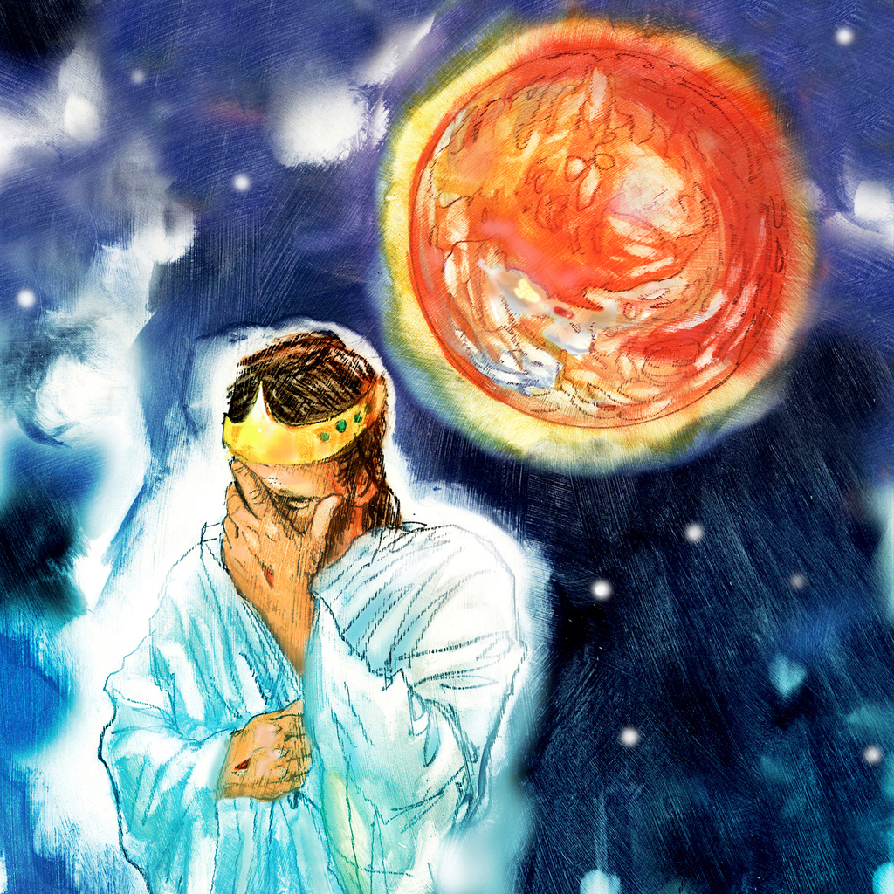
1000 Years & Beyond
As soon as the books of record are opened, and the eye of Jesus looks upon the wicked, they are conscious of every sin which they have ever committed. They see just where their feet diverged from the path of purity and holiness, just how far pride and rebellion have carried them in the violation of the law of God. Above the throne is revealed the cross; and like a panoramic view appear the scenes of Adam's temptation and fall, and the successive steps in the great plan of redemption…. all are vividly portrayed. Satan, his angels, and his subjects have no power to turn from the picture of their own work. Each actor recalls the part which he performed….. all behold the enormity of their guilt. They vainly seek to hide from the divine majesty of His countenance, outshining the glory of the sun…The whole wicked world stand arraigned at the bar of God,… They have none to plead their cause; they are without excuse; and the sentence of eternal death is pronounced against them.
Fire comes down from God out of Heaven. The earth is broken up…..Devouring flames burst from every yawning chasm. The very rocks are on fire. The day has come that shall burn as an oven. The elements melt with fervent heat, the earth also, and the works that are therein are burned up. [Malachi 4:1; 2 Peter 3:10.] The earth's surface seems one molten mass,—a vast, seething lake of fire. It is the time of the judgment and perdition of ungodly men,— “the day of the Lord's vengeance, and the year of recompenses for the controversy of Zion.” Great Controversy 88 pg. 664-672

Slide 24
1000 Years & Beyond
While the earth was wrapped in the fire of destruction, the righteous abode safely in the holy city. Upon those that had part in the first resurrection, the second death has no power. [Revelation 20:6; Psalm 84:11.] While God is to the wicked a consuming fire, he is to his people both a sun and a shield. [Revelation 20:6; Psalm 84:11.] IBID pg. 673
Q. What next?
A. “He who sat on the throne said, “Behold I make all things new” Revelation 21:5
God will create new heavens (sky) and a new earth. The earth has enjoyed its sabbath rest, sin and sinners are gone forever. “Affliction shall not rise up a second time, Nahum 1:9”. There shall be no more tears, death, sorrow, nor pain, for the former things are passed away.
The New Jerusalem will be the capital city of the New Earth. God’s people shall at long last receive the Kingdom promised to them, the meek shall inherit the earth and they shall obtain joy and gladness for all eternity.
Jesus has prepared a place for us, miss it and blame no one but yourself!!

Slide 25
1000 Years & Beyond
City Surrounded & Wicked Judged
Satan Loosed
New Jerusalem Descends
Wicked Destroyed & Earth Renewed
Wicked Revived
END OF THE 1000 YEARS

Slide 26
Closing
“The fire that consumes the wicked purifies the earth. Every trace of the curse is swept away. No eternally burning hell will keep before the ransomed the fearful consequences of sin… One reminder alone remains: our Redeemer will ever bear the marks of his crucifixion. Upon his wounded head, upon his side, his hands and feet, are the only traces of the cruel work that sin has wrought.
All that was lost by sin has been restored…God's original purpose in the creation of the earth is fulfilled as it is made the eternal abode of the redeemed. “The righteous shall inherit the land, and dwell therein forever.” [Psalm 37:29.]
Human language is inadequate to describe the reward of the righteous. It will be known only to those who behold it. No finite mind can comprehend the glory of the Paradise of God.
The great controversy is ended. Sin and sinners are no more. The entire universe is clean. One pulse of harmony and gladness beats through the vast creation. From Him who created all, flow life and light and gladness, throughout the realms of illimitable space. From the minutest atom to the greatest world, all things, animate and inanimate, in their unshadowed beauty and perfect joy, declare that God Is Love.” Great Controversy 88 pg. 673-678

Slide 27
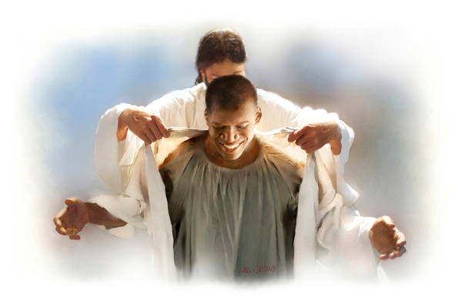





THANK YOU!
loudcrycompendium@gmail.com
www.loudcrycompendium.com
@loudcrycompendium
@ThePropheticEye

