Slide 1

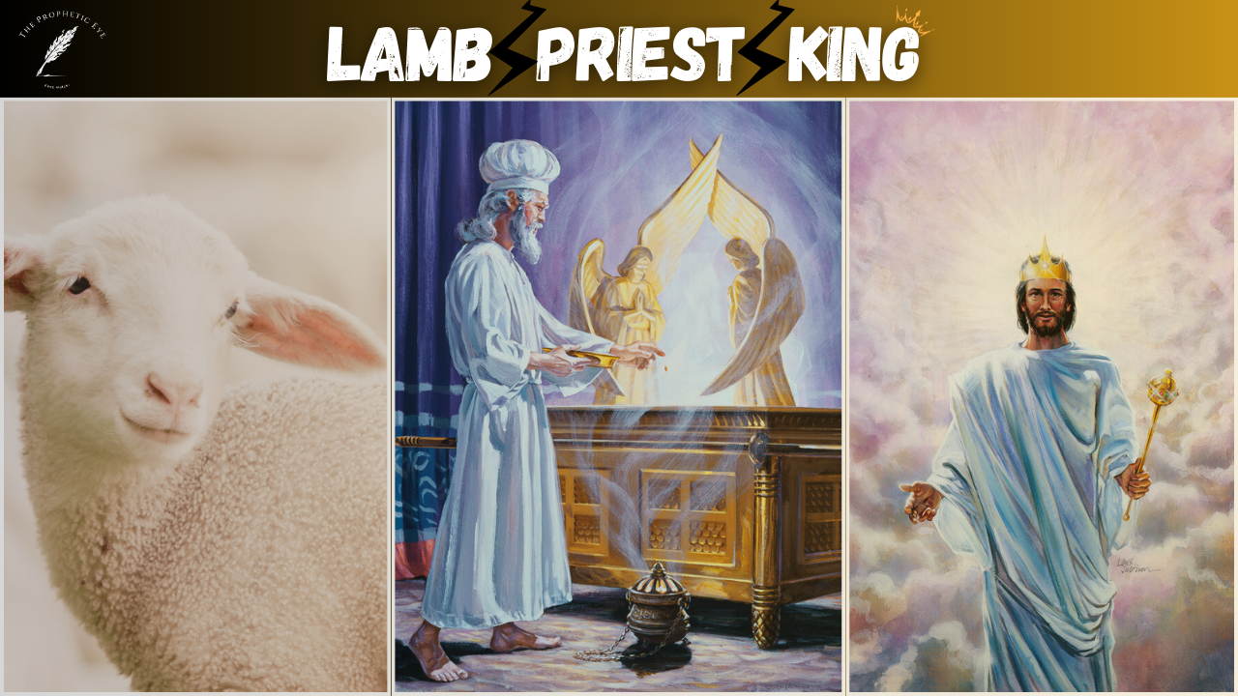
Eternal Sovereign
Revealing Christ as the Lamb, Priest & King

Slide 2
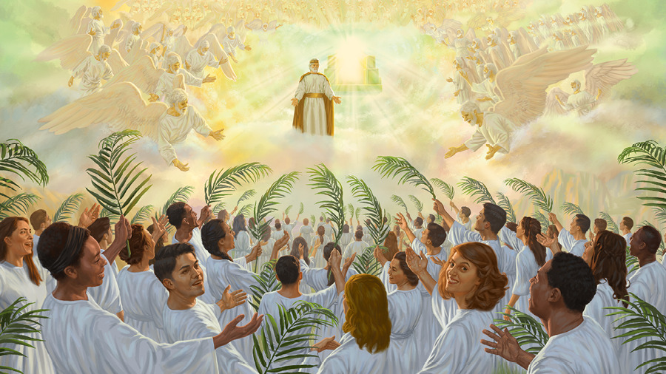
Preface
Throughout the Scriptures is revealed the Divine plan of the Father, to save fallen humanity, through His Son, Christ Jesus, by the power of the Holy Spirit.
The Triune Godhead, ordained this perfect plan from the foundations of the world, before humanity was ever created.
God in His foreknowledge, knowing the end from the beginning, put a plan in place that sinful humanity could be redeemed, and brought back to moral perfection.
This plan centers around Christ. “No man cometh to the Father but through Christ.” He is the way.
Jesus as The Lamb, The High Priest and The King, is the very foundation of The Father’s Divine Plan. Without Christ, humanity would be destined to eternal destruction.

Slide 3
Preface
“And if Christ be not risen, then is our preaching vain, and your faith is also vain. Yea, and we are found false witnesses of God; because we have testified of God that he raised up Christ: whom he raised not up, if so be that the dead rise not. For if the dead rise not, then is not Christ raised: And if Christ be not raised, your faith is vain; ye are yet in your sins. Then they also which are fallen asleep in Christ are perished. If in this life only we have hope in Christ, we are of all men most miserable.” 1 Corinthians 15:14-19
“…whose names are not written in the book of life of the Lamb slain from the foundation of the world.” Revelation 13:8
Blessed be the God and Father of our Lord Jesus Christ, who has blessed us with every spiritual blessing in the heavenly places in Christ, just as He chose us in Him before the foundation of the world, that we should be holy and without blame before Him in love. Ephesians 1:3-4

Slide 4
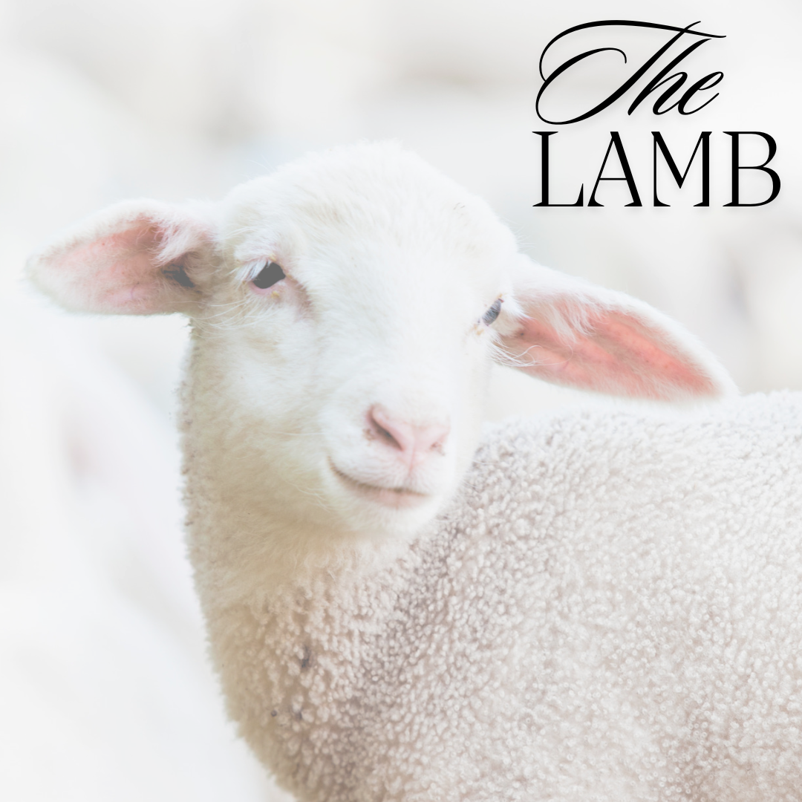
The Lamb Of God
Q. In the Old Testament, there were multiple clean beasts which were used in the sacrificial service, what were they and what was the primary animal used?
A. A calf, a lamb (and all other sheep derivatives), a kid of the goats, turtle dove and a pigeon.
Of these animals the lamb (and all other sheep derivatives) was the primary animal used.
Leviticus 1:2,3,5,10,14
Genesis 4:3-5
Genesis 22:7-8, 13
Exodus 12:3-5

Slide 5
The Lamb Of God
Q. Upon what was the lamb to be offered upon as a sacrifice?
A. Upon an altar- either of earth, stone or bronze.
Genesis 8:20
Genesis 22:9
Exodus 20:24-25
Exodus 27:1-2
Q. Why was the blood shed and the lamb offered?
A. It confirmed the covenant between God and His people. It signified the foreshadowing of the True Lamb who would be slain for the sins of the world.
Exodus 24:1-8
Hebrews 9:18,20,22

Slide 6
The Lamb Of God
Q. Was it possible for the blood of a literal lamb, goat, calf, pigeon or dove to take away sin?
A. No. This blood shed simply pointed to a greater and more perfect sacrifice which was to take place.
Hebrews 10:1-7
Q. Who and what did the lamb and this sacrifice in the Old Testament represent?
A. Assuredly, it pointed to Christ Jesus, the Lamb of God, who was slain on our behalf.
John 1:29
1 Peter 1:18-19
Hebrews 10:12,14
Genesis 22:7-8
Isaiah 53:6-7

Slide 7
The Lamb Of God
Q. If the blood that was shed in the Old Testament represented the confirmation of the Old Covenant, what did the Blood of the Lamb of God signify?
A. It represented the confirmation of the New Covenant, therefore, making the Old covenant along with all of its ceremonies and forms obsolete.
Hebrews 9:15-17
Hebrews 10:8-10
Hebrews 8:6-13
Colossians 2:13-17
Christ has fulfilled the Old Covenant and all of the ceremonies connected to the earthly sanctuary such as the priesthood, sacrifices and the feast days, also known as ceremonial sabbaths, [Leviticus 23].
This does not include the Sabbath of the 4th Commandment however, as the Moral Law of God stands the test of time.
The ceremonial law is obsolete, the Moral Law stands forever.

Slide 8
The Lamb Of God
The ceremonial law of sacrifices and rites was instituted after Adam and Eve committed sin in the Garden of Eden.
It was then that a lamb had to be slain, and God made tunics of skin to cover Adam and Eve’s nakedness.
Even though they had made fig leaf garments for themselves, it was not enough in the sight of God.
Blood had to be shed, and this bloodshed typified the eventual death of the True Lamb of God for the sins of humanity.
This ceremonial law of sacrifices and the priesthood which were all connected to the earthly sanctuary system, was passed down from generation to generation, from Adam down through the ages. It was made clearer when given to the Jewish nation, but it did not start with them.
It was at the death of Christ on the Cross that this Old Covenant was made obsolete. It was nailed to the Cross.

Slide 9
The Lamb Of God
Genesis 3:6-7
Genesis 3:20-21
Matthew 27:50-51
Hebrews 10:19-21
Hebrews 4:14-16
Hebrews 10:1-2

Slide 10
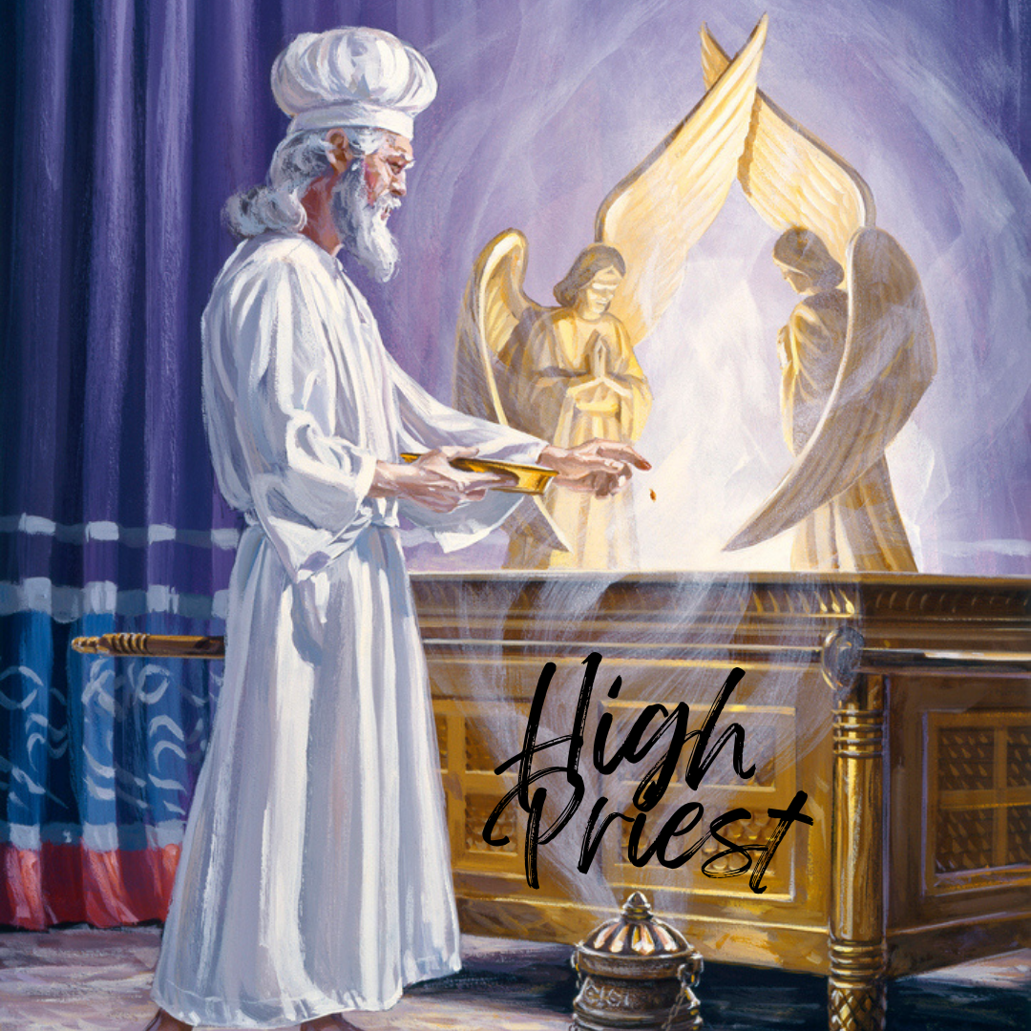
The Great High Priest
Q. After the animal to be sacrificed was slain, what was then done with its blood?
A. It was used to make atonement for the repentant individual.
Leviticus 1:3-5,10-11
Leviticus 3:7-8
Leviticus 4:5-8
Leviticus 16:14
Q. Who was it that officiated with the blood?
A. It was the priest, whether the high priest or his sons, the priests. The priesthood was the sole responsibility of Aaron and his male descendants.
Leviticus 1:10-11
Leviticus 3:7-8
Leviticus 4:5-8
Exodus 28:1,41,43
Exodus 29:8-9

Slide 11
The Great High Priest
Q. Who did the earthly priests as well as the work that they did foreshadow?
A. All the priests of the old covenant pointed forward to Jesus Christ, the Great High Priest, who now ministers for us in the Heavenly Sanctuary; the True Tabernacle in Heaven.
Hebrews 3:1
Hebrews 4:14-16
Hebrews 5:5-6,10-11
Hebrews 7:23-26
Hebrews 8:1,2,6
Hebrews 9:11,15

Slide 12
The Great High Priest
Q. If Christ, by His shed Blood, was made a sacrifice for us, what then is His role as High Priest?
A. Like Aaron the high priest, who stood before the presence of God on behalf of the children of Israel, so Jesus Christ, the Great High Priest, stands before the Father to make intercession for all who accept the Blood which He shed on their behalf. He is our Advocate, the Mediator of the New Covenant.
The Son of God became the Son of man, that He may represent us before the Father. No other of woman-born, could have this privilege, for all have sinned and are sinners in the sight of God. But His Son, stands before Him sinless and is thus able to intercede for fallen, sinful man.
Hebrews 7:24-25
Romans 8:34
Isaiah 53:12
Isaiah 59:16
1 Timothy 2:5
1 John 2:1
Daniel 7:9-10,13

Slide 13
The Great High Priest
“As in the typical service the high priest laid aside his pontifical robes and officiated in the white linen dress of an ordinary priest; so, Christ laid aside His royal robes and garbed Himself with humanity and offered sacrifice, Himself the Priest, Himself the Victim.” Acts of the Apostle, pg. 33
Christ serves as the Sacrifice for our sins and as our Great High Priest. His death as the sacrificial Lamb and Substitute and His continual powerful ministry as our High Priest in Heaven accomplishes two things for us:
A complete life change called the new birth, with all past sins forgiven. John 3:3-6, Romans 3:25
Power to live right in this present time and in the future. Without Christ we can do nothing. Titus 2:14; Philippians 2:13

Slide 14
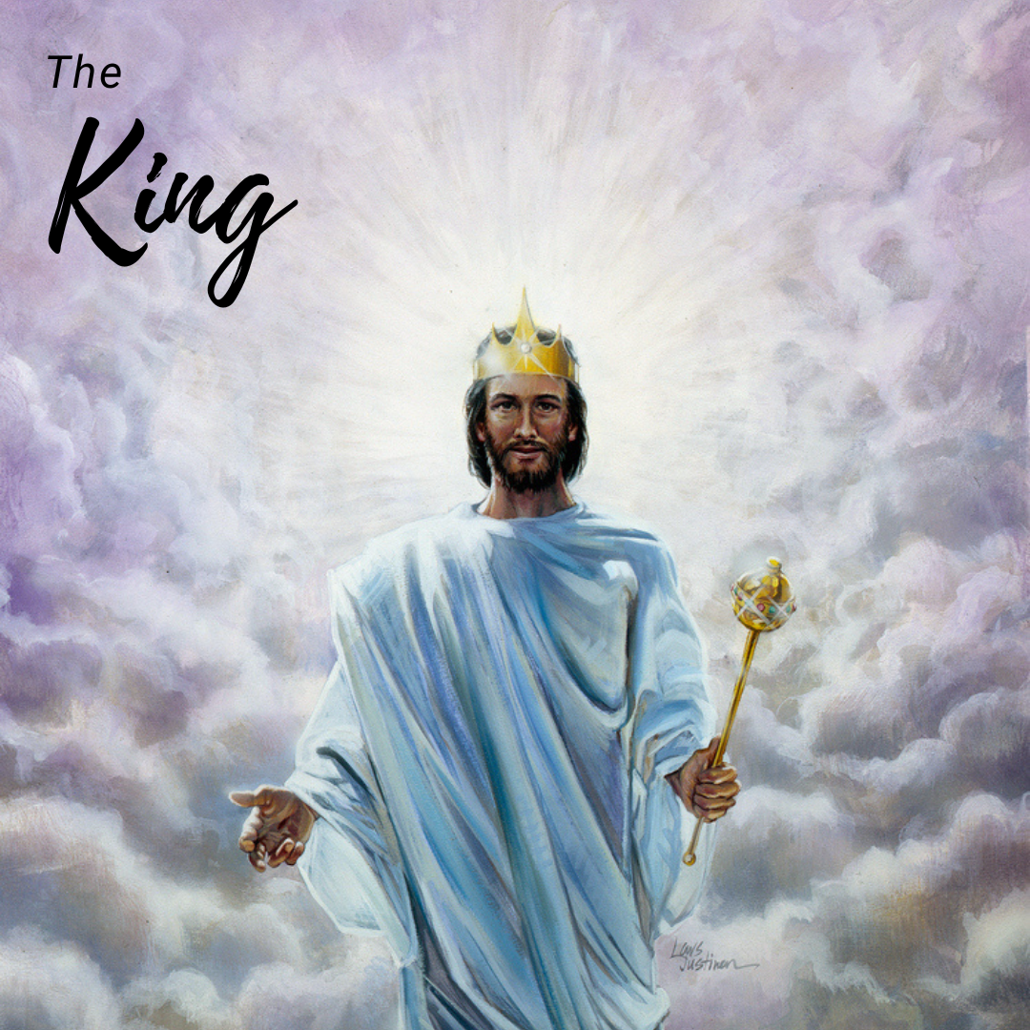
The King of kings
Q. Christ has been the Lamb, He is now our High Priest. What shall His next role be?
A. He returns at His Second Coming as a King. The King of all kings and Lord of all lords.
Revelation 19:11-13,16
1 Timothy 6:13-15
Philippians 2:9-10
Psalm 72:11
Q. What reward shall the King give to His loyal subjects when He comes again to receive them?
A. Eternal life and a Crown of Gold, among many other rewards.
Revelation 22:12
James 1:12
1 Peter 5:4
2 Timothy 4:8
1 John 3:2-3

Slide 15
The King of kings
Q. What shall be the reward of the wicked, who have persistently rejected the salvation of the King?
A. They shall be destroyed and shall cease to exist forevermore.
Revelation 20:11-15
Psalm 110:5-6
Malachi 4:1-3
Zephaniah 1:14-18
Isaiah 12:6-9,11,13
Q. What warning does Christ give to all humanity?
A. “I Come Quickly”
Revelation 22:7,12,20

Slide 16
The King of kings
Christ, The Lamb of God, takes away the sins of the world. Christ, the Great High Priests, the only Mediator, between God and men, intercedes on our behalf, and soon and very soon, Christ is to return as King of kings & Lord of Lords.
It is time to get ready friends, time is almost over! Get ready, get ready, get ready!

Slide 17
The King of kings
“Jesus is coming, but not as at His first advent, a babe in Bethlehem; not as He rode into Jerusalem, when the disciples praised God with a loud voice and cried, “Hosanna”; but in the glory of the Father and with all the retinue of holy angels to escort Him on His way to earth.
All heaven will be emptied of the angels, while the waiting saints will be looking for Him and gazing into heaven, as were the men of Galilee when He ascended from the Mount of Olivet. Then only those who are holy, those who have followed fully the meek Pattern, will with rapturous joy exclaim as they behold Him, “Lo, this is our God; we have waited for Him, and He will save us.” And they will be changed “in a moment, in the twinkling of an eye, at the last trump”—that trump which wakes the sleeping saints, and calls them forth from their dusty beds, clothed with glorious immortality, and shouting, “Victory! Victory over death and the grave!” The changed saints are then caught up together with the angels to meet the Lord in the air, never more to be separated from the object of their love.”
Early Writings pg. 110

Slide 18





Thank You
loudcrycompendium@gmail.com
@ThePropheticEye
www.loudcrycompendium.com
@loudcrycompendium

