Slide 1


High Time to Awake Out Of Sleep
The Signs of the Times & the Coming Crisis

Slide 3
Note: Disciples sleeping before the crisis- 2T 205.1,3
Humanity always sleeping before a major crisis- Flood, Sodom, Jerusalem destroyed both times, In the last days-sleeping Virgins
25LtMs, Ms 83, 1910, par. 30
19MR 234.3
10LtMs, Lt 84, 1895, par. 17 &18
AA 260.1; AA 535.2; AA 431.2
AH 186.2
CET 186.3; CET 220.2
ChS 42.3
CT 414.1
GW 323.3
CCh 60.2
CS 154.1: CT 165.2
6T 436- Let the Churches Awake

Slide 4
Lay The Foundation
In Scripture, there is a common trend of God’s People being in a state of slumber just before the coming of any great crisis.
Some examples come to mind:
The Days of Noah & Lot
Samson
The time of the crucifixion of Christ and the crisis that followed
All these events and more help us to better understand the state of God’s people in the last days, just before Christ shall return the Second Time.
“The thing that hath been, it is that which shall be; and that which is done is that which shall be done: and there is no new thing under the sun.”
Ecclesiastes 1:9

Slide 5
High Time to Awake
Jesus warns His followers, that as it was in the days of Noah & Lot, so will it be prior to His Second Coming.
“And as it was in the days of Noah, so it will be also in the days of the Son of Man…Likewise as it was also in the days of Lot…Even so will it be in the day when the Son of Man is revealed.” Luke 17:26,28,30
But how was it in the days of these two men of God?
Luke 17:27-29; Matthew 24:38-39
It was just business as usual for humanity, those in the world and even self-professed believers in the One True God.
The things of this world took precedence over spiritual things and as a result, many were found fast asleep before destruction came.

Slide 6
High Time to Awake
“The Bible declares that in the last days men will be absorbed in worldly pursuits, in pleasure and money-getting. They will be blind to eternal realities. Christ says, “As the days of Noah were, so shall also the coming of the Son of man be…. So it is today. Men are rushing on in the chase for gain and selfish indulgence as if there were no God, no heaven, and no hereafter.” COL 228
In addition, the animals were coming two by two, supernaturally unto the ark in Noah’s time; an event that could only have been orchestrated by God and not man.
“two by two they went into the ark to Noah, male and female, as God had commanded Noah.” Gensis 7:9
The signs of the times were clear before all, yet the majority were lulled into a deep sleep.

Slide 7
High Time to Awake
Likewise in the days of Lot, we see that society had degraded to a state of widespread immorality. Unnatural relations, pride, idolatry, abomination after abomination was rife throughout the cities of the plain.
“Behold, this was the iniquity of thy sister Sodom: pride, fulness of bread, and prosperous ease was in her and in her daughters; neither did she strengthen the hand of the poor and needy. And they were haughty, and committed abomination before me: therefore, I took them away as I saw good.” Ezekiel 16:49-50 ASV
See also 2 Peter 2:6-8
The inhabitants of Sodom, even some of Lot’s own household, were fast asleep in their prosperous ease and knew not until it was too late.
And Lot went out, and spake unto his sons in law, which married his daughters, and said, Up, get you out of this place; for the LORD will destroy this city. But he seemed as one that mocked unto his sons in law. Genesis 19:15

Slide 8
High Time to Awake
Think about Samson, a leader in the Jewish Church, a Judge; was he not found literally sleeping upon Delilah’s lap just before his crisis?
Read Judges 16:18-21
Samson, was a child of God, one endowed with the Holy Spirit as you and I today, yet he was found fast asleep just before the crisis.
Had he been paying attention to the signs of the times around him, he would have realised that Delilah and the Philistines wanted him dead.
But because he was found sleeping in a time of trouble, he was caught unawares and knew not that “the Lord was departed from him.” Judges 16:20
Three times Samson had the clearest evidence that the Philistines had leagued with his charmer to destroy him, but Samson loved to sleep.

Slide 9
High Time to Awake
Now before we address the signs in our day, let us take a look at the disciples of Christ:
Time after time, Jesus made known to His disciples, that a time of trouble would unfold upon Him and likewise upon them, yet they, in their blindness could not understand.
Matthew 16:21; Matthew 17:12,22-23; Mark 9:30-32; Luke 18:31-34
Because of their lack of spiritual discernment, the disciples were not able to receive this all-important truth for their time. As a result, when Christ’s experience came in Gethsemane, and He would have them to stay up with Him to watch & pray, not only for Him but also for themselves and the coming crisis, they were found fast asleep. Asleep before the crisis!
Matthew 26:36-46

Slide 10
High Time to Awake
“…as He prayed, the great drops of bloody sweat moistened the sod of Gethsemane. He went to His disciples, hoping to find them watching, but they were asleep. Are any of us asleep? God help us! We are facing a crisis. Christ was facing a crisis then. We shall have conditions that we do not dream of, and we will need to be in close relation with God.” Manuscript 83, 1920, par. 30
“…again He came to His disciples and found them sleeping. Their eyes were heavy. By these sleeping disciples is represented a sleeping church, when the day of God's visitation is nigh. It is a time of clouds and thick darkness, when to be found asleep is most perilous.” Testimonies for the Church, vol.2, pg. 205
“ A storm is coming, relentless in its fury.
Are we prepared to meet it?”
Testimonies for the Church, vol. 8, pg. 315.2

Slide 11
The Signs of the Times
All throughout the prophetic portions of the Bible, Christ gives us signs to warn us of His soon Second Coming.
These signs are not meant to scare us, but to warn us and to awaken us from our lukewarm condition.
Widespread Deception and Christians Leaving the Faith:
Matthew 24:4-5,11,24; 1 Timothy 4:1; 2 Thessalonians 2:3,9-10; Revelation 13:13-14
Wars and Various Global Climate & Health Calamities:
Matthew 13:7-8; Luke 21:10-11,25
Immorality within Society and Spiritual Declension in the Church:
2 Timothy 3:1-5; 2 Timothy 4:2-4
Lack of Brotherly Love:
Matthew 24:9-10,12

Slide 12


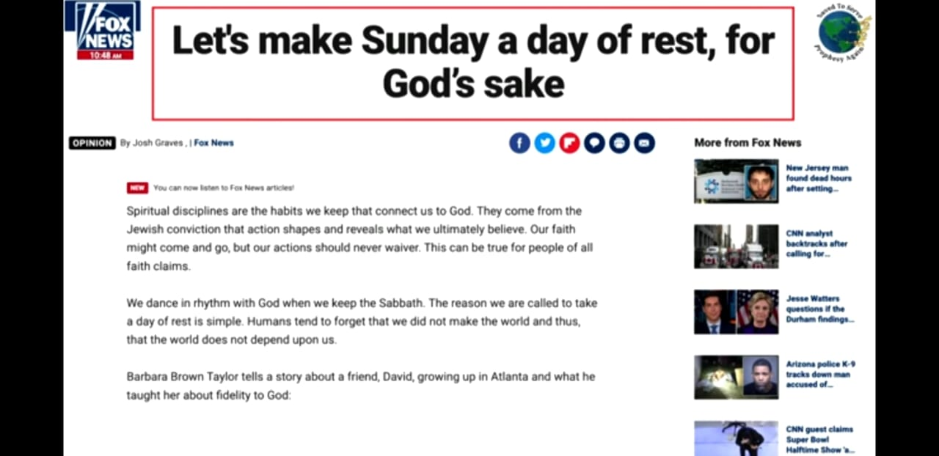
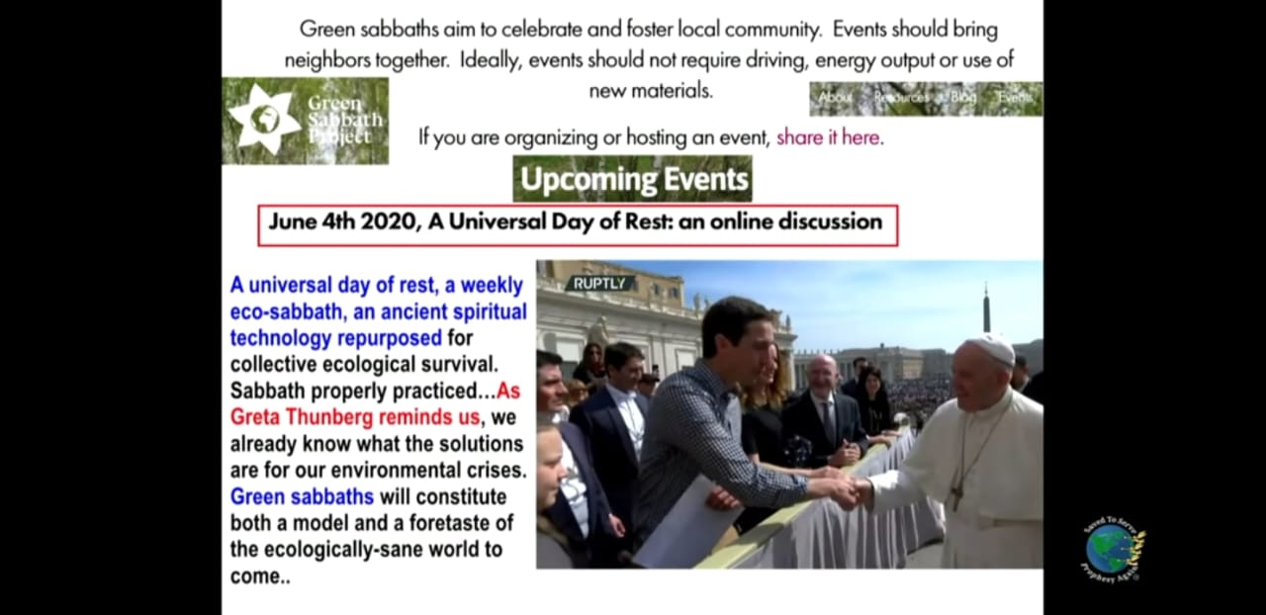




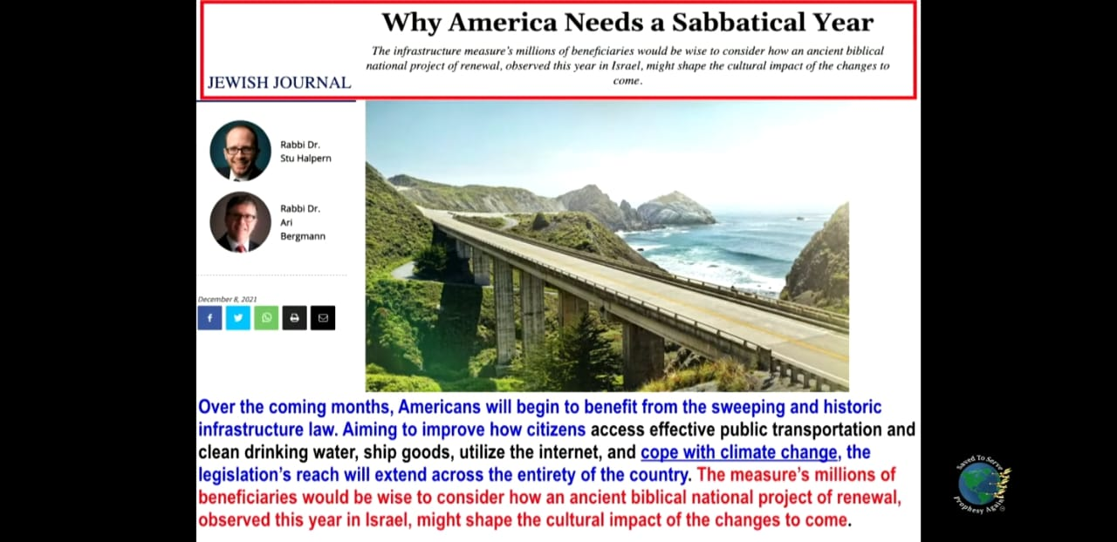

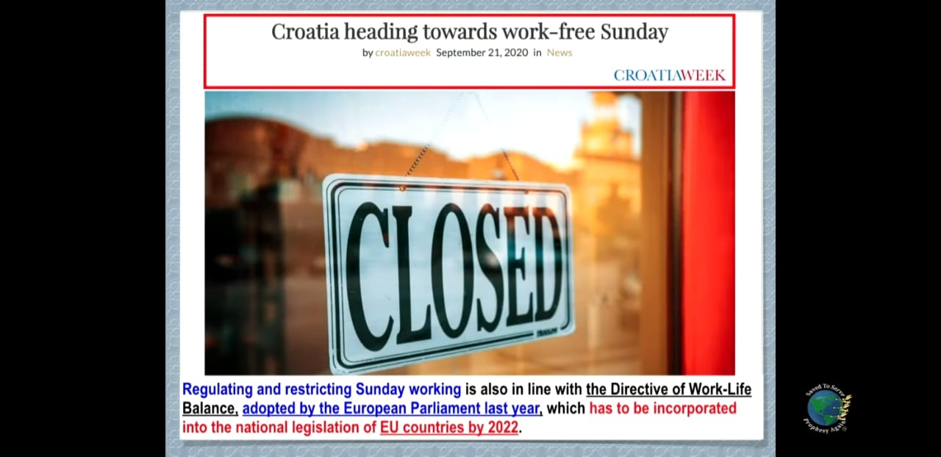
The Signs of the Times
Restoration of Power unto the First Beast:
Revelation 13:3,12; Revelation 17:7,8
The Second Beast unites Church & State to enforce a false religious law, demanding all to honour the First Beast & receive its mark :
Revelation 13:11-12,15-16

Slide 13
The Signs of the Times
“There are in the world today many who close their eyes to the evidences that Christ has given to warn men of His coming. They seek to quiet all apprehension, while at the same time the signs of the end are rapidly fulfilling, and the world is hastening to the time when the Son of man shall be revealed in the clouds of heaven.” Acts of the Apostles pg. 260
“As the end of all things earthly should approach, there would be faithful ones able to discern the signs of the times. While a large number of professing believers would deny their faith by their works, there would be a remnant who would endure to the end.” Ibid pg. 535
God desires His people to prepare for the soon-coming crisis. Prepared or unprepared, they must all meet it; and those only who have brought their lives into conformity to the divine standard, will stand firm at that time of test and trial. Ibid pg. 431

Slide 14
The Signs of the Times
“Satan is marshalling his hosts; and are we individually prepared for the fearful conflict that is just before us? Are we preparing our children for the great crisis? Are we preparing ourselves and our households to understand the position of our adversaries and their modes of warfare? Are our children forming habits of decision, that they may be firm and unyielding in every matter of principle and duty? I pray that we all may understand the signs of the times, and that we may so prepare ourselves and our children that in the time of conflict God may be our refuge and defense.” Adventist Home pg. 186
“The signs of Christ's coming are fast fulfilling. Satan sees that he has but a short time in which to work, and he has set his agencies to work to stir up the elements of the world, that men may be deceived, deluded, and kept occupied and entranced until the day of probation shall be ended, and the door of mercy be forever shut.” Counsels to Parents, Teachers and Students pg. 414

Slide 15
The Signs of the Times
“The Lord wants us to come up into the mount, more directly into His presence. We are coming to a crisis which, more than any previous time since the world began, will demand the entire consecration of everyone who has named the name of Christ.” Gospel Workers pg. 323
As the people of God approach the perils of the last days, Satan holds earnest consultation with his angels as to the most successful plan of overthrowing their faith….He directs his angels to lay their snares especially for those who are looking for the second advent of Christ and endeavouring to keep all the commandments of God. Counsels on Stewardship pg. 154

Slide 16
The Signs of the Times
“Let the churches awake before it is everlastingly too late. Let every member take up his individual work and vindicate the name of the Lord by which he is called. Let sound faith and earnest piety take the place of slothfulness and unbelief.
Oh, that all may arouse and manifest to the world that theirs is a living faith, that a vital issue is before the world, that Jesus will soon come. Let men see that we believe that we are on the borders of the eternal world.”
Testimonies for the Church, volume 6, pg. 437

Slide 17
In Closing
“And that, knowing the time, that now it is high time to awake out of sleep: for now is our salvation nearer than when we believed.”
Romans 13:11
Ye are all the children of light, and the children of the day: we are not of the night, nor of darkness. Therefore let us not sleep, as do others; but let us watch and be sober.
1 Thessalonians 5:5,6
“The days in which we live are solemn and important. The Spirit of God is gradually but surely being withdrawn from the earth. Plagues and judgments are already falling upon the despisers of the grace of God. The calamities by land and sea, the unsettled state of society, the alarms of war, are portentous. They forecast approaching events of the greatest magnitude. The agencies of evil are combining their forces, and consolidating. They are strengthening for the last great crisis. Great changes are soon to take place in our world, and the final movements will be rapid ones.”
Testimonies for the Church, vol. 9, pg. 11
Friends, the signs of the times are happening right before our eyes.
These signs which are meant to awaken us, so often go unnoticed and ignored by God’s professed people.
It is time to awaken from our spiritual slumber, lest we be found weighed in the balances and found wanting.
Both the wise and the foolish virgins were found sleeping and it was the crisis which awoke them from their slumber.
Five were prepared and Five were unprepared. Five were ready and Five were unready. Which will we be when the cry goes forth and we are faced with the final test that shall come upon all humanity?

Slide 18






THANK YOU
loudcrycompendium@gmail.com
@ThePropheticEye
www.loudcrycompendium.com
@loudcrycompendium

