Slide 1
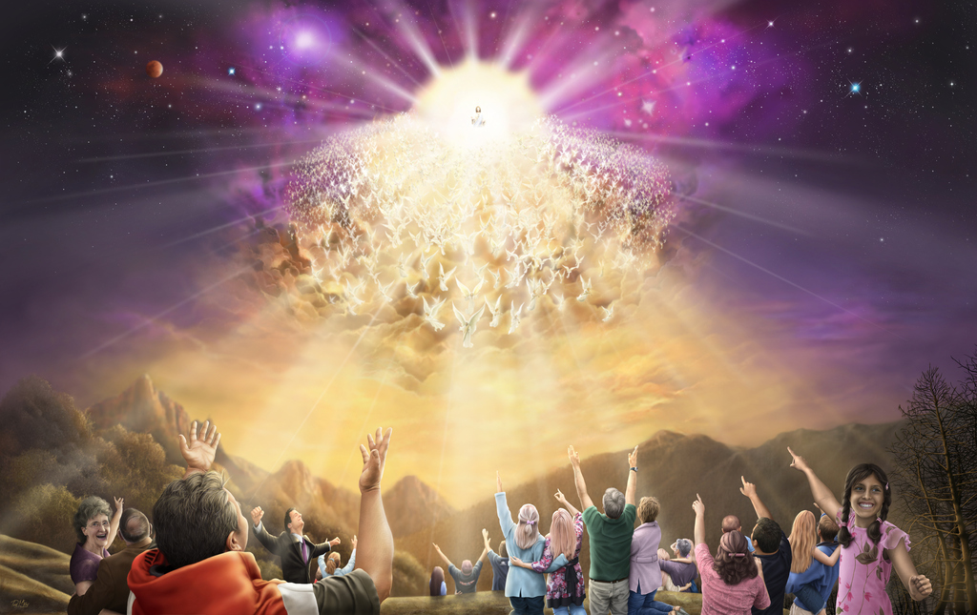

Our Blessed Hope
The Return of the King

Slide 2
INTRODUCTION
Christ, our Great High Priest, is returning as King of kings for His people, to take us to the place which He has prepared for us.
Today, we hear of many false doctrines in the world regarding the Second Coming of Christ, but what does the Bible truly have to say about Jesus’ 2nd Coming?
This is the purpose of today’s study. To see what the Bible teaches us concerning this great and marvellous event.
So, join me as we dig deep to study the Word of God and to get a deeper understanding of the Coming of Christ.

Slide 3
INTRODUCTION
Now is the time to prepare for the coming of our Lord. Readiness to meet Him cannot be attained in a moment. Preparatory to that solemn scene there must be vigilant waiting and watching, combined with earnest work.
“The coming of the Lord is nearer than when we first believed. The great controversy is nearing its end….The Lord is coming. We hear the footsteps of an approaching God, as he comes to punish the world for its iniquity. We are to prepare the way for Him by acting our part in getting a people ready for that great day. ”
RH, Nov. 12, 1914

Slide 4
ALL WILL SEE
Jesus will come in the clouds and every eye will see Him. He will appear with billions upon billions of His holy angels. He will come in the full glory of His Father and in His full glory. He will not be veiled in human form as He was at His 1st Coming, this time He is coming as the King of kings and Lord of lords, His priestly ministry is now over, intercession has ceased. No longer a Servant, but now a King.
This event will be universally visible to all who are upon the earth at this time: the final generation; additionally, even those that pierced Him shall be resurrected to see the King in His glory.
This denounces the common non-biblical teaching of a ‘secret rapture’ which we hear in the church today. The bible is clear that every eye shall see Christ.

Slide 5
ALL WILL SEE
“They also which pierced him” [Revelation 1:7; Mark 14:62], those that mocked and derided Christ's dying agonies, and the most violent opposers of His truth and His people, are raised to behold Him in His glory and to see the honour placed upon the loyal and obedient…When Christ comes the second time, not as a prisoner surrounded by a rabble will they see Him. They will see Him as heaven's King.... Then the priests and rulers will remember distinctly the scene in the judgment hall. Every circumstance will appear before them as if written in letters of fire.
Maranatha pg. 282
“Christ is coming with power and great glory. He is coming with His own glory and with the glory of the Father. He is coming with all the holy angels with Him. While all the world is plunged in darkness, there will be light in every dwelling of the saints [Rev. 16:8-11]. They will catch the first light of His second appearing. The unsullied light will shine from His splendour, and Christ the Redeemer will be admired by all who have served Him. While the wicked flee from His presence, Christ's followers will rejoice.”
Christ’s Object Lessons, pg. 420.3
Revelation 1:7
Matthew 24:27
Matthew 25:31
Matthew 16:27
Mark 8:38
2 Thessalonians 1:7
Revelation 19:11-16
Psalm 97:1-6
Revelation 6:14-17

Slide 6
ALL WILL HEAR
Every ear shall hear the 7th Trumpet when it is blown and the loud shout from the heavens.
1 Thessalonians 4:16
Matthew 24:31
Psalm 50:3-4
1 Corinthians 15:52
2 Peter 3:10
Revelation 16:17-18
John 5:28-29

Slide 7
ALL WILL HEAR
The time is coming when the trumpet of the Lord will again be heard by mortals, when its notes will “shake not the earth only, but also heaven.” The clear notes of that trumpet will penetrate the deepest recesses of the earth; and, just as anciently the trumpet summoned all Israel to appear before the Lord [at Sinai], so every child of God sleeping in the earth will answer the trumpet call and come forth to meet his Lord….The whole earth will resound with the tread of the innumerable company of the redeemed, as the living and the resurrected saints gather to meet their Lord in answer to the summons of the last trumpet call that will be given on this sin cursed earth. Then all the discordant notes will forever cease, and the redeemed will hear the Saviour say, “Come, ye blessed of My Father, inherit the kingdom prepared for you from the foundation of the world.” The Cross & Its Shadow pg. 207.1

Slide 8
THE RIGHTEOUS
The dead in Christ, from Adam down to the last repentant sinner who accepts Christ, who faithfully dies in the faith, shall be resurrected in their glorified bodies. This is known as the ‘resurrection of the just/life’ or ’ the first resurrection.’
After this, those of us who by God’s grace, have received the Seal of the living God, and have been protected through the Great Tribulation, when the four winds have been released, shall receive our glorified bodies.
This transformation, from the mortal to immortal bodies shall take place in a moment, in the “twinkling of an eye.” Then we shall be gathered by the angels and taken up to meet Christ in the air.
CHRIST SHALL NOT TOUCH THE EARTH AT THE SECOND COMING!-Matthew 24:24

Slide 9
THE RIGHTEOUS
Luke 14:12-14; John 5:28-29
Revelation 20:6
1 Thessalonians 4:16-17
1 Corinthians 15:52-53
Philippians 3:20-21
1 John 3:2-3
Isaiah 26:19

Slide 10
THE RIGHTEOUS
The King of kings descends upon the cloud, wrapped in flaming fire. The heavens are rolled together as a scroll, the earth trembles before Him, and every mountain and island is moved out of its place.
Amid the reeling of the earth, the flash of lightning, and the roar of thunder, the voice of the Son of God calls forth the sleeping saints. He looks upon the graves of the righteous, then, raising His hands to heaven, He cries: “Awake, awake, awake, ye that sleep in the dust, and arise!” Throughout the length and breadth of the earth the dead shall hear that voice, and they that hear shall live. And the whole earth shall ring with the tread of the exceeding great army of every nation, kindred, tongue, and people. From the prison house of death they come, clothed with immortal glory, crying: “O death, where is thy sting? O grave, where is thy victory?” 1 Corinthians 15:55. And the living righteous and the risen saints unite their voices in a long, glad shout of victory.

Slide 11
THE RIGHTEOUS
All come forth from their graves the same in stature as when they entered the tomb.... But all arise with the freshness and vigour of eternal youth.... The mortal, corruptible form, devoid of comeliness, once polluted with sin, becomes perfect, beautiful, and immortal. All blemishes and deformities are left in the grave.... The living righteous are changed “in a moment, in the twinkling of an eye.” At the voice of God, they were glorified; now they are made immortal and with the risen saints are caught up to meet their Lord in the air. Angels “gather together his elect from the four winds, from one end of heaven to the other.” As the little infants come forth immortal from their dusty beds, they immediately wing their way to their mothers’ arms. Friends long separated by death are united, nevermore to part, and with songs of gladness ascend together to the City of God.
Maranatha pg.299

Slide 12
THE WICKED
The Bible is clear what happens to those who reject the mercies of Christ; They shall be destroyed.
Just like there are two classes of the Righteous, the dead and the living in Christ, likewise, there are two classes of the wicked.
What do I mean?
Those who were dead before the 2nd Coming of Christ and thus remain in the grave until the Final Judgment, and those who were alive at Jesus’ Second Coming-those who had received the mark of the Beast during the final crisis.
Between the resurrection of the just and the resurrection of the unjust, there is a period of 1,000 years- A period of Sabbath Rest for the Earth before the final judgment and restoration of the New Earth. We will study this aspect of the 1000 years in our next study.

Slide 13
THE WICKED
The Living Wicked-Those who receive the mark of the Beast.
Revelation 6:14-17
Revelation 14:14-20
Jude 14-15
2 Thessalonians 1:7-10
Isaiah 34:1-4
Jeremiah 25:31-36
Revelation 16:17-21
Zephaniah 1:2-3, 8,14-18;2:3

Slide 14
THE WICKED
The mark of deliverance has been set upon those “that sigh and that cry for all the abominations that be done.” Now the angel of death goes forth, represented in Ezekiel's vision by the men with the slaughtering weapons, to whom the command is given: “Slay utterly old and young, both maids, and little children, and women: but come not near any man upon whom is the mark; and begin at my sanctuary.” Says the prophet: “They began at the ancient men which were before the house.” Ezekiel 9:1-6. The work of destruction begins among those who have professed to be the spiritual guardians of the people. The false watchmen are the first to fall. There are none to pity or to spare….. “The Lord cometh out of his place to punish the inhabitants of the earth for their iniquity: the earth also shall disclose her blood and shall no more cover her slain.” Isaiah 26:21.... In the mad strife of their own fierce passions, and by the awful outpouring of God's unmingled wrath, fall the wicked inhabitants of the earth—priests, rulers, and people, rich and poor, high and low. “And the slain of the Lord shall be at that day from one end of the earth even unto the other end of the earth: they shall not be lamented, neither gathered, nor buried.”
Maranatha pg. 296

Slide 15
THE WICKED
The revelator describes the destruction that is to take place when the “great voice out of the temple of heaven” announces, “It is done.” He says, “There fell upon men a great hail out of heaven, every stone about the weight of a talent.” Revelation 16:17, 21. In the last scenes of this earth's history, war will rage. The powers of evil will not yield up the conflict without a struggle. But Providence has a part to act in the battle of Armageddon. The Captain of the Lord's host will stand at the head of the angels of heaven to direct the battle. He on whose vesture is written the name, King of kings and Lord of lords, leads forth the armies of heaven on white horses, clothed in fine linen, clean and white. When He shall come to the earth again, He will shake “not the earth only, but also heaven.” “The earth shall reel to and fro like a drunkard and shall be removed like a cottage.” “The heavens shall be rolled together as a scroll”; “the elements shall melt with fervent heat, the earth also and the works that are therein shall be burned up.” But “the Lord will be the hope of his people, and the strength of the children of Israel.” See: Hebrews 12:26; Isaiah 24:20; 34:4; 2 Peter 3:10; Joel 3:16
Maranatha pg.297

Slide 16
FINAL POINTS
Friends, there is no Second Chance Gospel. Jesus is soon to return for a Spotless Bride; Bible Prophecy is fast fulfilling, and final movements will be rapid ones.
Today the entire Christian Church is split between so many different views regarding how Jesus is coming. This confusion is not of God, for He is not the Author of confusion but rather satan is. The devil wants you to be confused and unready.
These varying views of the greatest event the universe has ever seen, will be witnessed by all upon the earth at that time. Every eye alive upon the earth shall see Christ at His Second Coming, both the Righteous & the Wicked; the Bible is clear on this.
Take heed that you are not deceived, for many false doctrines are in the world from the enemy and his agents, so that many would be caught off guard at Christ’s Second Coming.
“Be ye also ready, for in such an hour as ye think not, the Son of Man cometh.” Matthew 24:44

Slide 17
FINAL POINTS
Suppose that today Christ should appear in the clouds of heaven, who ... would be ready to meet Him? Suppose we should be translated into the kingdom of heaven just as we are. Would we be prepared to unite with the saints of God, to live in harmony with the royal family, the children of the heavenly King? What preparation have you made for the judgment? Have you made your peace with God? ... Are you seeking to help those around you, those in your home, those in your neighbourhood, those with whom you come in contact with that are not keeping the commandments of God? ... Remember that profession is worthless without a practice that enters into the daily life. God knows whether we are keeping His Law in truth. He knows just what we are doing, just what we are thinking and saying. Are we getting ready to meet the King? When He comes in the clouds of heaven with power and great glory, will you be able to say, “Lo, this is our God; we have waited for him, and he will save us” (Isaiah 25:9)? To those who can say this Christ will say, “Come up higher. Upon this earth you have loved Me. You have loved to do My will. You can now enter the Holy City and receive the crown of everlasting life.” Maranatha 298

Slide 18





THANK YOU
loudcrycompendium@gmail.com
@ThePropheticEye
www.loudcrycompendium.com
@loudcrycompendium

