Slide 1
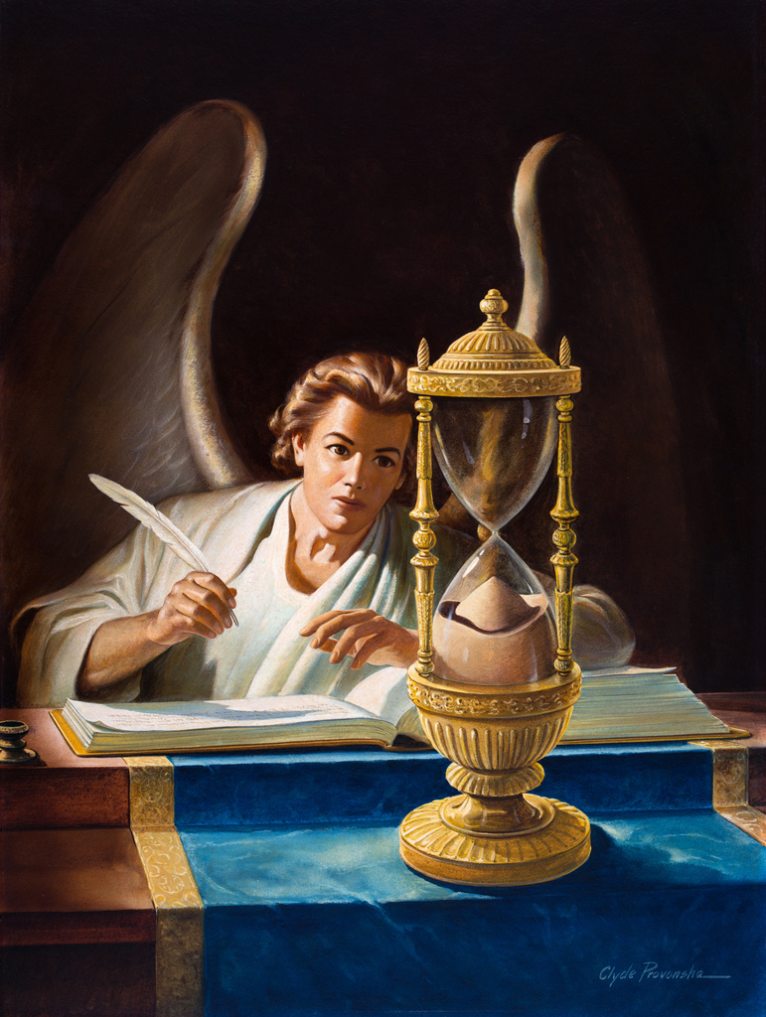

Right On Time
Christ & The Feasts
Part 2

Slide 2
The Redeemer of the world generally chose the open air in which to give his lessons of instruction, rather than to be enclosed in walls. He could make his teachings more impressive when surrounded with the beauties of nature…..that He might illustrate important truths of the kingdom of God, by the works of God in nature.
The Review and Herald, July 25, 1871
There is much to be learnt about the plan of salvation for mankind as seen in the workings of nature.

Slide 3
Foundation
The entire system of the Sanctuary reveals Christ and His plan to save you and I.
The tabernacle, the furniture, the sacrifices and the offerings, the work of the priests and the high priest as well as their clothing and the various feasts, all point to some aspect of The Plan of Redemption, from Christ’s 1st Coming to His 2nd Coming.
Seven Feasts: Split between two seasons- Spring & Autumn
The Passover, Unleavened Bread, First-fruits, Pentecost
Trumpets, Day of Atonement, Tabernacles
God ordained these feasts to be object lessons for the children of Israel, but additionally, they were also prophecies of the work of the Messiah, fulfilled to the exact time.
Today we will be studying the Autumn Feasts.

Slide 4


Spring (4)
Autumn (3)
Seven (7)

Slide 5
Foundation
Foundation
The entire system of the Sanctuary reveals Christ and His plan to save you and I.
The tabernacle, the furniture, the sacrifices and the offerings, the work of the priests and the high priest as well as their clothing and the various feasts, all point to some aspect of The Plan of Redemption, from Christ’s 1st Coming to His 2nd Coming.
Seven Feasts: Split between two seasons- Spring & Autumn
The Passover, Unleavened Bread, First-fruits, Pentecost
Trumpets, Day of Atonement, Tabernacles
God ordained these feasts to be object lessons for the children of Israel, but additionally, they were also prophecies of the work of the Messiah, fulfilled to the exact time.
Today we will be studying the Autumn Feasts.
“Now all these things happened unto them [Israel] for ensamples: and they are written for our admonition, upon whom the ends of the world are come.” 1 Corinthians 10:11
“For whatever things were written before were written for our learning...” Romans 15:4
“The experiences of Israel were recorded for our instruction.” Education, pg. 50
“The whole Jewish economy is a compacted prophecy of the gospel,” and every service commanded by God in the Jewish economy was… a [fore]shadow of the service of our High Priest in the heavenly sanctuary. The Cross & Its Shadow, pg. 103.2

Slide 6
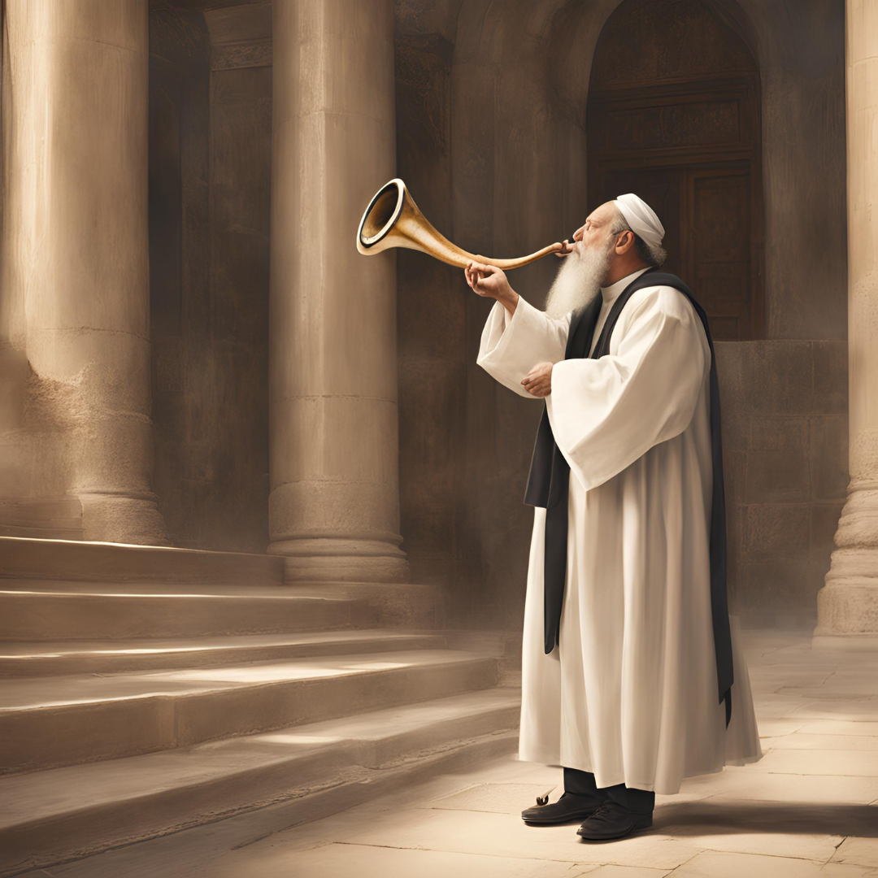
Trumpets
The trumpet as an instrument, was used extensively by the children of Israel for music, but it also had an important place in their religious & civil worship.
It was used on their joyful days and their solemn days and announced the beginning of each new month. Numbers 10:10.
The trumpets were also used to gather the children of Israel and the leaders. Numbers 10:2-3; Exo.19:10-11,16,19
While the trumpets were used often by the children of Israel, there was one day each year that the trumpets played a very important role throughout Israel---The Feast of Trumpets- the first day of the seventh month.
‘And in the seventh month, on the first day of the month, you shall have a holy convocation. You shall do no customary work. For you it is a day of blowing the trumpets.” Numbers 29:1
See also Leviticus 23:24

Slide 7
Trumpets
The Feast of Trumpets fell 10 days before the Day of Atonement, the sixth feast, and it was a warning to all the children of Israel that judgment and the cleansing of the sanctuary was near. Leviticus 24:24,27
Just like all the other feasts that we have studied before, not only was the Feast of Trumpets commemorative but it was also typical. In other words, it pointed to a greater, spiritual event connected to Christ and His Priestly work for humanity.
Just like the literal feast of trumpets took place 10 days before the literal day of atonement (the judgment of the children of Israel), likewise we see that before the Investigative Judgment or the antitypical Day of Atonement, which began at the end of the 2300-year prophecy (1844) of Daniel 8:14, for 10 years, a great message was preached across the world warning humanity of the soon Coming of Christ. 1834-1844.
See our study on Daniel 8 & 9, for more on this.

Slide 8
Trumpets
“In the type the trumpets were blown throughout Israel, warning all of the near approach of the solemn day of atonement. In the antitype we should expect some world-wide message to be given in trumpet tones, announcing the time near when the great antitypical day of atonement, the investigative judgment would convene in the heavens. Beginning with the years 1833-34 and extending down to 1844, such a message was given to the world in trumpet tones, announcing, “The hour of His judgment is come.” Revelation 14:6-7.
William Miller and others, in their study of the declaration in Dan. 8:14, “Unto two thousand and three hundred days; then shall the sanctuary be cleansed,” found that this long prophetic period would end in 1844. They failed to connect this text with the ancient typical sanctuary but applied the term “sanctuary” to this earth and taught that in 1844 Christ would come to the earth to cleanse it and judge the people.
William Miller was joined by hundreds of other ministers in America, who proclaimed his message with great power. Edward Irving, with many other consecrated men, preached the same in England; while Joseph Wolff and others heralded it in Asia and other portions of the world.” The Cross & its Shadow pg. 204

Slide 9
Trumpets
“The fact that the men who proclaimed this message misunderstood the full importance of it, did not prevent their fulfilling the antitype of the ancient type. When the followers of Christ cried before Him, “Blessed be the King that cometh in the name of the Lord,” and spread palm branches in the way, believing that Jesus was entering Jerusalem to take the earthly kingdom, they fulfilled the prophecy of Zechariah 9:9. If they had known that in a few days their Lord would hang upon the accursed tree, they could not have fulfilled the prophecy; for it would have been impossible for them to “rejoice greatly.”
In like manner the message due to the world between 1834 and 1844 could never have been given with the power and joyfulness demanded to fulfil the antitype, if those giving it had understood that the Saviour, instead of coming to this earth, was to enter the most holy apartment of the heavenly sanctuary and begin the work of the investigative judgment. God hid from their eyes the fact that there were two other messages to be given to the world before the Lord should come to the earth in power and glory.”
The Cross & Its Shadow pg. 205-206
Revelation 10:8-11; Revelation 14:6-12

Slide 10
Trumpets
“Cry aloud, spare not, lift up thy voice like a trumpet…” Isaiah 58:1
“For if the trumpet give an uncertain sound, who shall prepare himself…? 1 Corinthians 14:8
“Blow ye the trumpet in Zion, and sound an alarm on my holy mountain…” Joel 2:1
“Blow ye the trumpet in Zion, sanctify a fast, call a solemn assembly.” Joel 2:15

Slide 11
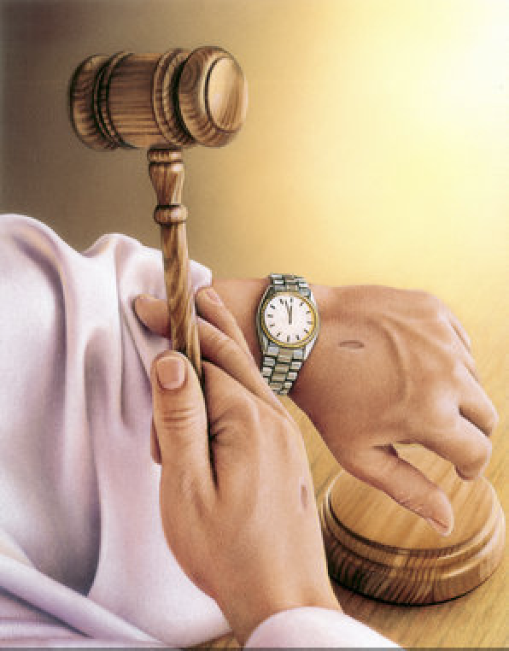
Day of At-One-Ment
The most solemn & sacred of the feast days, the Day of Atonement took place on the 10th day of the 7th Jewish month; called Tishrei or Ethanim. It took place once a year, primarily in the Most Holy Place.
It was a ceremonial or annual sabbath, and therefore no secular work was to take precedence on this day. It was a day of ‘afflicting’ the soul, repenting of sin, forsaking evil, fasting & praying.
This was a day of judgment and all who were not found in this state of mind during this period, were to be cut off from the children of Israel.
“Also, the tenth day of this seventh month shall be the Day of Atonement. It shall be a holy convocation for you; you shall afflict your souls, and offer an offering made by fire to the LORD. And you shall do no work on that same day, for it is the Day of Atonement, to make atonement for you before the LORD your God. For any person who is not afflicted in soul on that same day shall be cut off from his people.” Leviticus 23:27-29
This was a time when the sanctuary was to be cleansed symbolically, from all the record of sin that had been confessed and placed into the earthly sanctuary by faith through the sin-offering.
Read Leviticus 16:16,19,30,33

Slide 12
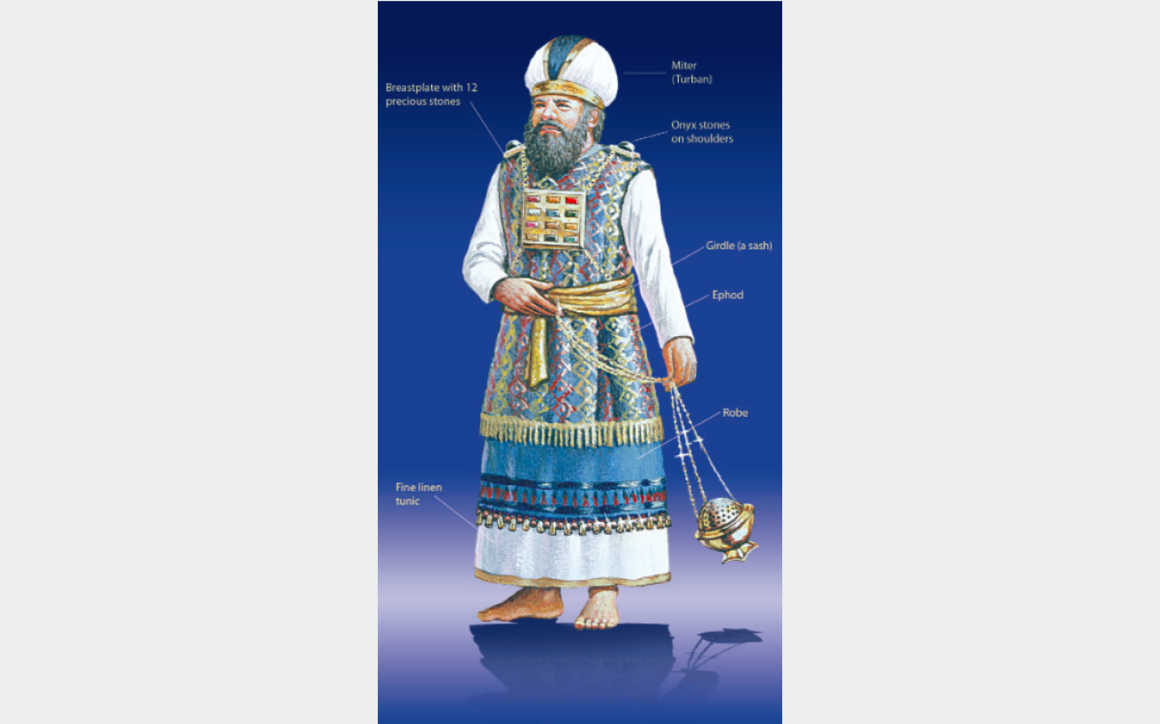
Day of At-One-Ment
On this sacred day, the priest would first make atonement for himself and his family and then for the repentant congregation. Leviticus 16:11,15
No atonement could be made for the individual who did not see his true spiritual condition before God. If there was no afflicting of the soul, no atonement could be made and at the end of this solemn day, the individual would be cut off.
Read Leviticus 16:5,7-10,15-16,19
“The chief service of the day was the offering of the goats. Two goats were brought to the door of the sanctuary, where lots were cast upon them, one for the Lord, the other for the scapegoat. The high priest killed the Lord’s goat, and then, clad in his gorgeous robes, with the breastplate of judgment bearing the names of the twelve tribes of Israel over his heart, and the sacred onyx stones with the names of the tribes on his shoulders, he passed with the blood of the goat into the most holy place…. With his fingers he sprinkled the blood upon the mercy-seat above the broken law of God. Then going out into the first apartment, he touched the horns of the golden altar with the blood.” The Cross & its Shadow pg. 210

Slide 13
Day of At-One-Ment
After the high priest finished making atonement for the children of Israel by ‘cleansing the sanctuary’, he now bore the sins of the repentant children of Israel upon himself symbolically. He would then confess these sins upon the head of the of the living goat (goat #2, which was not slain). As a result, this goat, called the scapegoat, now bore all the sins of the repentant children of Israel at the end of the Day of Atonement. This scapegoat, in other words, was the one responsible for all the sins of the repenting children of Israel.
If an individual refused to confess and repent of their sins, they bore their own sins, and no atonement was made for them.
“In type the high priest now bore in his person all the sins of the children of Israel which had been confessed and transferred to the sanctuary. He then laid his hands upon the head of the scape-goat, and confessed “over him all the iniquities of the children of Israel, and all their transgressions in all their sins, putting them upon the head of the goat,” and the goat was sent away, “by the hand of a fit man into the wilderness.” The goat bore upon him all the iniquities unto a land “not inhabited,” a “land of separation.” Ibid. pg. 210.
See Leviticus 16:20-22

Slide 14
Day of At-One-Ment
Going back into the tabernacle of the congregation, the high priest laid aside his gorgeous priestly robes, and put on his other garments; then coming again into the court, he cleansed the court from its defilement of sin. The bodies of the animals whose blood had been taken within the sanctuary, were carried out of the camp and burned. When the sun set on the day of atonement, the sins were all gone into the “land of separation,” and nothing but ashes remained as a reminder of them. Ibid pg. 211; Leviticus 16:23-28
In type, all the sins of the repentant children of Israel, which had been cast into the sanctuary and had been covered under the blood of the sin-offering, were now completely cleansed from the sanctuary and blotted out, never to be remembered.
Jesus Christ, the Great High Priest, who ministers in the sanctuary not made by human hands, but that which was pitched by the Lord, likewise must fulfil the antitype, for the earthly sanctuary and its services were mere foreshadows of the true Heavenly Sanctuary under the Priesthood of Christ Himself. All these earthly ceremonies under the old covenant were nailed to the Cross at the death of Christ, and under the new covenant, Christ fulfils all these Sanctuary services in the Heavenly Sanctuary.
See Hebrews 8:1-2, 7-13; Hebrews 9:11; Colossians 2:16

Slide 15
Day of At-One-Ment
The earthly sanctuary was cleansed on the tenth day of the seventh month of each year; the heavenly will be cleansed once for all. This work began in 1844, at the end of the prophetic period of the two thousand three hundred days in Daniel 8:14
For a more in-depth study on the Cleansing of the Sanctuary and 1844, please refer to our Daniel 8 Bible Study: “Within the Veil: the 2300 days of Daniel 8” and “Divine Time-Table: The Countdown to Messiah the Prince, Daniel 9”. It is imperative that you fully understand these two prophetic chapters of Daniel, to understand fully the Day of Atonement.

Slide 16
Day of At-One-Ment
Recap of Day of Atonement:
Fasting & prayer and affliction of the heart. The people must see their need. No work to be done.
Confession and forsaking of all sin.
Sin offering for the people and the blood applied on their behalf by the high priest.
At the end of the day of atonement, all of the sins of the repentant children of Israel had been completely blotted out, never to be remembered, and the sanctuary had been cleansed symbolically from all the record of sin.
The high priest took all those sins and placed them upon the head of the scape-goat, and it became responsible for the sins of the children of Israel. The scapegoat was then led into the wilderness and was left to wander in a desolate wasteland and would eventually die.
The unrepentant sinner, who refused to confess and forsake sin, was cast out from the children of Israel and left to perish in the wilderness.
The animals that were offered in the sanctuary, were burnt and the ashes left outside of the camp of the Israelites.

Slide 17
Day of At-One-Ment
Fulfilment of the Day of Atonement:
We are now living in the Antitypical Day of Atonement, and we must also see our need, we must forsake and put away all sin, placing them into the Heavenly Sanctuary by faith so that Christ, The Great High Priest, can take our sins. If we refuse this great work, then we will surely be cut off when Christ comes the Second Time to receive His own.
We must put God’s work first, and all other work second. The Day of Atonement was a day where all were to be fully focused on God and the work of cleansing. There must be total member involvement in the work of God.
At the end of the Day of Atonement, Christ will place all of our sins, if we forsake them and repent, upon the head of the scapegoat, satan himself. He will be bound in ‘a desolate land’, at the Second Coming of Christ, along with all the fallen angels, to await their punishment in the Lake of Fire. More on this in our Study called “Our Blessed Hope: 1000 years & beyond”.
If we refuse to forsake sin, and continue to live for this world, we like the devil shall be cast into the lake of fire, ‘which is the second death’. Revelation 20:15; Malachi 4:1-3

Slide 18
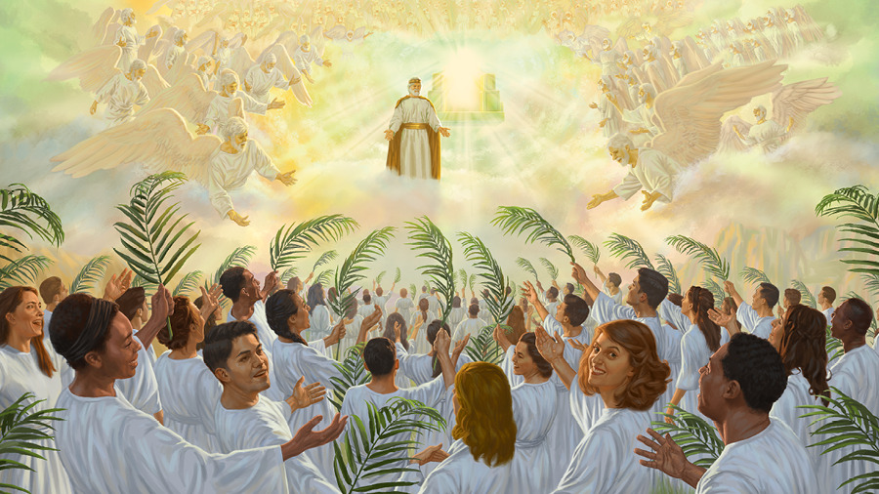
Tabernacles
The final feast in the yearly round of sanctuary services. It foreshadowed the final ingathering of the saints of God throughout all ages and the great rejoicing of the saints. It typified the end of the plan of redemption.
It began on the 15th day of the 7th month, when the harvests were all gathered in from the field, vineyards and olive groves. Leviticus 23:33-34
The Lord required all men to attend this feast, but many times women and children also attended. It was a time when the Jews from Israel and those who were scattered across the known world would all come together to meet in Jerusalem to rejoice and celebrate the end of the year and the fact that they lived through the day of atonement thus being reconciled to God. Exodus 23:16-17
It is at the end of the antitypical day of atonement, where Christ now intercedes for all of His people throughout all ages, that He shall come the Second time to gather ‘His elect from the four winds, from the four corners of the earth, Matthew 24:31’. Those who were once scattered shall now be gathered together to meet Christ in the air and be taken to the New Jerusalem. 1 Thessalonians 4:16-17.
Leviticus 23:39; Revelation 14:14-16; Joel 3:13

Slide 19
Tabernacles
This feast also was a memorial of the fact that the children of Israel were strangers and pilgrims on their wilderness journey to the promised land, as they dwelt in tents in the wilderness.
Leviticus 23:40,43; Nehemiah 8:14-15
In the same way, we, antitypical Israel, who are now currently dwelling as strangers and pilgrims upon this earth, in these temporary, earthly homes, shall at the last day, receive eternal life with Christ, to dwell in the mansions that He has gone to prepare for us. We shall go from dwelling in earthly tents to heavenly mansions.
Hebrews 11:13; 1 Peter 2:11; Ephesians 2:19-20; John 14:1-2
“For our citizenship is in heaven…” Philippians 3:20
Some very interesting Bible scenes are connected with this feast. Solomon’s temple was dedicated at the Feast of Tabernacles, 1 Kings 8:2,65-66. When Israel returned from the Babylonian captivity, this was the first feast celebrated after the wall of Jerusalem was restored, and was a time of great rejoicing, Nehemiah 8:17-18.
Likewise, we “the temple of God”, shall be dedicated to the Father as the faithful saints who have overcome, with Christ Jesus being the Chief Cornerstone. We shall celebrate greatly in Heaven for we have been delivered and saved from Babylon.

Slide 20
Tabernacles
The feast of tabernacles followed the day of atonement or the judgement in ancient times; therefore, we must expect that after Christ finishes His work in the Heavenly Sanctuary as the Great High Priest at the end of the Day of Atonement, probation shall close for all humanity, and a short time after that, He shall come as King of kings and Lord of lords, to gather His faithful elect.
“They overcame him (satan) by the blood of the Lamb and by the word of their testimony, and they did not love their lives to the death.” Revelation 12:11
“He who overcomes shall be clothed in white garments, and I will not blot out his name from the Book of Life; but I will confess his name before My Father and before His angels.” Revelation 3:5
In ancient times, the branches of various ‘goodly trees’ were used in connection with the feast of Tabernacles. In the same way, all those who overcome, shall have the branches of goodly palm trees in their hands and celebrating the King in His glory.

Slide 21
Tabernacles
‘Also, on the fifteenth day of the seventh month, when you have gathered in the fruit of the land, you shall keep the feast of the LORD for seven days…. And you shall take for yourselves on the first day the fruit of beautiful trees, branches of palm trees, the boughs of leafy trees, and willows of the brook; and you shall rejoice before the LORD your God for seven days. Leviticus 23:39-40
“After these things I looked, and behold, a great multitude which no one could number, of all nations, tribes, peoples, and tongues, standing before the throne and before the Lamb, clothed with white robes, with palm branches in their hands, and crying out with a loud voice (rejoicing), saying, “Salvation belongs to our God who sits on the throne, and to the Lamb!”…These are the ones who come out of the great tribulation, and washed their robes and made them white in the blood of the Lamb. Therefore, they are before the throne of God, and serve Him day and night in His temple. And He who sits on the throne will dwell (tabernacle) among them.” Revelation 7:9,14-15
“And I heard a loud voice from heaven saying, “Behold, the tabernacle of God is with men, and He will dwell (tabernacle) with them, and they shall be His people. God Himself will be with them and be their God.” Revelation 21:3

Slide 22
Closing Thoughts
“The entire system of Judaism was the gospel. True, it was veiled in types and symbols, but the light from Calvary illuminates the entire Jewish economy; and the one who will study it in the light of the cross, will gain such an intimate acquaintance with Him who is the Antitype (fulfilment) of every service, that by beholding, they will become changed into His image, from glory to glory.” 2 Corinthians 3:18
“The typical service shines the brightest when placed by the side of the Antitype (Christ)…. a study of the entire system of Judaism more nearly reveals the fullness of His character than any other portions of the Scriptures. The entire Bible is full of it. Every Bible writer refers to the Levitical service to illustrate divine truth; and the person who is familiar with the entire sanctuary service, not only, receives a blessing from the study, but also understands more fully other portions of the Sacred Book, for the different feasts and sacrifices are referred to frequently all through the Bible.”
The Cross & its Shadow pg. 243-244

Slide 24





Closing Thoughts
“The entire system of Judaism was the gospel. True, it was veiled in types and symbols, but the light from Calvary illuminates the entire Jewish economy; and the one who will study it in the light of the cross, will gain such an intimate acquaintance with Him who is the Antitype (fulfilment) of every service, that by beholding, they will become changed into His image, from glory to glory.”
“The typical service shines the brightest when placed by the side of the Antitype (Christ)…. a study of the entire system of Judaism more nearly reveals the fullness of His character than any other portions of the Scriptures. The entire Bible is full of it. Every Bible writer refers to the Levitical service to illustrate divine truth; and the person who is familiar with the entire sanctuary service, not only, receives a blessing from the study, but also understands more fully other portions of the Sacred Book, for the different feasts and sacrifices are referred to frequently all through the Bible.” The Cross & its Shadow
THANK YOU
loudcrycompendium@gmail.com
@ThePropheticEye
www.loudcrycompendium.com
@loudcrycompendium

