Slide 1
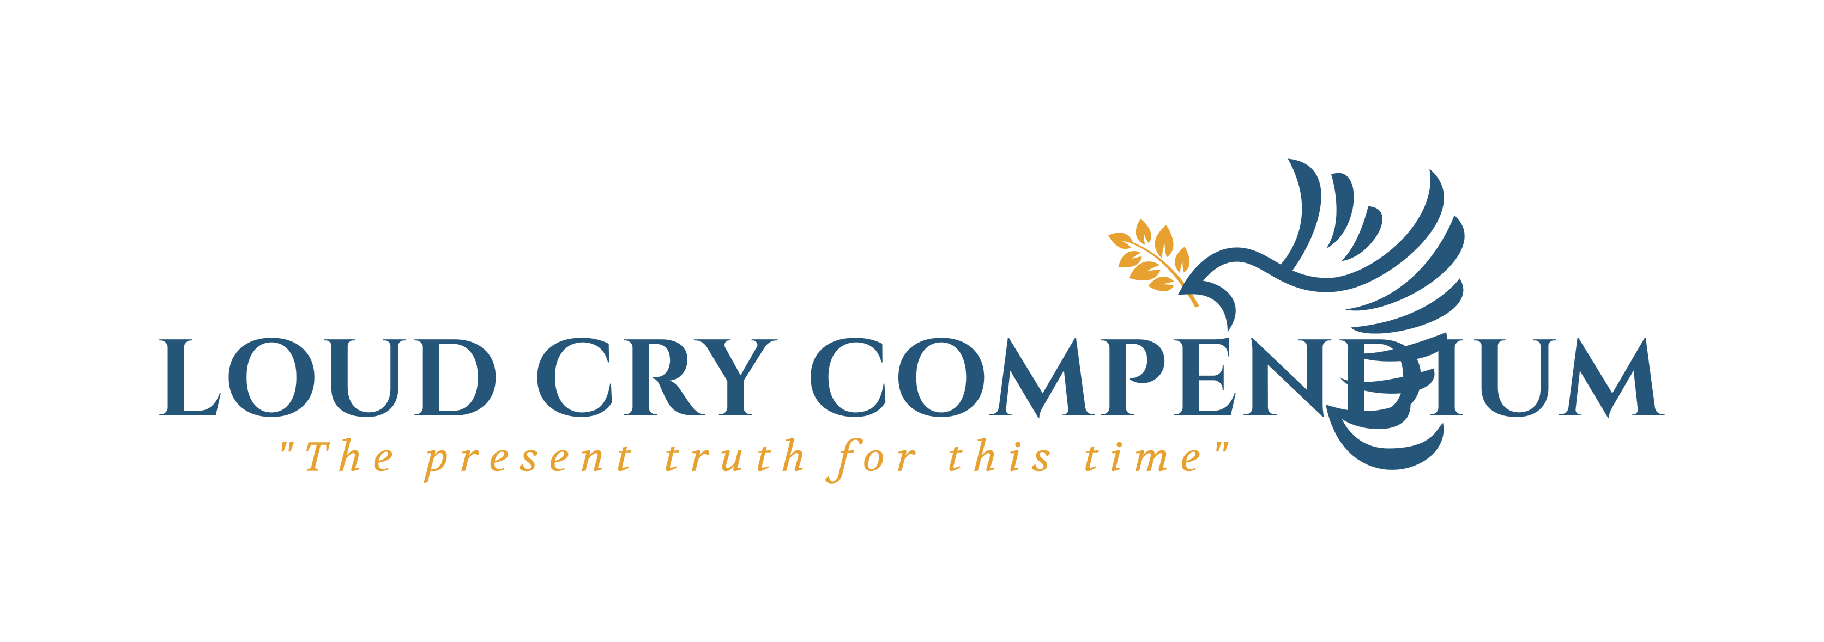
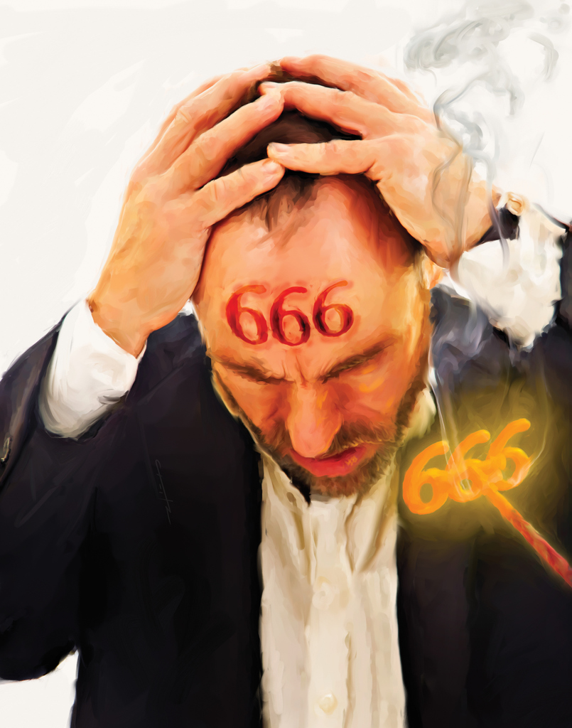
From Prophecy To Reality
Revealing The Mark
of the Beast

Slide 2
Intro
“As we near the close of this world's history, the prophecies relating to the last days especially demand our study. The last book of the New Testament scriptures is full of truth that we need to understand. Satan has blinded the minds of many, so that they have been glad of any excuse for not making the Revelation their study.” COL pg. 133.2
All that prophecy has foretold as coming to pass, until the present time, has been traced on the pages of history, and we may be assured that all which is yet to come will be fulfilled in its order. PK 536.3

Slide 3
Recap
Daniel 2: The major world kingdoms from Daniel’s day until Christ’s Second Coming.
Daniel 7: The rise of the antichrist power
Daniel 8*: The Judgment of the Church; i.e., Cleansing of the Sanctuary from all record of sin/Day of Atonement
Daniel 9: The death of the Messiah and the end of the Old Covenant.
Revelation 13: The Two Beasts Unite: The Papacy and America, to enforce false worship.
God’s Seal: God’s faithful elect fully recreated into His image and will stand amidst the final crisis.
Mark (seal) of the Beast: The final crisis

Slide 4
Recap-The Seal of God
In our previous study, we looked at the Seal of God, i.e., God’s mark of authority and ownership that is placed upon His people, “in their foreheads.”
We saw that this sealing work is done through the Holy Spirit, and it begins when an individual comes to Christ and repents of their sins.
Once the sealing work has ended, God’s people reflect His image fully, because they reflect the image of Christ fully. The Father’s name is written in their foreheads, that is, His Law, which is a reflection of His character, is impressed upon their minds/character.
“This is the covenant that I will make with them after those days, saith the Lord, I will put my laws into their hearts, and in their minds will I write them.” Hebrews 10:16, ref. Rev. 7:3; Rev. 14:1
God’s Law reveals His character, and this character must be in our minds. His character must become our character through Christ!

Slide 5
Recap-The Seal of God
An important point to remember is that in the Bible, the words: SEAL, SIGN, MARK, TOKEN are all used interchangeably.
Therefore, the Seal of God can also be referred to as the Mark of God.
Once the door of mercy is shut and probation is closed, all of humanity alive upon the earth at that time, will either be marked with God’s mark or Satan’s mark (the mark of the beast).
We also identified that the Seal of God’s Law is the faithful observance of the Fourth Commandment. This will be the final test for all of Adam & Eve’s descendants living in these last days.
“The Sabbath will be the great test of loyalty, for it is the point of truth especially controverted. When the final test shall be brought to bear upon men, then the line of distinction will be drawn between those who serve God and those who serve Him not.”
Last Day Events 225

Slide 6
The Mark of The Beast
“And he had power to give life unto the image of the beast, that the image of the beast should both speak, and cause that as many as would not worship the image of the beast should be killed. And he causeth all, both small and great, rich and poor, free and bond, to receive a mark in their right hand, or in their foreheads: And that no man might buy or sell, save (except) he that had the mark, or the name of the beast, or the number of his name.” Revelation 13:15-17
We have already identified from our previous studies that in Scripture, a beast represents a nation/kingdom. Daniel 7:17,23
We also saw that at the end of time, The beast from the sea, will work together with The beast out of the earth, to enforce worldwide worship & governance (A NEW WORLD ORDER).

Slide 7

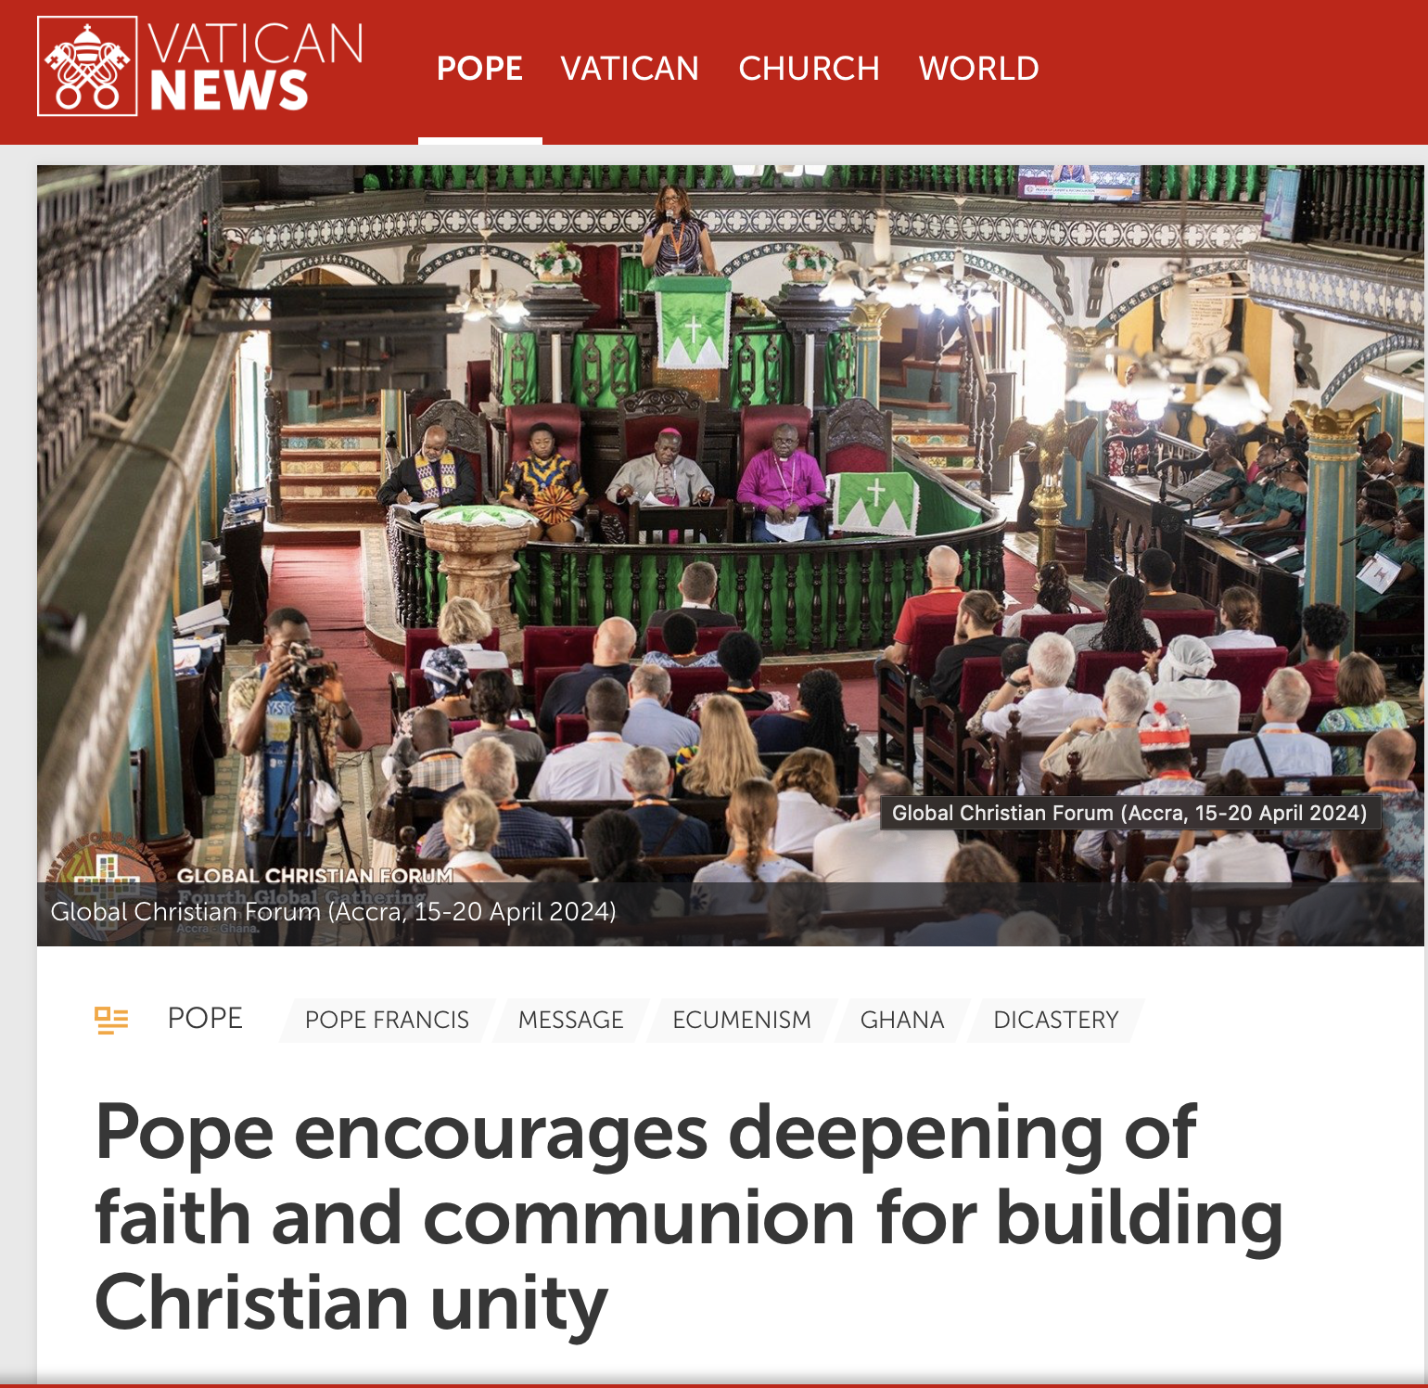
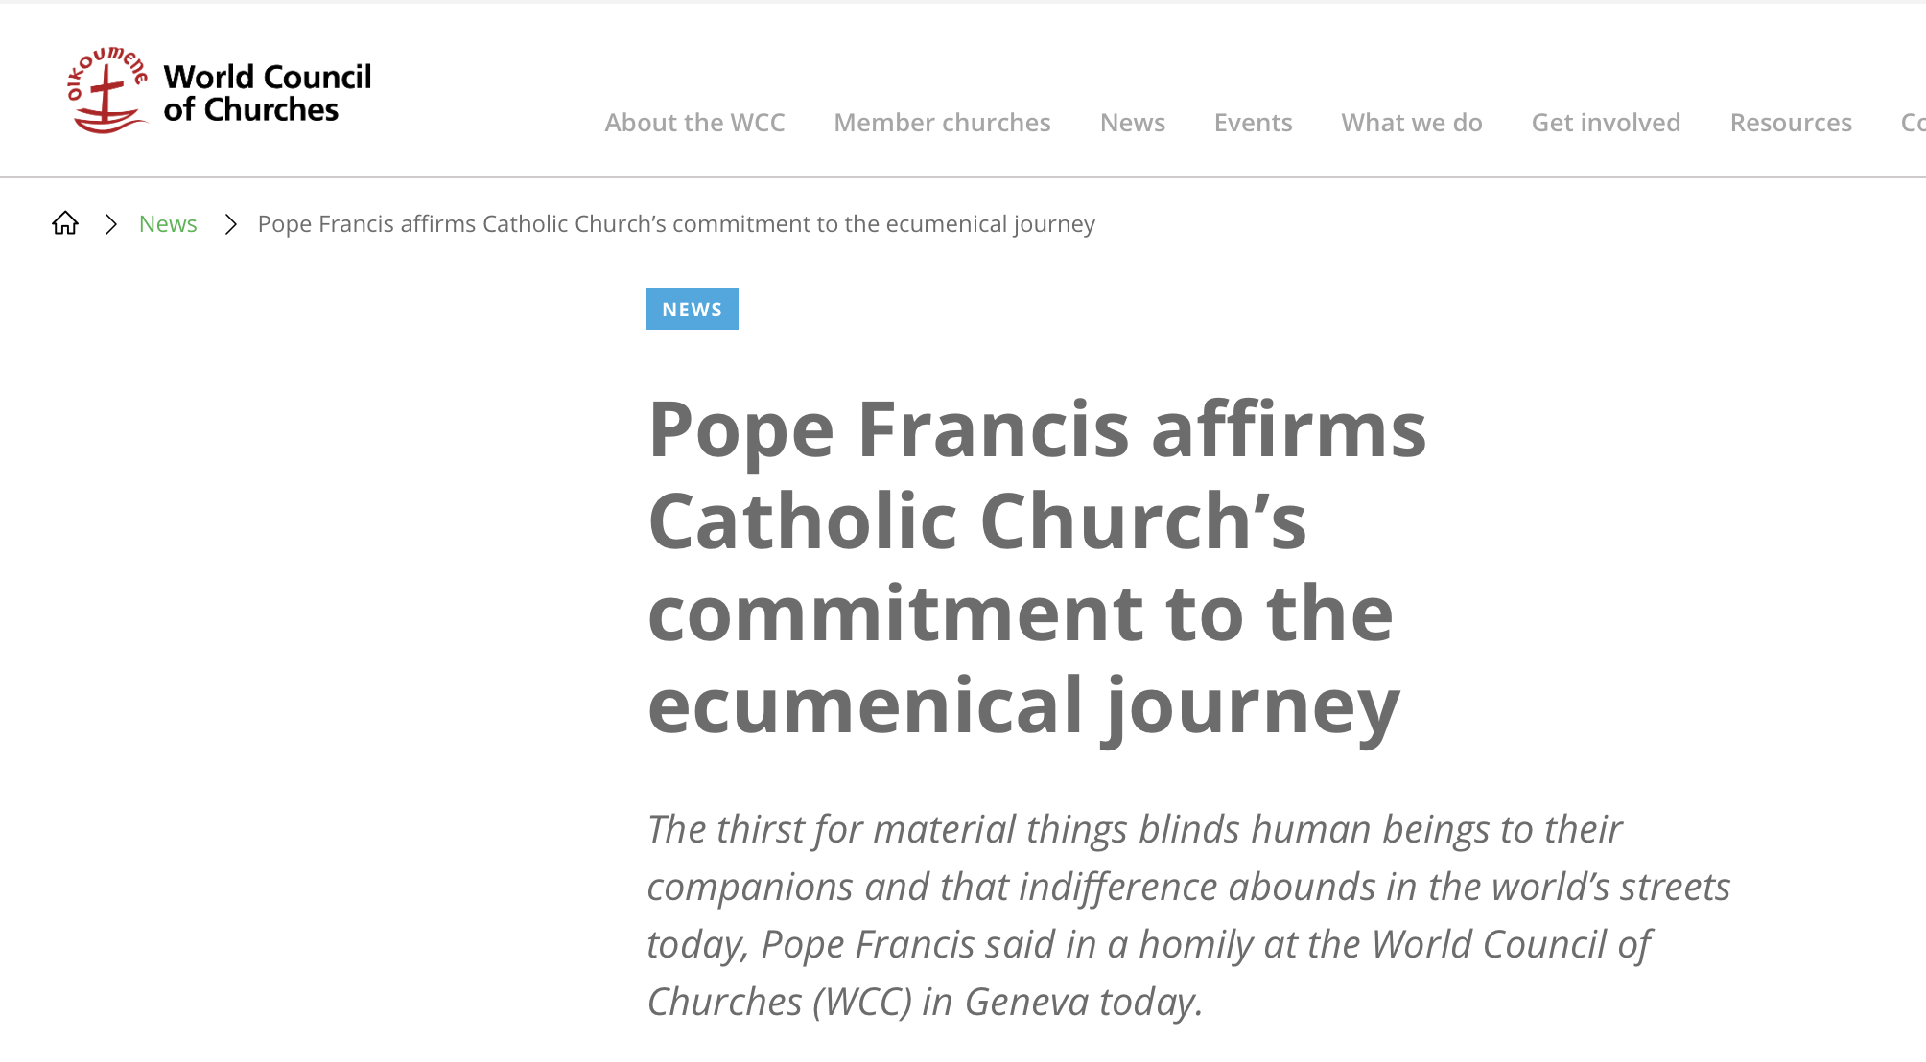
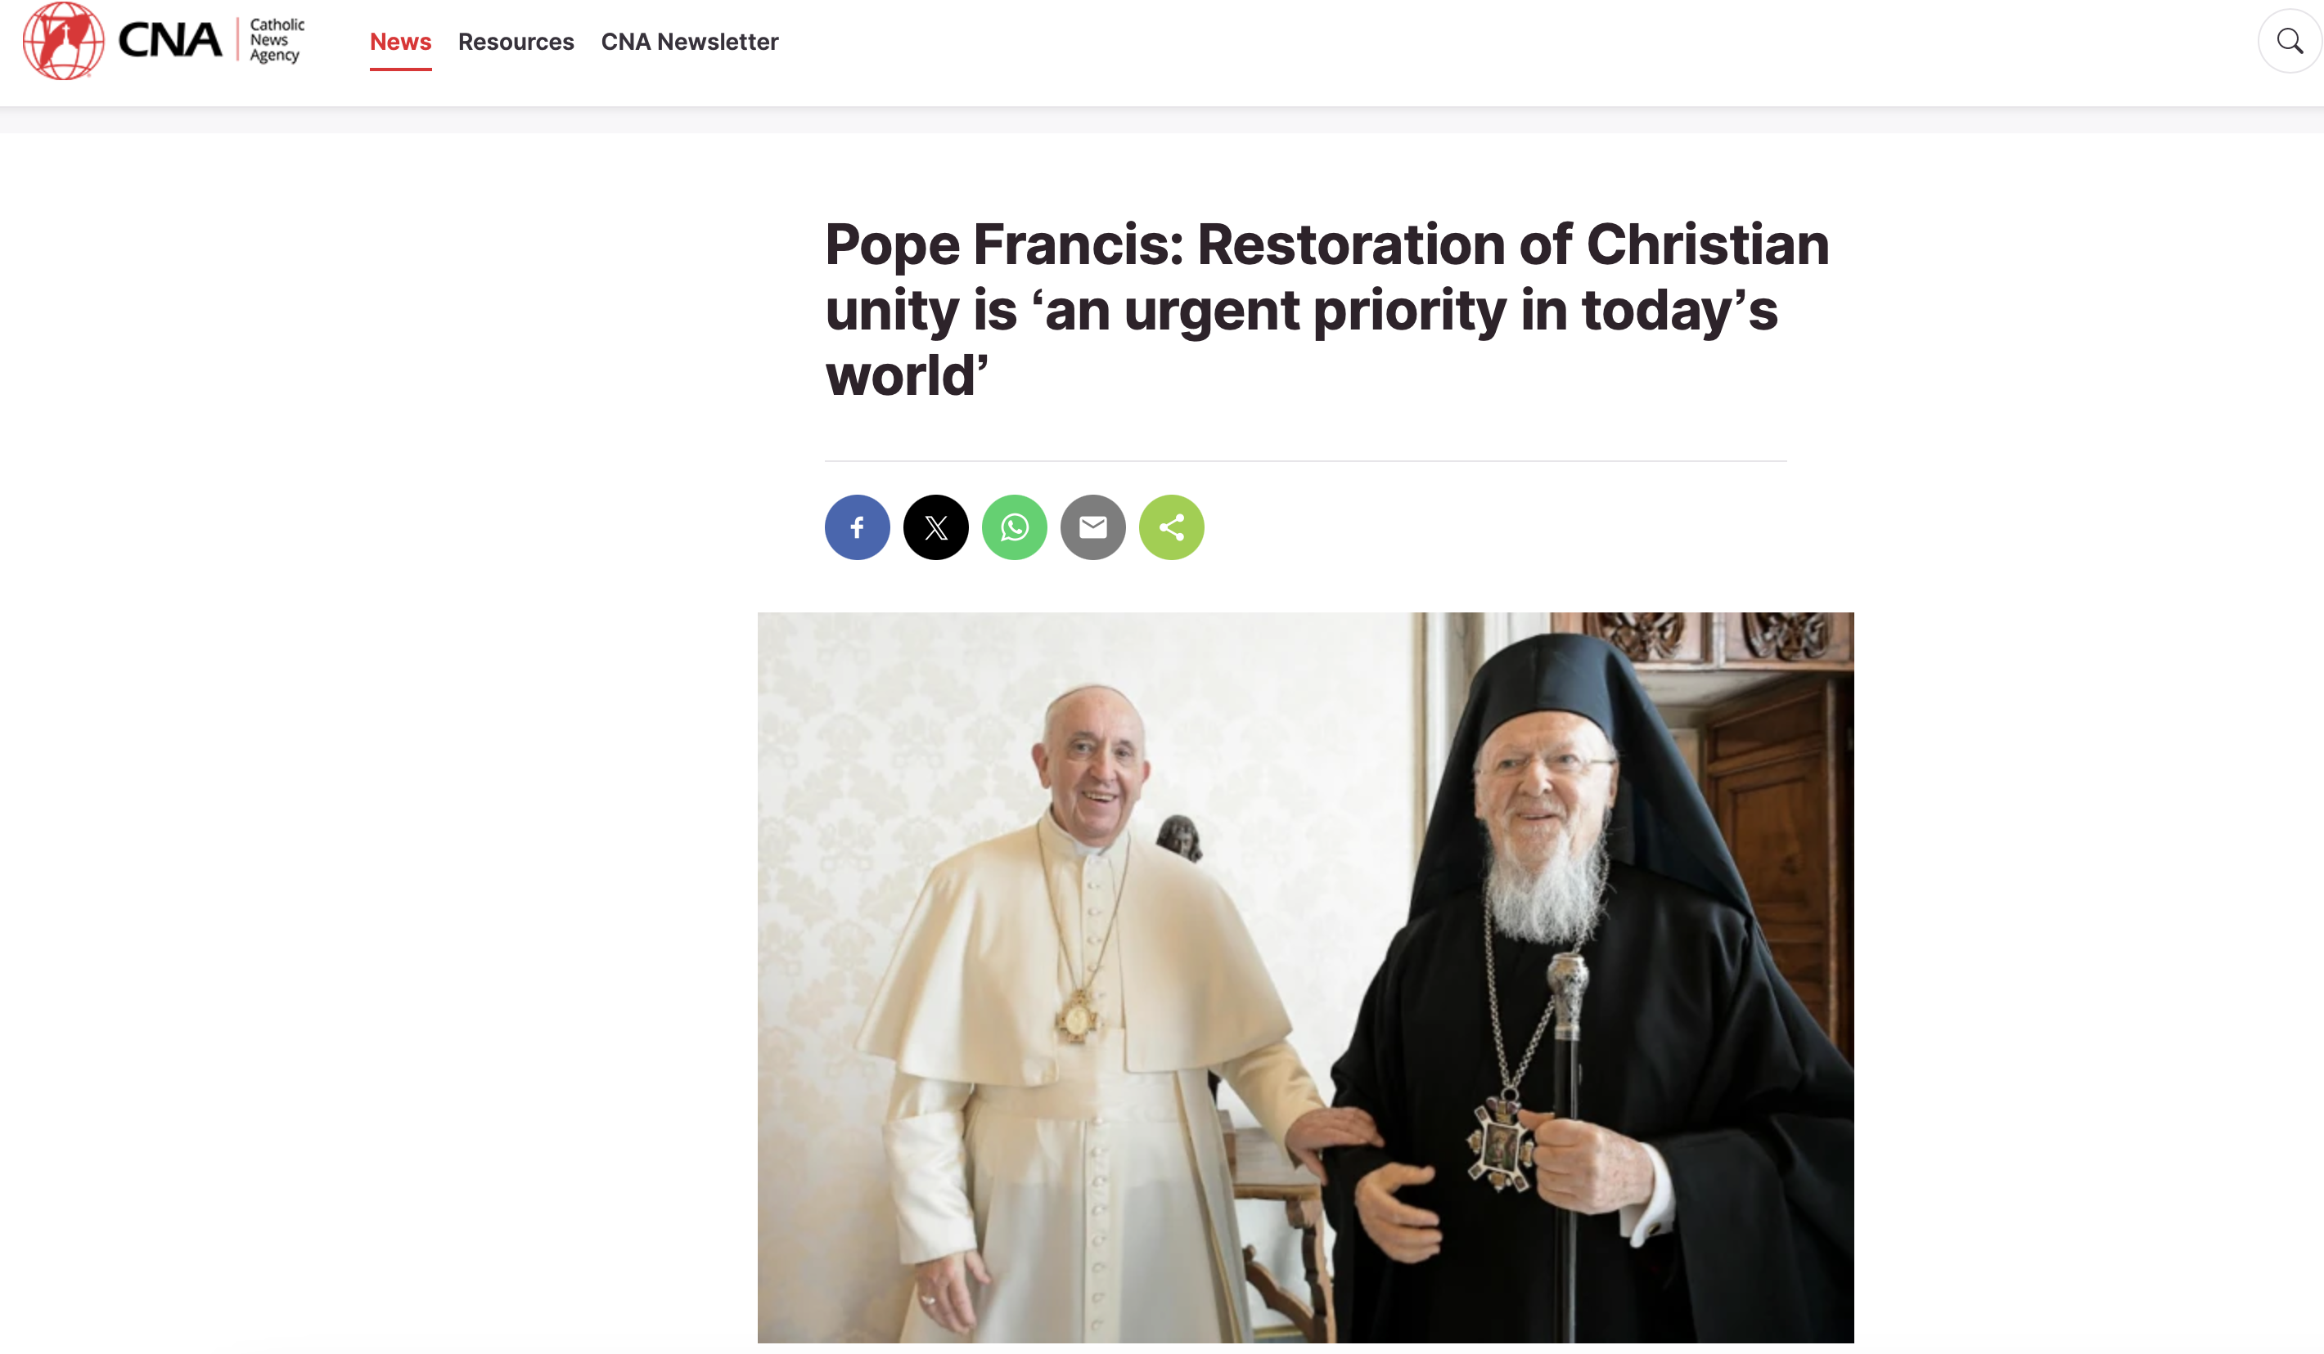
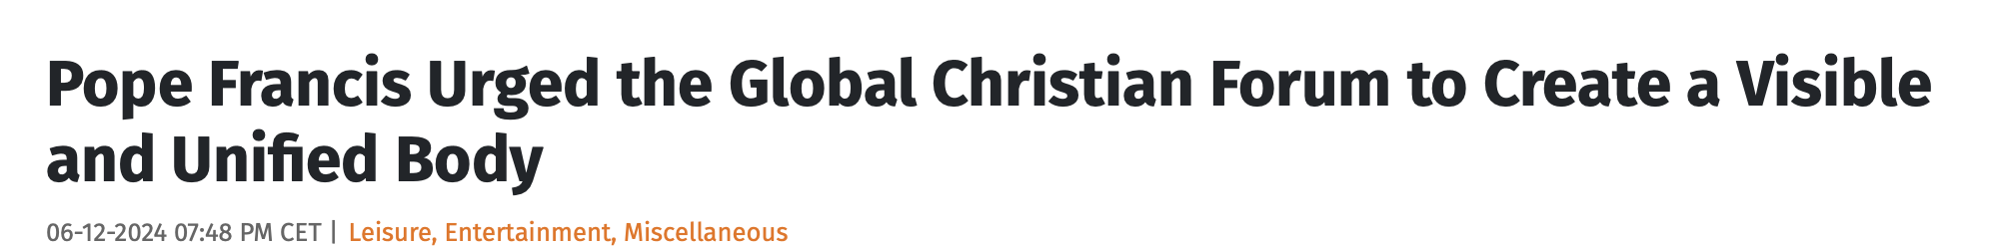
The Mark of The Beast
We identified that the image of the beast is to be a form of governance instituted by the second beast, which replicates that of the first beast.
Unification of the Church (Religious) power and the State power, where the Church controls the State power and enforces religious laws.
“Then to learn what the image is like and how it is to be formed we must study the characteristics of the beast itself—the papacy. When the early church became corrupted by departing from the simplicity of the gospel and accepting heathen rites and customs, she lost the Spirit and power of God; and in order to control the consciences of the people, she sought the support of the secular (state) power. The result was the papacy, a church that controlled the power of the state and employed it to further her own ends, especially for the punishment of “heresy.”
In order for the United States to form an image of the beast, the religious power must so control the civil government that the authority of the state will also be employed by the church to accomplish her own ends.”
Great Controversy pg. 443.1,2
When the leading churches of the United States, uniting upon such points of doctrine as are held by them in common, shall influence the state to enforce their decrees and to sustain their institutions, then Protestant America will have formed an image of the Roman hierarchy.
GC 445.1
Can two walk together, except they be agreed?
Amos 3:3

Slide 8
The Mark of The Beast
“But in vain they do worship me, teaching for doctrines the commandments of men.” Matthew 15:9
When the Church power shall unite with the State power, firstly in America, and then globally, to enforce a false religious law, which goes contrary to God’s Law, it is then that one will “worship” or “obey” the beast.
“Know ye not, that to whom ye yield yourselves servants to obey, his servants ye are to whom ye obey…” Romans 6:16
By yielding to the dictates of the State, in complete opposition to the Law of God, one is worshipping the Beast, i.e., The Papacy.
Man’s will is placed above God’s will and thus one receives his number, 666. Six- number of man, Seven- number of God.

Slide 9
The Commandments Of Men
The mark of the beast is in direct contrast to the Seal of God.
It is the mark of satan’s authority upon sinful man, executed through the beast of the earth, which “causeth the earth and them which dwell therein to worship the first beast, whose deadly wound was healed.” Revelation 13:12,4
As the Seal of God is connected to God’s Law, so the mark of the beast is in complete opposition to God’s Law.
The Seal of God is found in the Sabbath Command, whereas the mark of the beast (mark of the papacy), is in direct opposition to the Sabbath command.
Let’s analyze a few historical facts and statements on this point.

Slide 10
The Commandments Of Men
On March 7th 321 AD, Emperor Constantine of the Roman Empire instituted Sunday (Day of the Sun), as a legal holiday across the Roman Empire.
“Let all the judges and town people, and the occupation of all trades, rest on the venerable day of the sun…” History of the Christian Church, vol. 3, pg.380
This was in a sense the first Sunday Law in Ancient Rome.
It was in the year c.363-364 AD, at the council of Laodicea, that the now Apostate R.C Church, followed suit and likewise decreed (Canon 29) that Sunday should now be a day of rest throughout the church.
“Christians must not judaize by resting on the Sabbath, but must work on that day, rather honouring the Lord's Day; and, if they can, resting then as Christians. But if any shall be found to be judaizers, let them be anathema from Christ.” Canon 29, Council of Laodicea

Slide 11
The Commandments Of Men
“He shall speak pompous (blasphemous) words against the Most High, shall persecute the saints of the Most High, and shall intend to change (the) times and law.” Daniel 7:25; ref. Revelation 13:5-6
“Protestants…accept Sunday rather than Saturday as the day for public worship, after the Catholic Church made the change… But the Protestant mind does not seem to realise that in accepting the Bible, in observing the Sunday, they are accepting the authority of the spokesman for the Church, the Pope.” Our Sunday Visitor, Feb. 5, 1950
“Reason and common sense demand the acceptance of one or the other of these two alternatives; either Protestantism and the keeping holy of Saturday or Catholicity and the keeping of Sunday. Compromise is impossible.” The Catholic Mirror, December 23, 1893

Slide 12
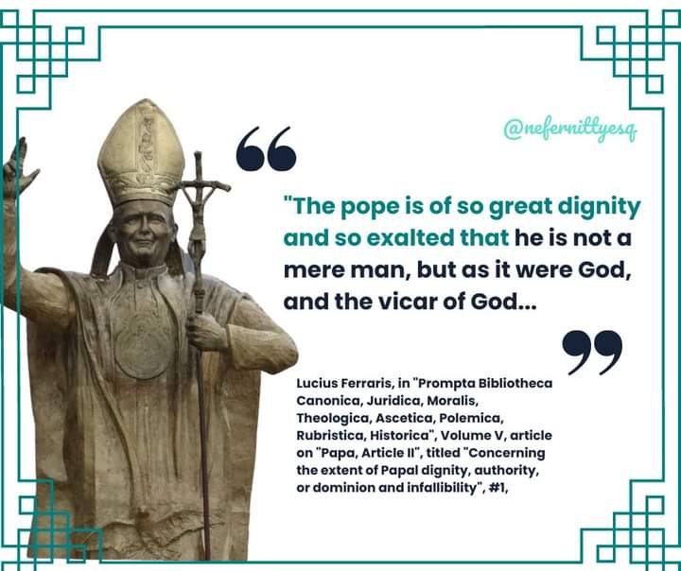
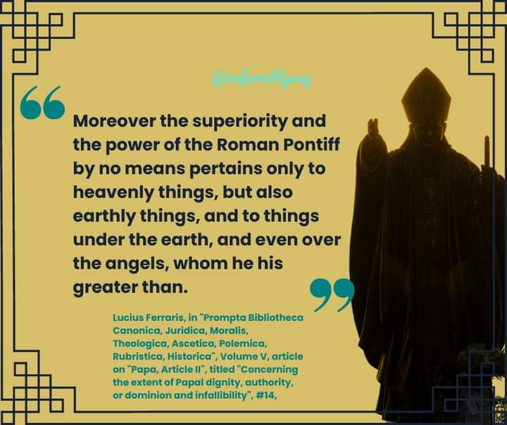
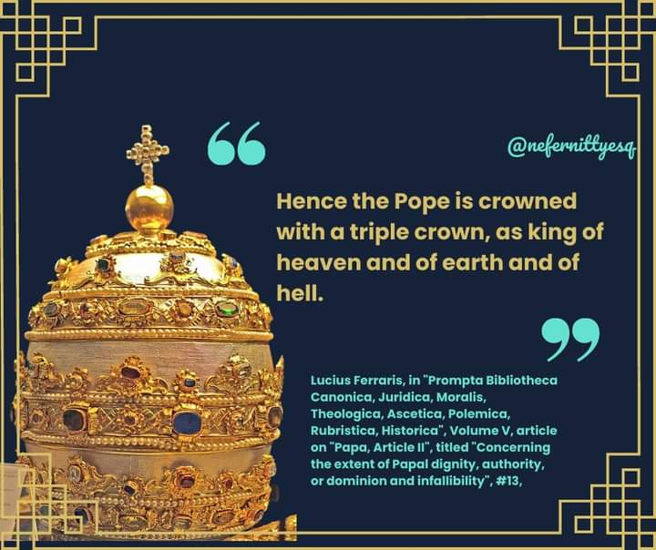
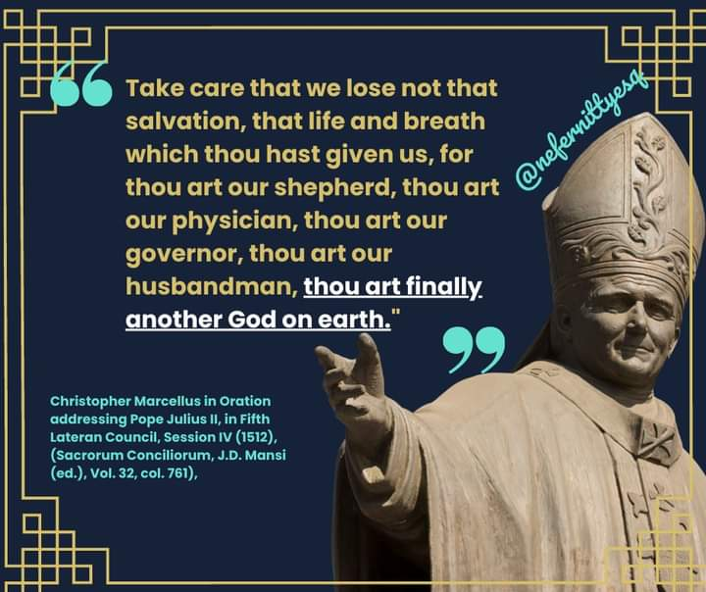
The Commandments Of Men
“If Protestants would follow the Bible, they should worship God on the Sabbath Day. In keeping Sunday they are following a law of the Catholic Church. Albert Smith, Chancellor of the Archdiocese of Baltimore, in a letter dated February 10,1920
“It was the Catholic Church which, by the authority of Jesus Christ, has transferred this rest [Sabbath] to the Sunday…Thus the observance of Sunday by the Protestants is an homage they pay in spite of themselves to the authority of the [Catholic] Church.” Mr. Louis Segur, Plain Talk about the Protestantism of Today pg. 213
“Of course, the Catholic Church claims that the change [Saturday Sabbath to Sunday] was her act... And the act is a mark of her ecclesiastical authority in religious things” H.F. Thomas, Chancellor of Cardinal Gibbons
“Let no man deceive you by any means: for that day shall not come, except there come a falling away first, and that man of sin be revealed, the son of perdition; Who opposeth and exalteth himself above all that is called God, or that is worshipped; so that he as God sitteth in the temple of God, shewing himself that he is God.”
2 Thessalonians 2:3-4

Slide 13
The Mark of The Beast
These statements are “straight from the horse’s mouth”
There can be no conjecture, the “man of sin”, “the beast out of the sea”, claims dominion over this entire world and when the time comes for this false religious law enforcing Sunday worship, all will have to make a choice.
Scripture and secular history show us that when ever a nation tries to enforce worship, persecution always follows for those dissenters.
Esther; Shadrach, Meshach & Abednego; Daniel
Like these faithful individuals, all of us will need to make a decision.
Will we stand for God, or will we bow to the image and receive the mark?
The choices that we make today are preparing us to receive the Seal of God or the mark of the beast.

Slide 14
The Mark of The Beast
“The time is not far distant when the test will come to every soul. The observance of the false sabbath will be urged upon us. The contest will be between the commandments of God and the commandments of men.
Those who have yielded step by step to worldly demands and conformed to worldly customs will then yield to the powers that be, rather than subject themselves to derision, insult, threatened imprisonment, and death. At that time the gold will be separated from the dross. True godliness will be clearly distinguished from the appearance and tinsel of it. Many a star that we have admired for its brilliance will then go out in darkness…” Prophets & Kings, pg. 188

Slide 15
The Mark of The Beast
“The sign, or seal, of God is revealed in the observance of the seventh-day Sabbath, the Lord's memorial of creation…. The mark of the beast is the opposite of this—the observance of the first day of the week. This mark distinguishes those who acknowledge the supremacy of the papal authority from those who acknowledge the authority of God.” 8T pg.117
When Sunday observance shall be enforced by law, and the world shall be enlightened concerning the obligation of the true Sabbath, then whoever shall transgress the command of God to obey a precept which has no higher authority than that of Rome, will thereby honour popery above God. He is paying homage to Rome (1st beast), and to the power which enforces the institution ordained by Rome (2nd beast). He is worshiping the beast and his image…And it is not until the issue is thus plainly set before the people, and they are brought to choose between the commandments of God and the commandments of men, that those who continue in transgression will receive “the mark of the beast.” LDE 226.1-2

Slide 16
The Mark of The Beast
And these words, which I command thee this day, shall be in thine heart: And thou shalt teach them diligently unto thy children, and shalt talk of them when thou sittest in thine house, and when thou walkest by the way, and when thou liest down, and when thou risest up. And thou shalt bind them for a sign upon thine hand, and they shall be as frontlets between thine eyes.
Deuteronomy 6:6-8
The Seal of God is placed in the forehead whereas the mark of the beast is placed in the forehead OR the hand.
Revelation 7:3; Revelation 14:1; Revelation 13:16
The forehead represents the mind, the seat of one’s character. The Most Holy Place of the body Temple. Romans 12:2; 1 Corinthians 3:16-17
God’s Law must be written in our minds, His character must become our character and as a result, we will follow in His paths and live like Christ, our King. Fully obedient to the Father’s Law. 1 John 2:6
The mark of the beast in the mind reveals that those individuals have the character of the beast, the agent of satan. They are rebellious; choosing to wilfully transgress the Law of God, in favour of the papal sabbath, Sunday. Satan becomes their king.
Those who receive in the hand may not necessarily believe the principles of the beast power or the law that is enforced, but for fear of not being able to buy or sell, they will compromise and be marked in their hand.

Slide 17
The Mark of The Beast
1. “And the third angel followed them, saying with a loud voice, If any man worship the beast and his image, and receive his mark in his forehead, or in his hand…...” Revelation 14:9-10 ref. Revelation 15:1;16:1-2
2. “And I saw as it were a sea of glass mingled with fire: and them that had gotten the victory over the beast, and over his image, and over his mark, and over the number of his name, stand on the sea of glass, having the harps of God….” Revelation 15:2; ref. Revelation 14:12

Slide 18
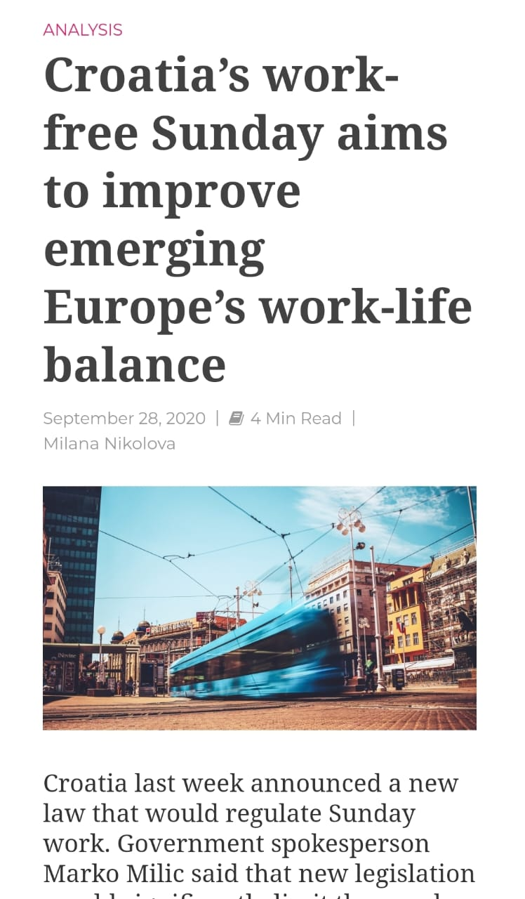


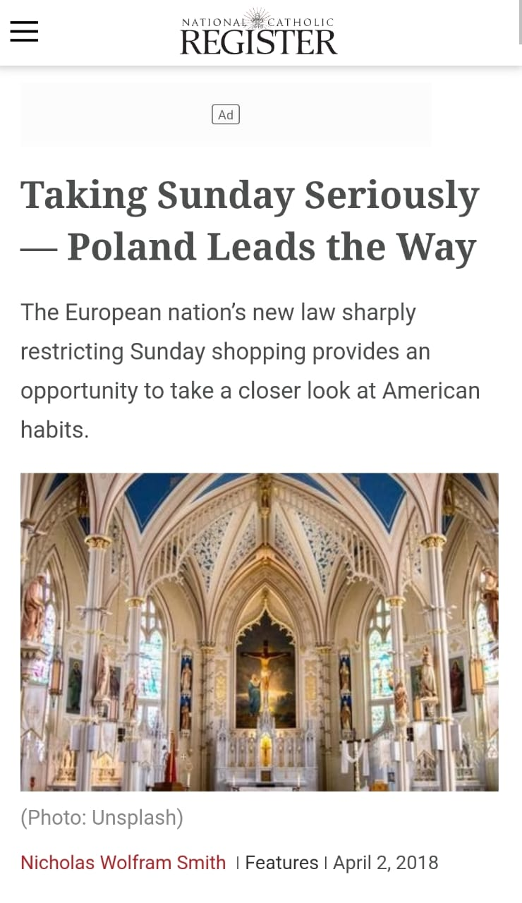
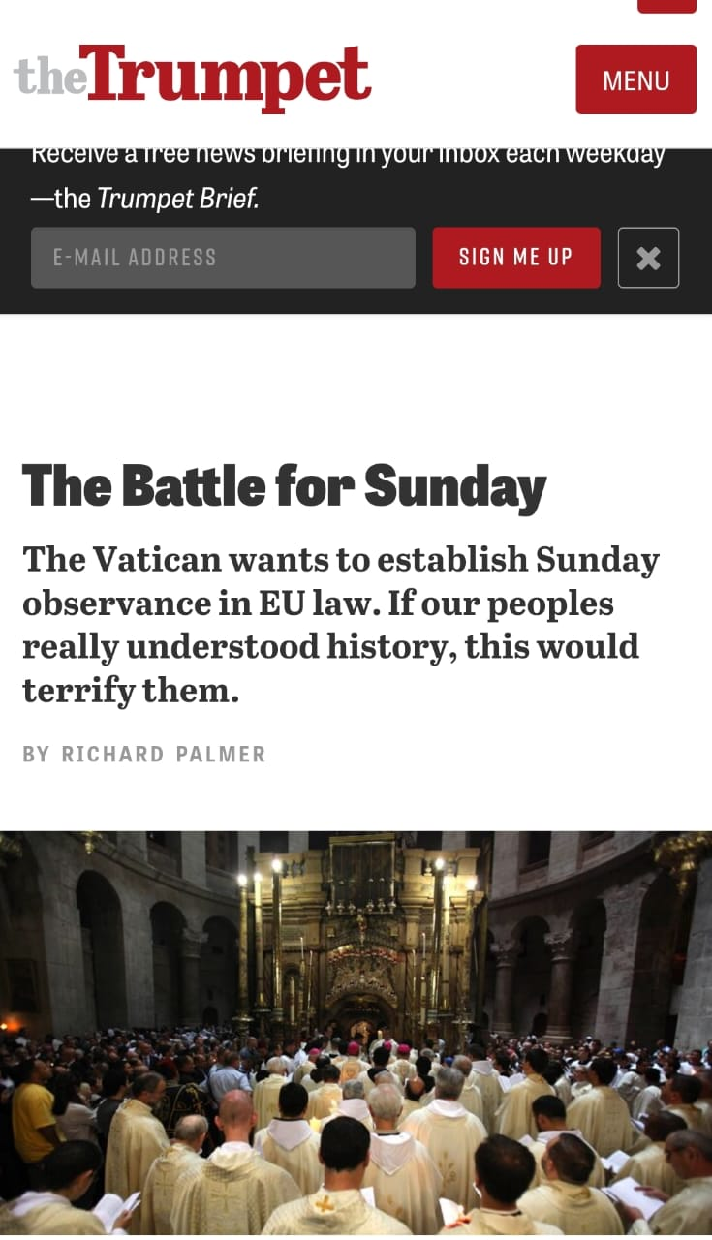
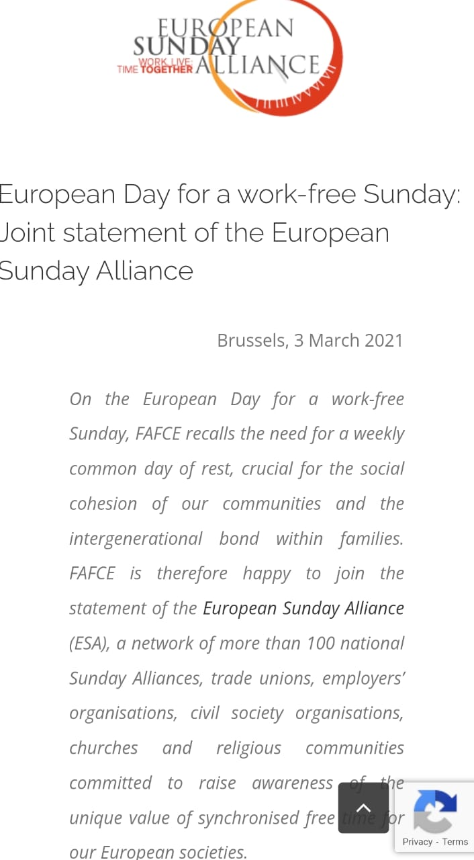
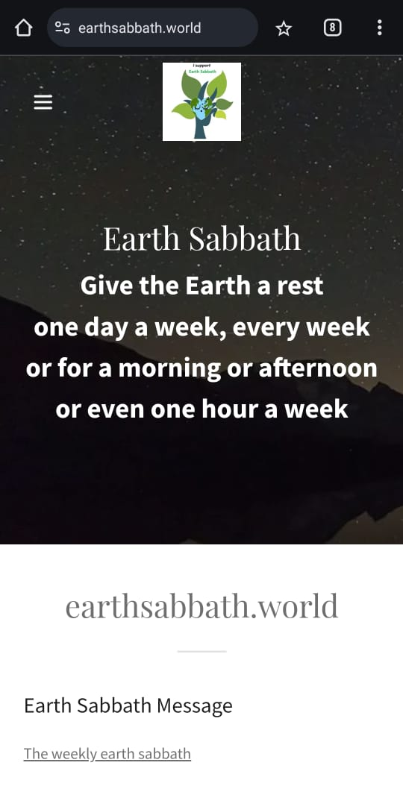
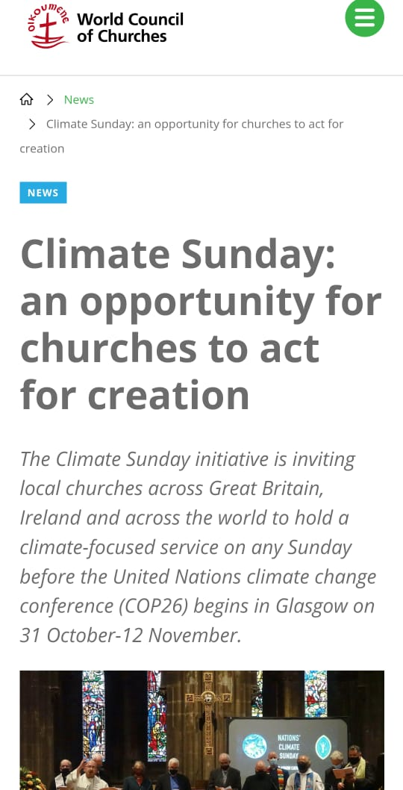
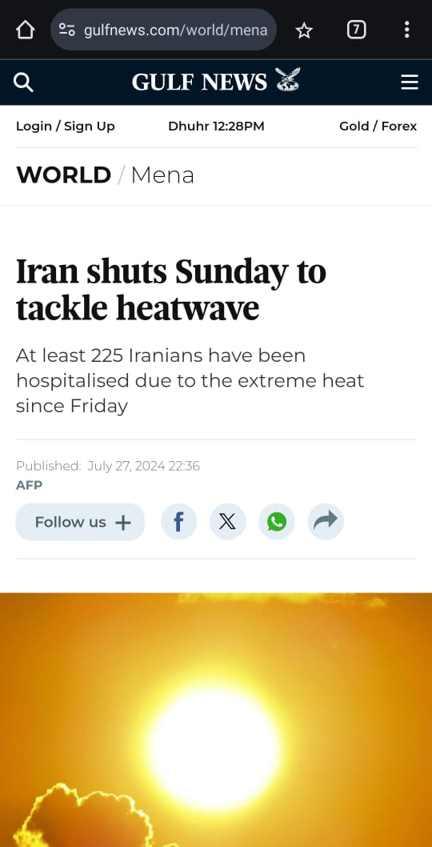

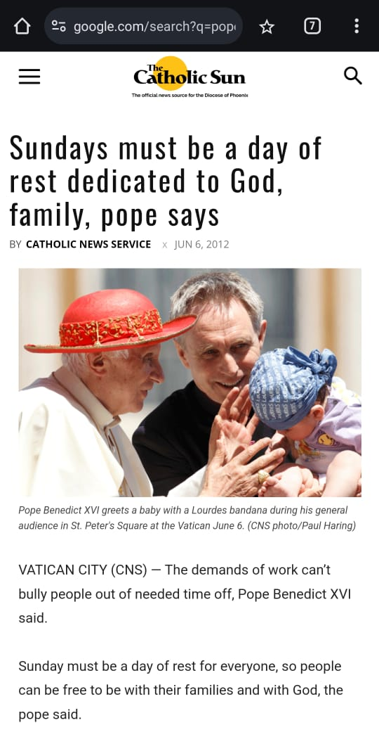

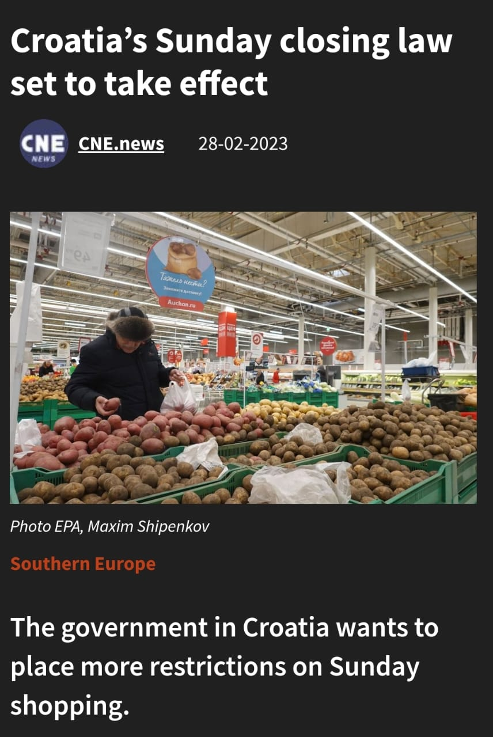

Slide 19
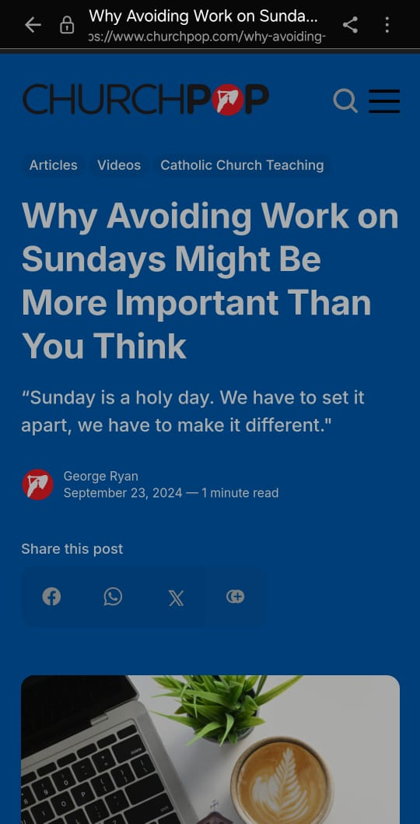

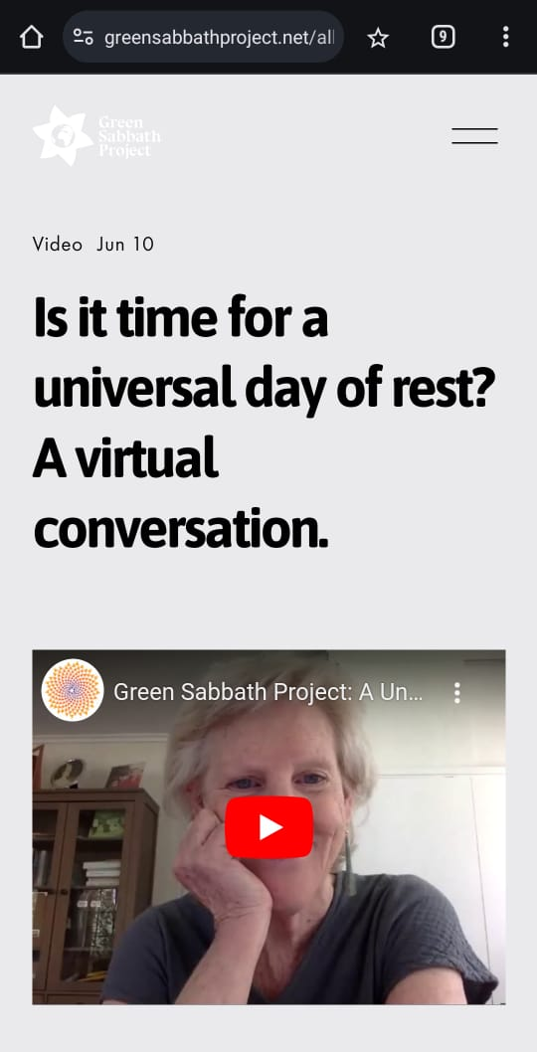
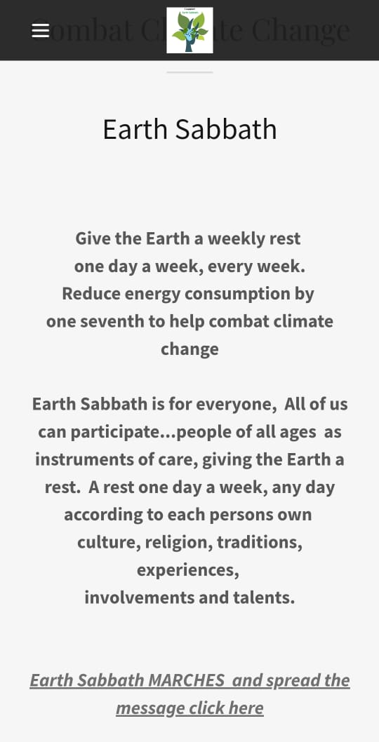
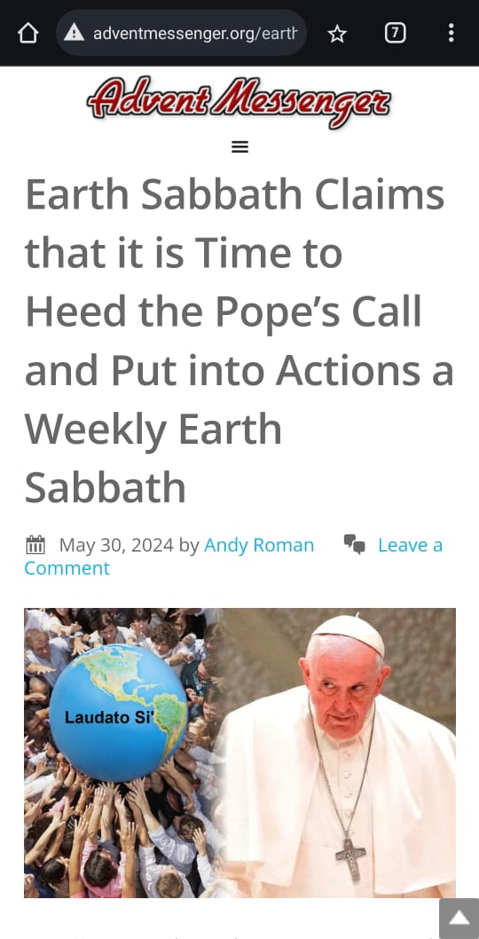
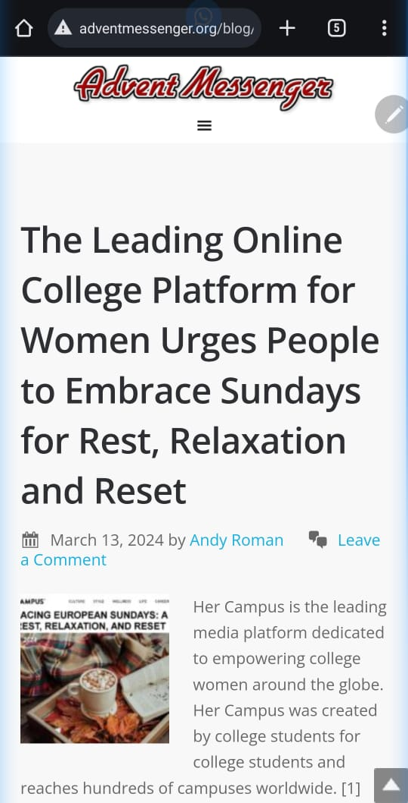
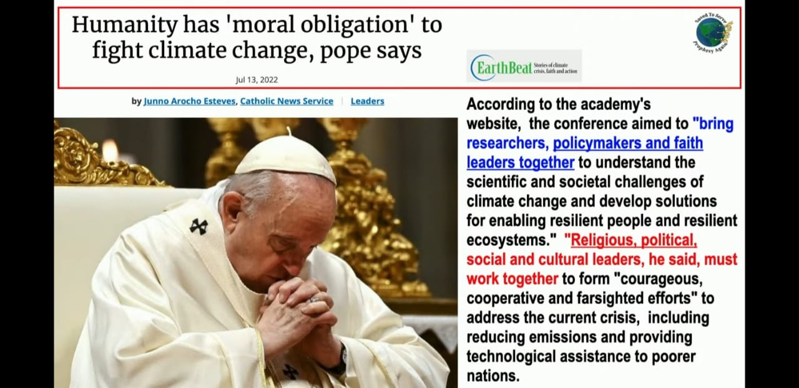
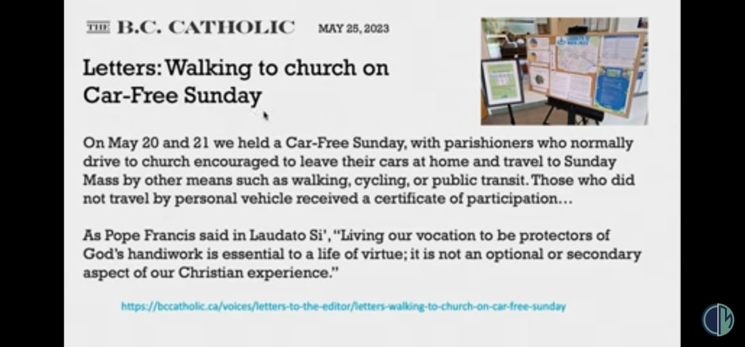
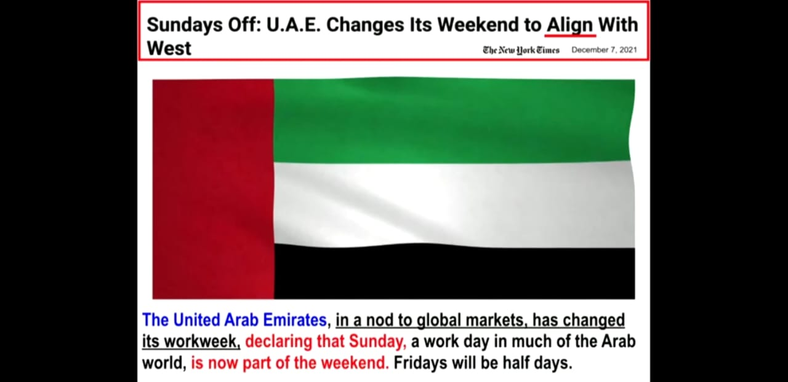
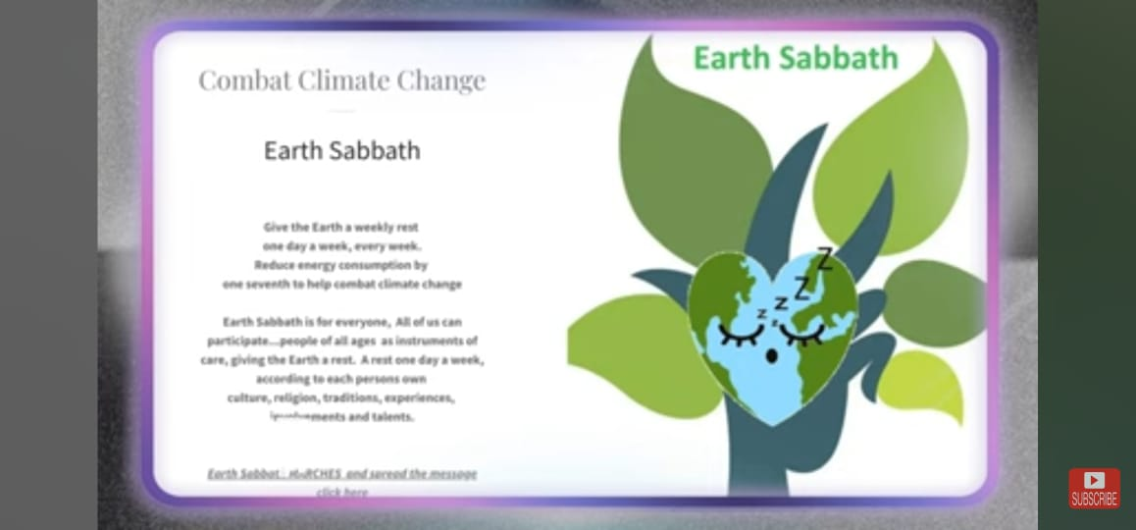

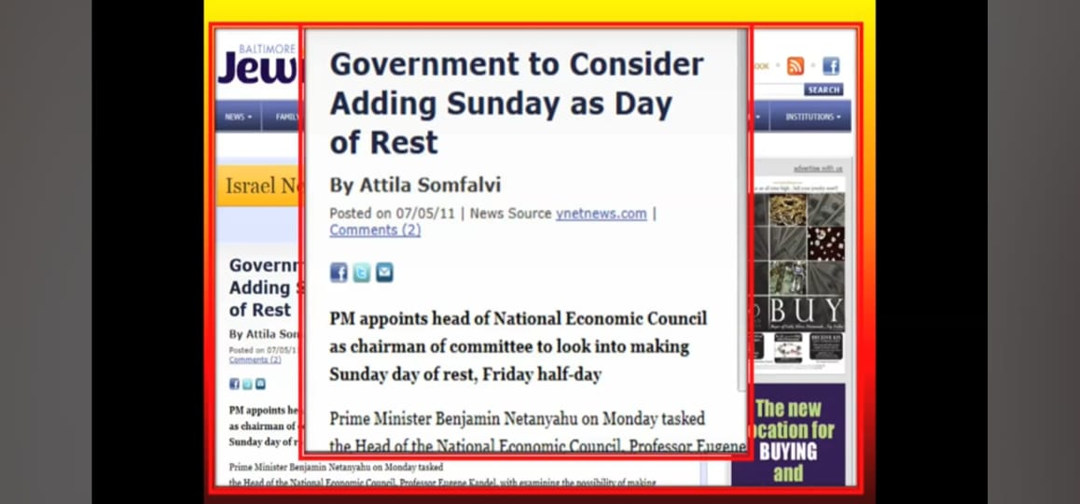
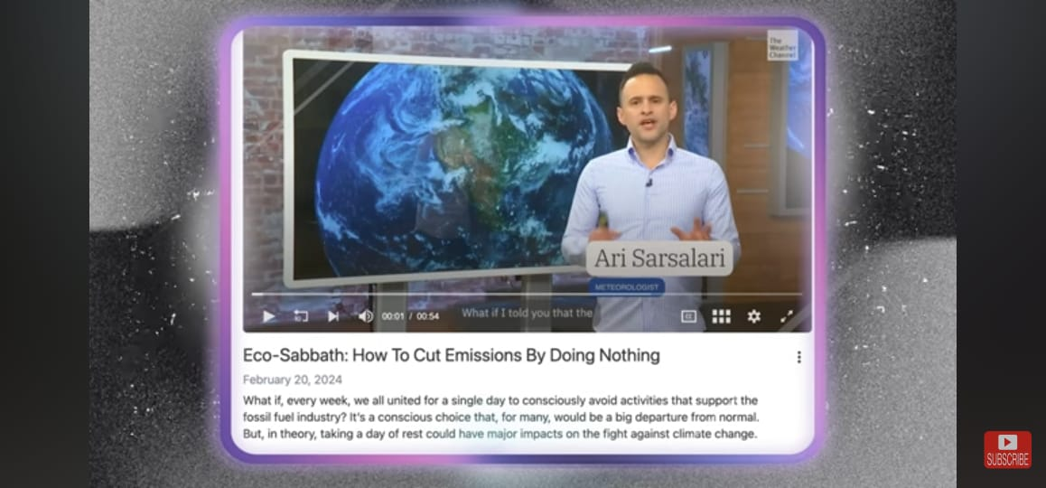
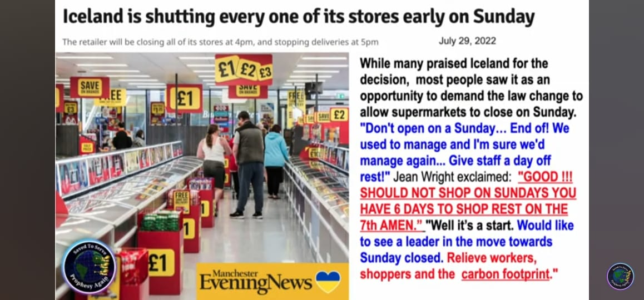
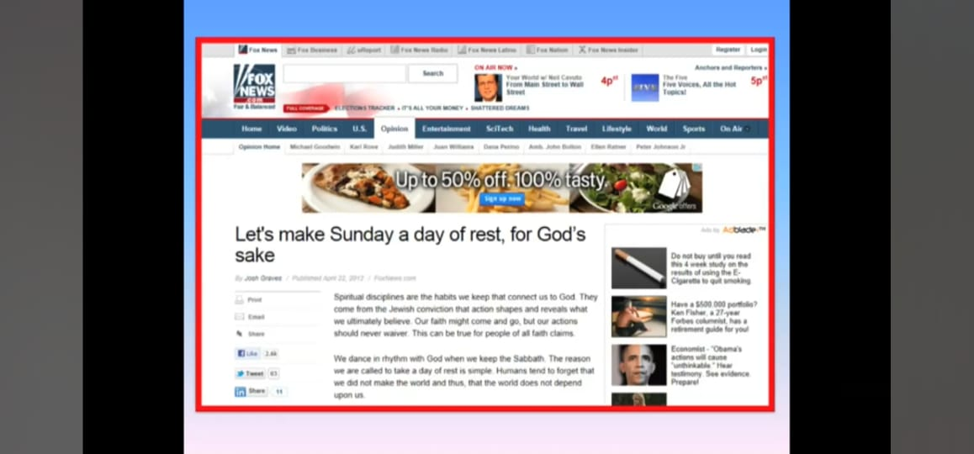
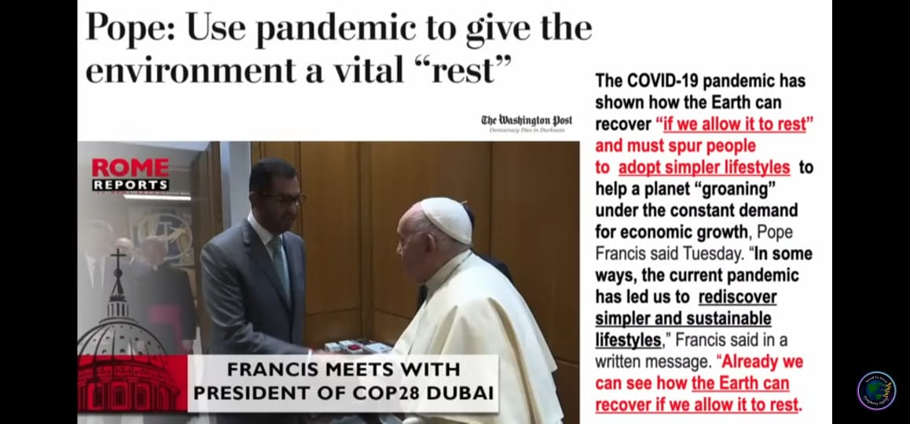
A great crisis awaits the people of God. Very soon our nation [USA, 2nd Beast] will attempt to enforce upon all the observance of the first day of the week as a sacred day. In doing this they will not scruple to compel men against the voice of their own conscience to observe the day the nation declares to be the Sabbath.
Last Day Events pg. 144
The substitution of the laws of men for the law of God, the exaltation, by merely human authority, of Sunday in place of the Bible Sabbath, is the last act in the drama.
7T 141.1

Slide 20
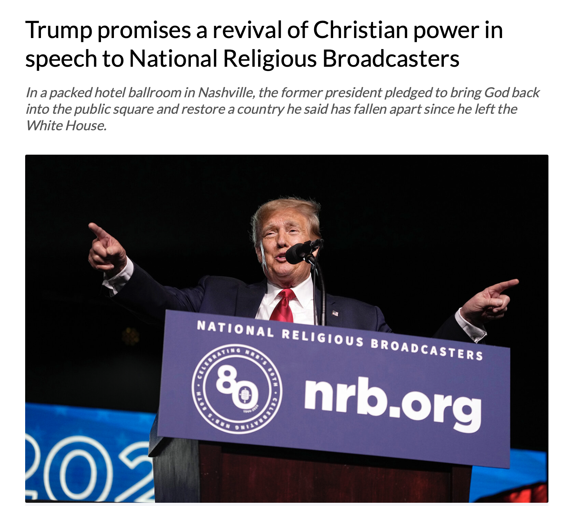
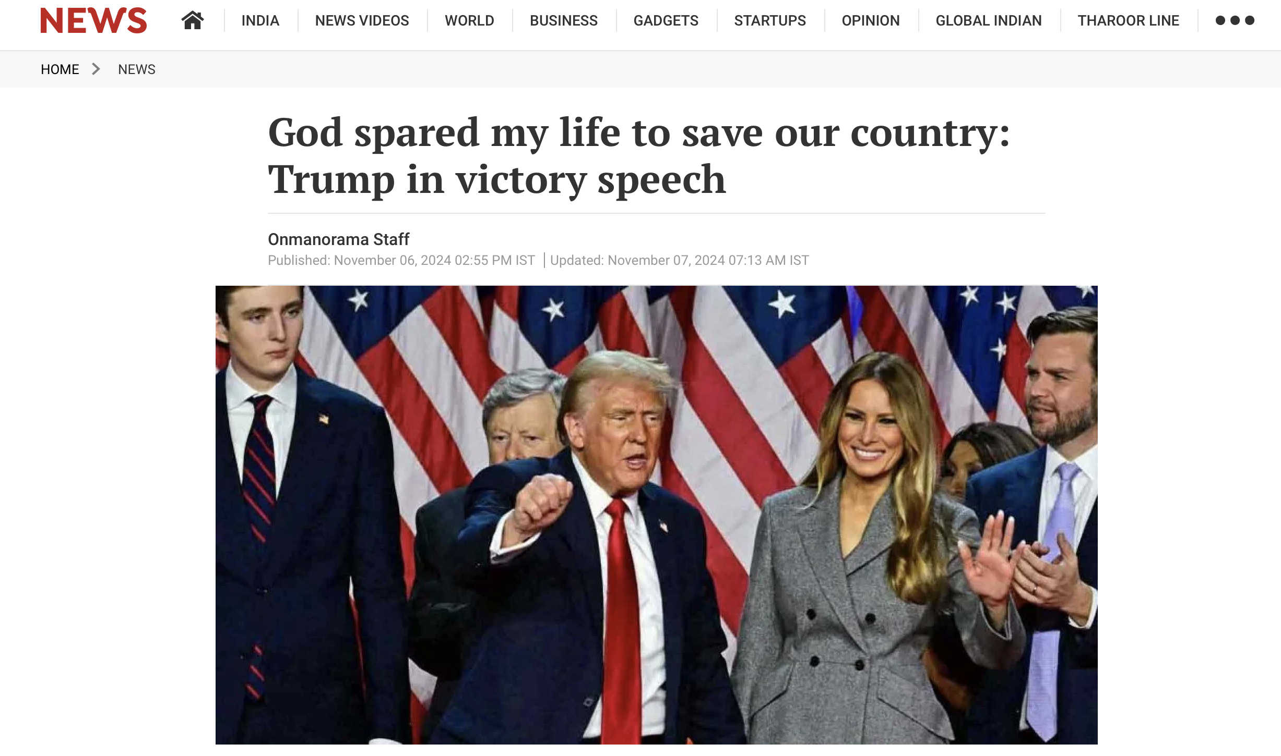
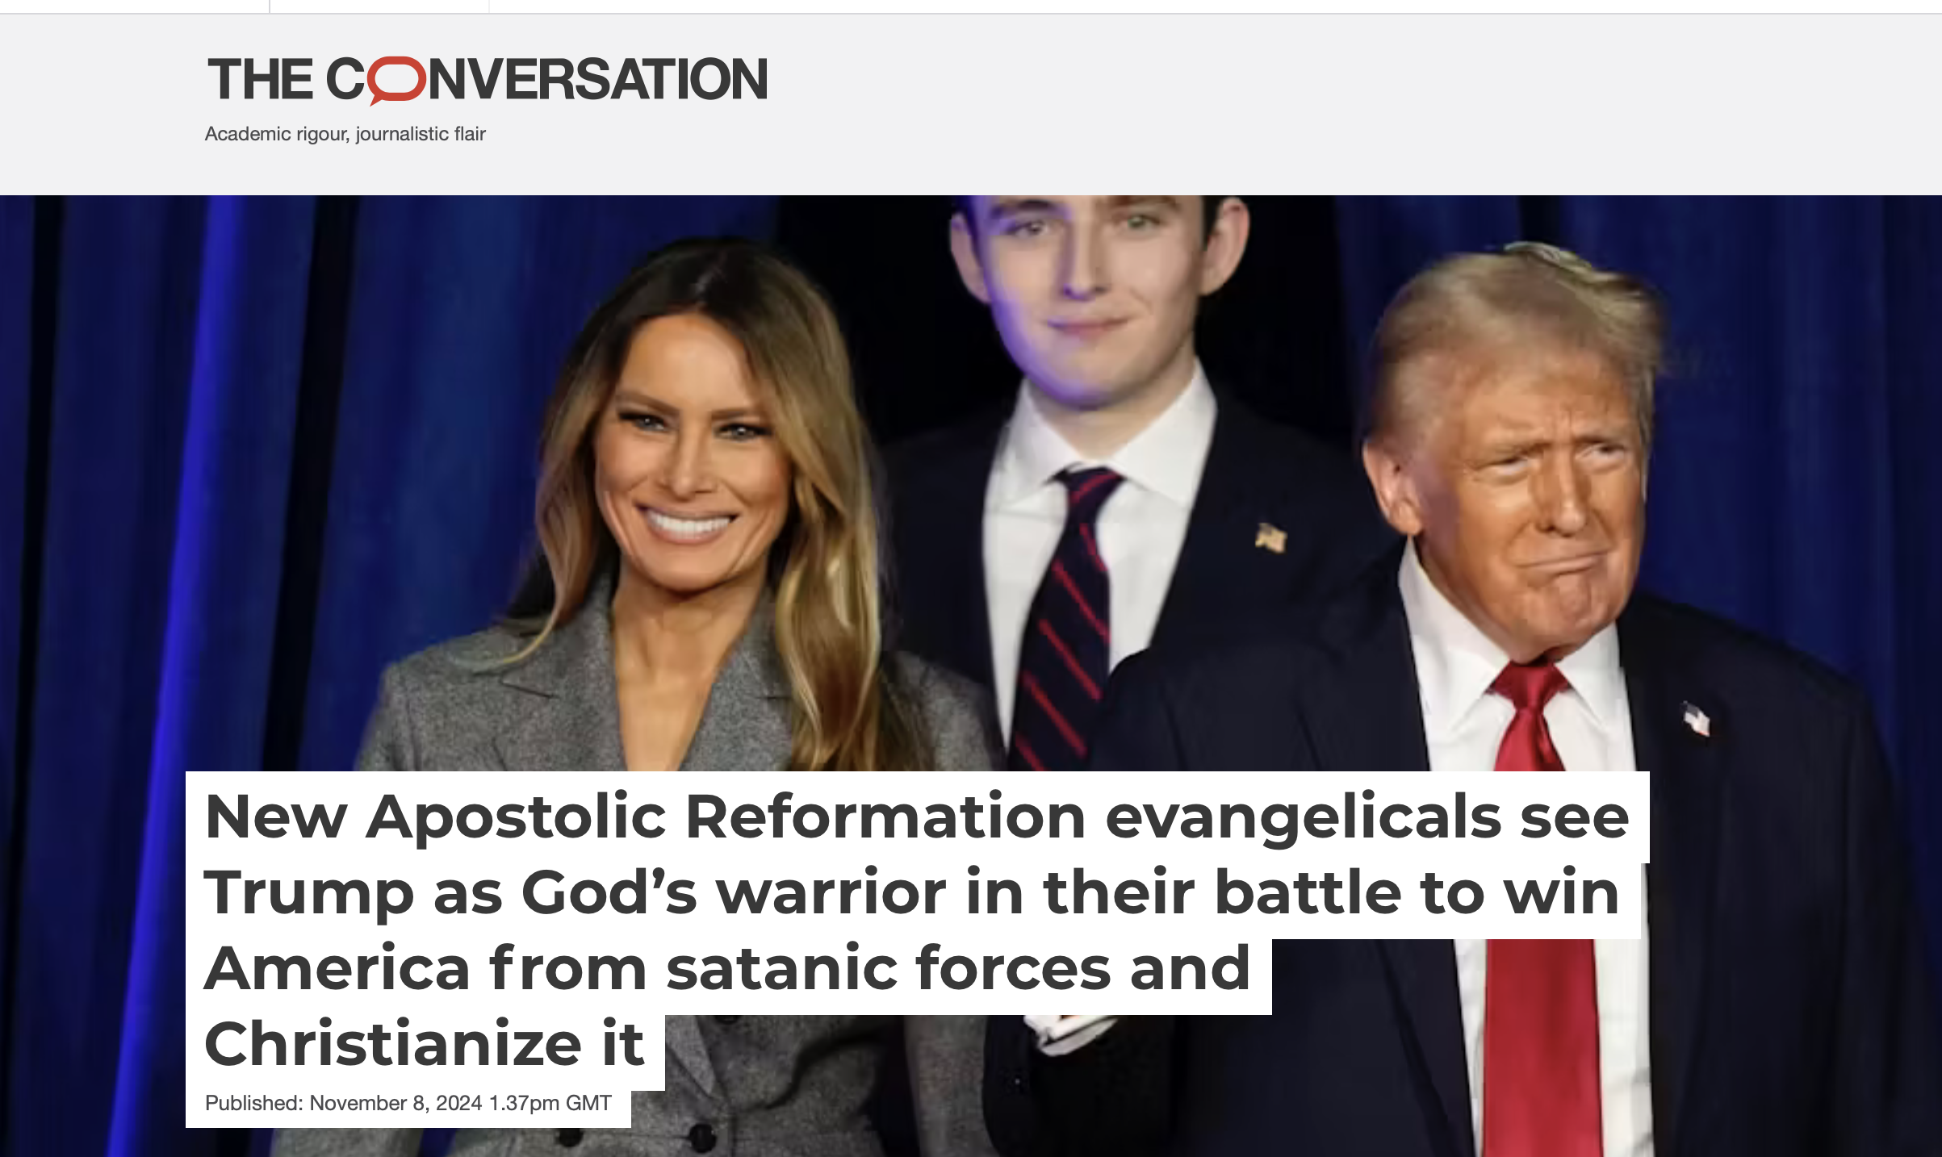
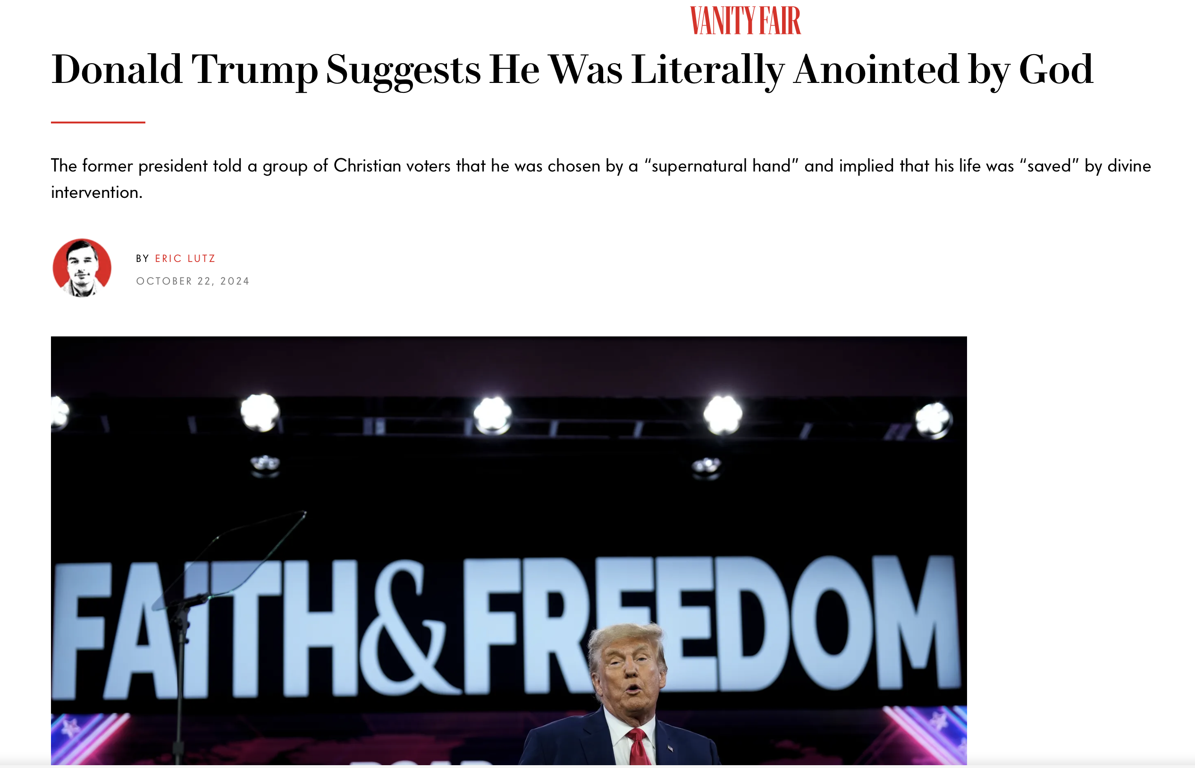
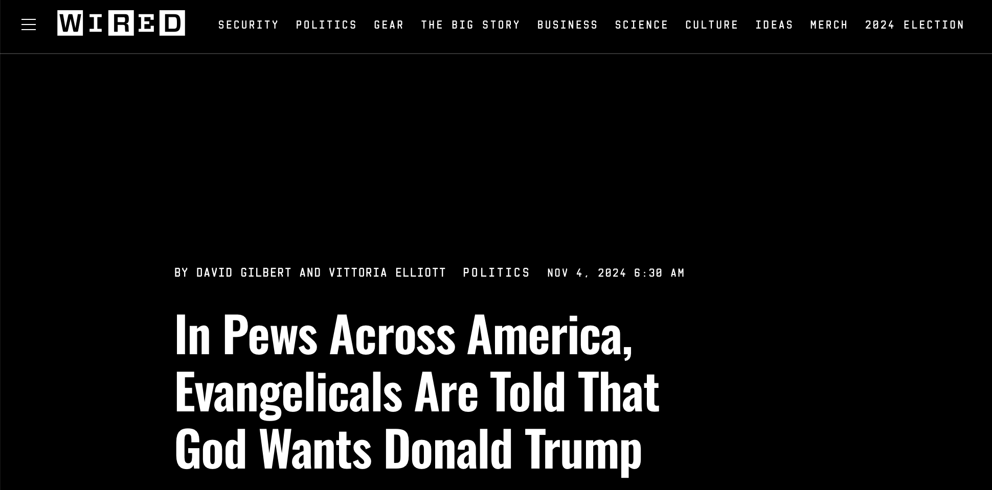
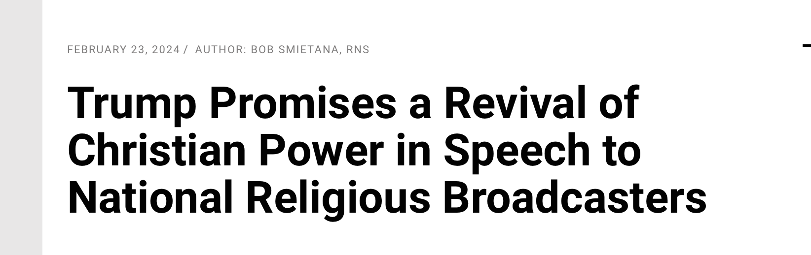
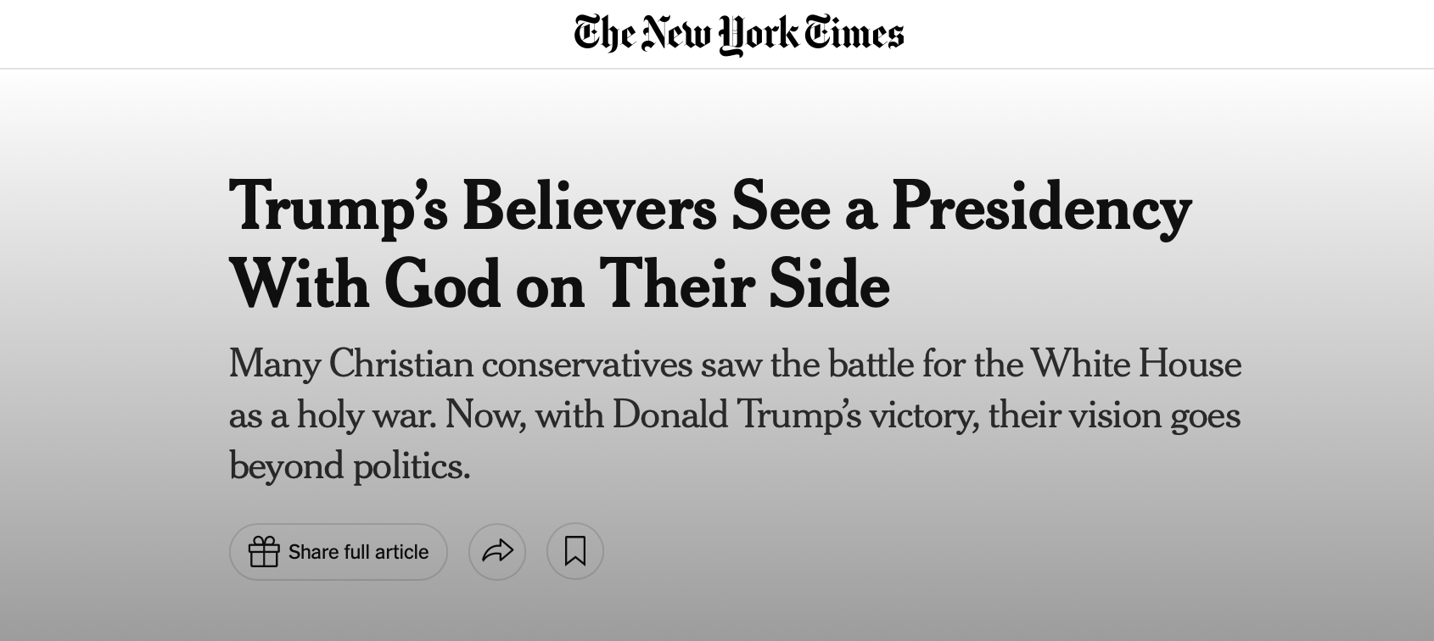
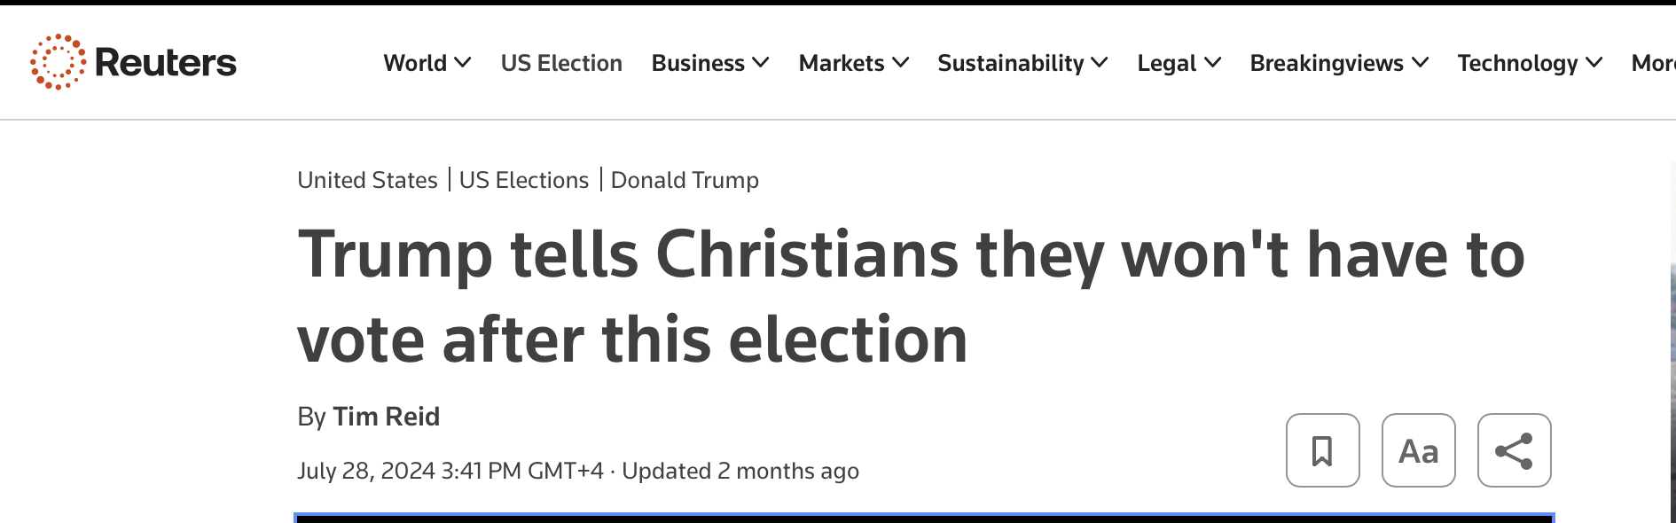
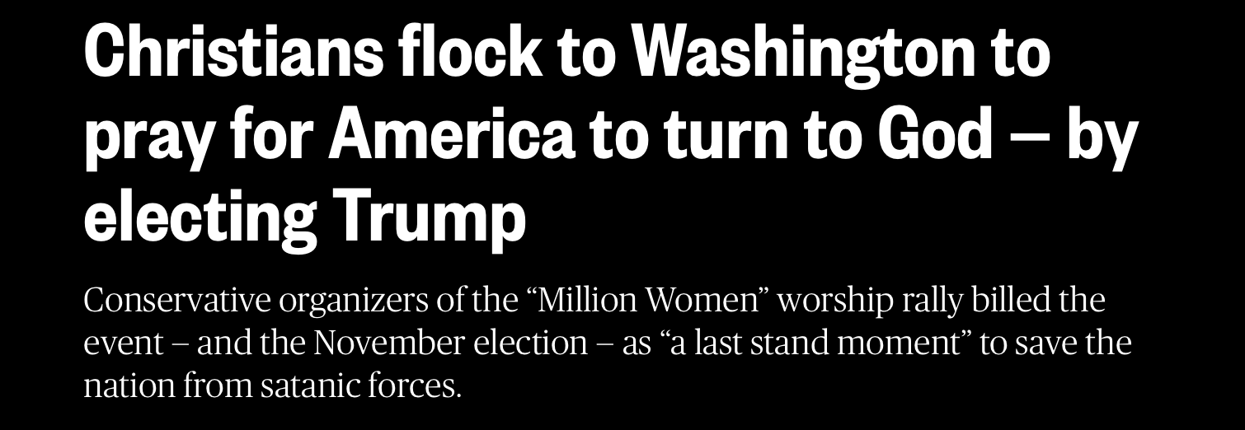
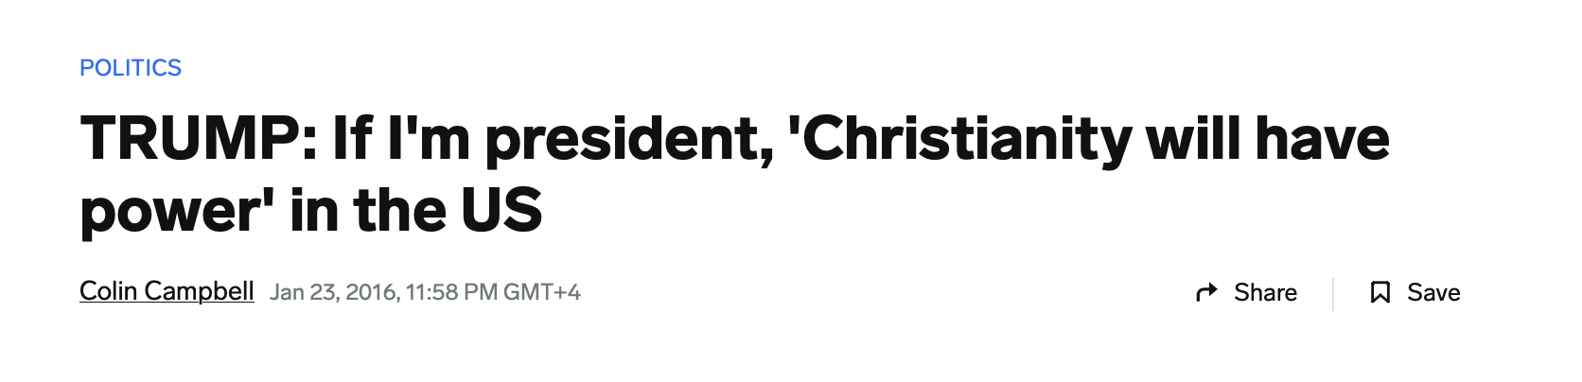
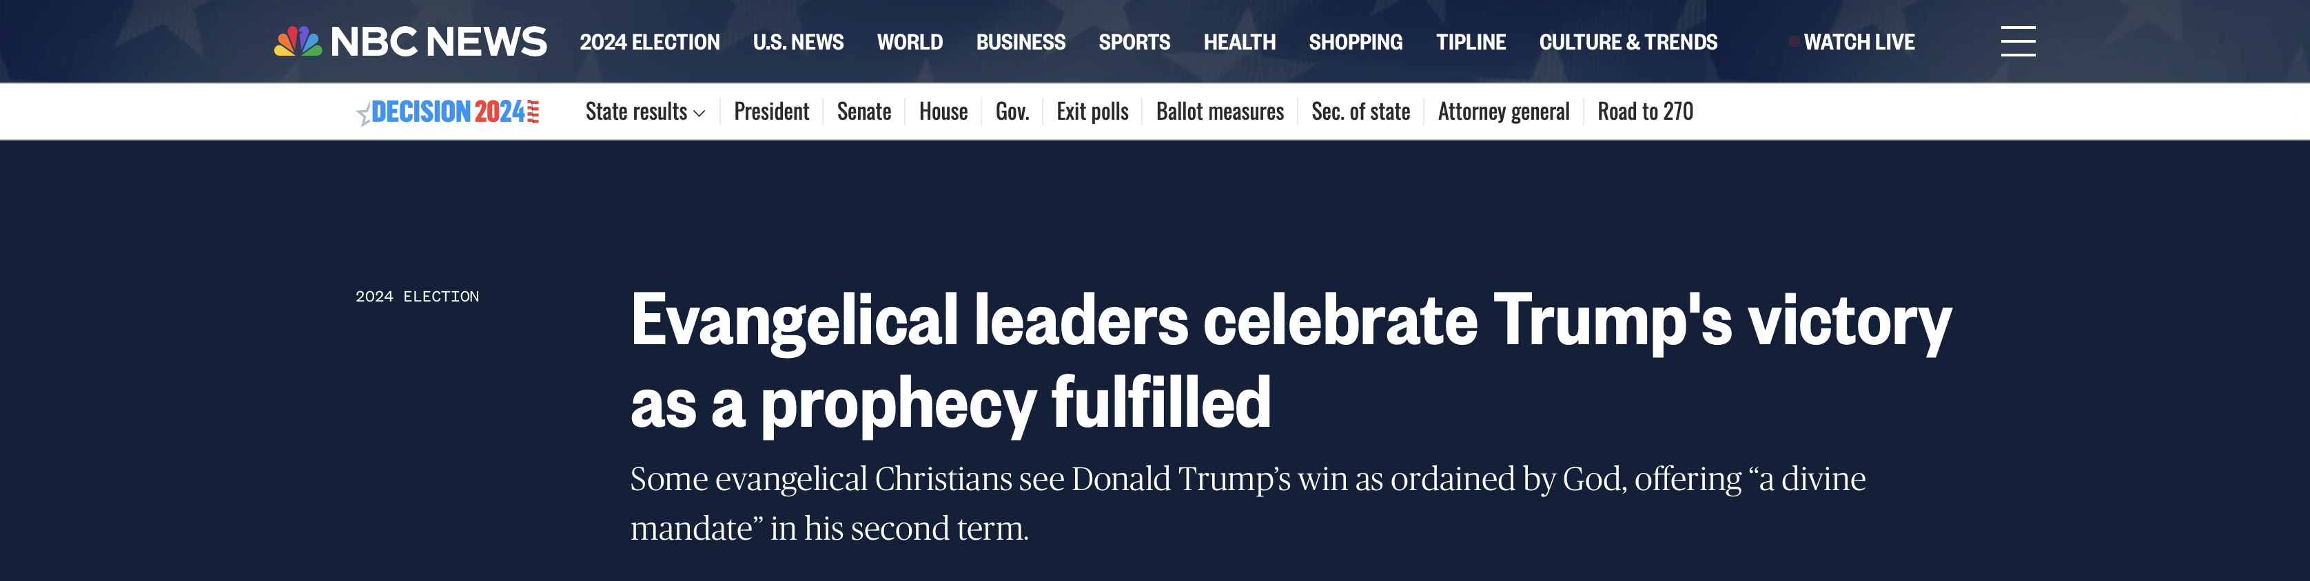
In the very act of enforcing a religious duty by secular power, the churches would themselves form an image to the beast; hence the enforcement of Sunday-keeping in the United States would be an enforcement of the worship of the beast and his image.”
Great Controversy pg. 448.3
When Protestant churches shall unite with the secular power to sustain a false religion….then will the papal sabbath be enforced by the combined authority of church and state.”
Last Day Events pg. 134

Slide 21

In Closing
“And that, knowing the time, that now it is high time to awake out of sleep: for now, is our salvation nearer than when we believed...” Romans 13:11-12
Friends, all of humanity living during these last days shall receive one of two marks. There is no middle ground, it is either God’s mark of His authority over our lives or satan’s mark of his authority over our lives.
Read Matthew 7:21-23
Time is of the essence. Now is the time to put away sin from our lives.
Now it is time to allow Christ to put the oil in our vessels, lest we be found “weighed in the balances and found wanting.”

Slide 22
In Closing
“…God's servants must not hold their peace. The signs foretold in prophecy are fast fulfilling around us. This should arouse every true follower of Christ to zealous action. ”
Testimonies For The Church, volume 4, p.g. 307.2

Slide 23
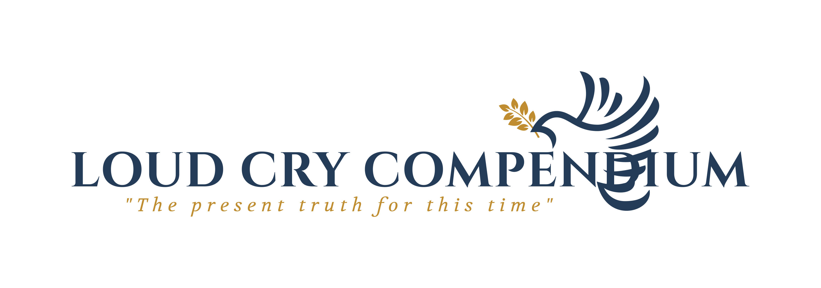





Thank You
loudcrycompendium@gmail.com
@ThePropheticEye
www.loudcrycompendium.com
@loudcrycompendium

