Slide 1
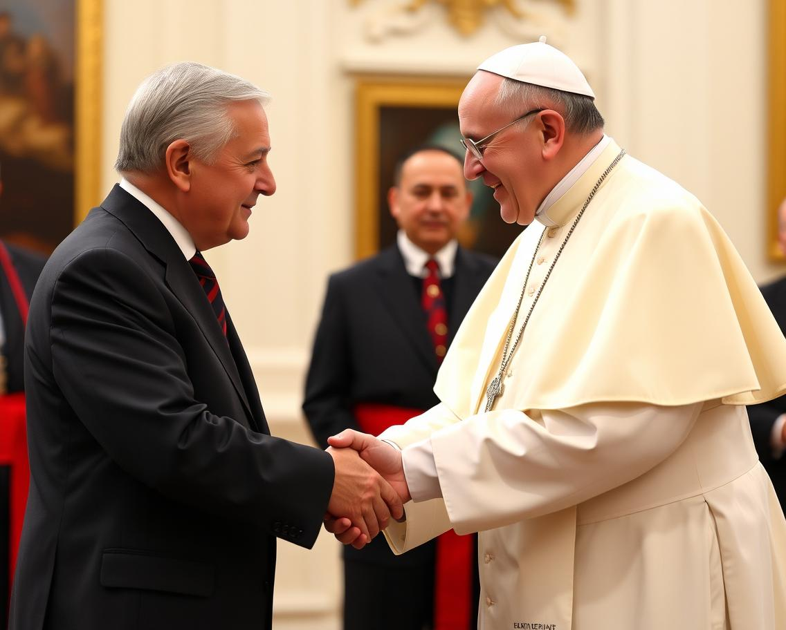
Theocracy Alert!
When The Church Marries The State

Slide 3
FOUNDATION
“And he said unto them, Render therefore unto Caesar the things which be Caesar's, and unto God the things which be God’s.” Luke 20:25
“Render therefore unto Caesar the things which be Caesar’s and unto God the things which be God’s.” These were the words of Christ in His teaching unto the Scribes and Pharisees while they were trying to trap Jesus in their evil exploits. These words, spoken by Jesus, were not only for the benefit of the Jews in His day, but also for all subsequent generations after that.
Christ was teaching us that there must be a separation of the things dedicated unto God with that of the state or government; that is, the things of the state and those of a Heavenly nature should not co-mingle. In matters of an earthly nature, we are to obey the government and the relevant authorities, Romans 13:3-7, but in matters of a Heavenly nature, we ought to obey God.
However, it must be stated, that when the government or any earthly power, overstates its authority and creates dictates and laws usurping the authority of God, then, “we ought to obey God rather than men.” Acts 5:29.

Slide 4
FOUNDATION
Praise ye the LORD. Praise ye the LORD from the heavens: praise Him in the heights. Praise ye Him, all his angels: praise ye Him, all his hosts.
Kings of the earth, and all people; princes, and all judges of the earth: Both young men, and maidens; old men, and children. Let them praise the name of the LORD: for His name alone is excellent; His glory is above the earth and heaven. Psalms 148:1-2,11-13
This principle of the separation of the Church and the State is not a new principle.
It is seen right through the Scriptures, from the very beginning unto the very end. Therefore, I intend to look at a few examples in the Scriptures which will teach us about the adverse effects upon God’s faithful people whenever there is a unification of the Church and the State to enforce certain laws and how this affects us, God’s faithful followers, in these last days of earth’s history.

Slide 5
QUEEN ESTHER
Our first example will be taken from the account seen in the Book of Esther.
In this account, we see King Ahasuerus (Xerxes I) of the Medo-Persian Empire, select Esther, also called Hadassah, to be his new queen after the disposal of Queen Vashti. See Esther 1:1-2:17.
“And the king loved Esther above all the women, and she obtained grace and favour in his sight more than all the virgins; so that he set the royal crown upon her head and made her queen instead of Vashti.” Esther 2:17
Subsequently, after this takes place, the king promotes one of his princes, Haman, to be the Prime Minister of the Empire above all the princes that were with him.
“After these things did king Ahasuerus promote Haman the son of Hammedatha the Agagite, and advanced him, and set his seat above all the princes that were with him.” Esther 3:1
It was after this promotion that we see the true colours of Haman revealed. He was to be used as an agent in the hand of satan to accomplish his will, viz, the destruction of the Jewish Church, to prevent the 1st Coming of the Messiah into the world.

Slide 6
QUEEN ESTHER
Read Esther 3:2
When all the king’s servants had obeyed the king’s command to bow and reverence his newly elected Prime Minister, Mordecai, the adoptive father of Queen Esther, refused to bow. He was a faithful follower of the one true God and neglected the king’s command which stipulated that he was to transgress the Law of God.
Mordecai held the commandments of God in high esteem, and he knew that if he was to compromise and break one of the Lord’s commandments, then he was guilty of breaking them all.
“For whosoever shall keep the whole law, and yet offend in one point, he is guilty of all.” James 2:10
It was therefore because of Mordecai’s persistent refusal to bow down and reverence Haman, that we see persecution arise for Mordecai as well as all the Jews throughout the empire.
“And when Haman saw that Mordecai bowed not, nor did him reverence, then was Haman full of wrath. And he thought scorn to lay hands on Mordecai alone; for they had shewed him the people of Mordecai: wherefore Haman sought to destroy all the Jews that were throughout the whole kingdom of Ahasuerus, even the people of Mordecai.” Esther 3:5-6

Slide 7
QUEEN ESTHER
Read Esther 3:7-15
We see that Haman goes to the king and misleads him into approving a decree throughout his empire, that would result in the destruction of all the children of Israel, Queen Esther included.
This law was a direct result of Mordecai, here representing the faithful children of God, refusing to bow to a religious decree enforcing false worship.
As a result of Mordecai’s refusal to adhere to this religious law created by the king (the state), we see very clearly that a death decree is issued and persecution and a time of trouble, such as never was, arises for all of God’s people at this time.
We therefore here see an example of what occurs when the state tries to take upon itself the role of the Church and forces its subjects into false worship. We must render unto Caesar that which is Caesar’s and unto God that which is God’s. The state has its role to play in the governing of a nation and should never force any religious law upon the people. This is a matter of one’s own liberty of conscience to choose to worship God or not. God has given us all a choice. Matters of the state and of worship should always be separate.

Slide 8
HANANIAH, MISHAEL & AZARIAH
In Daniel 3:1-30, we see a very similar event to that of Mordecai.
Nebuchadnezzar II, King of the Neo-Babylonian Empire, constructed a golden image and placed it in the plain of Dura, that all of his subjects should bow down and worship it, Daniel 3:1-5.
Immediately, we see in this account, the government enforcing false worship upon its people as we saw in Mordecai’s experience.
However, despite this decree and the fact that the majority bowed, three individuals: Shadrach, Meshach and Abednego, refused to bow and transgress the law of God.
“There are certain Jews whom thou hast set over the affairs of the province of Babylon, Shadrach, Meshach, and Abednego; these men, O king, have not regarded thee: they serve not thy gods, nor worship the golden image which thou hast set up.” Daniel 3:12

Slide 9
HANANIAH, MISHAEL & AZARIAH
These three Hebrew young men served not the gods of the Babylonians neither did they bow themselves down unto the graven image to worship it. They upheld and obeyed the law of God and refused to hearken unto the apostate commands of the government.
Yes, it is true that God has placed governments and kingdoms upon the earth to rule, Romans 13, however, when these kingdoms, regard not the one true God and create decrees that lead their subjects into sin, then we, as the Apostle Peters says, “ought to obey God rather than men.” Acts 5:29.
“…be it known unto thee, O king, that we will not serve thy gods, nor worship the golden image which thou hast set up.” Daniel 3:18
As a result of their steadfastness and refusal to transgress the law of Jehovah, a death decree was issued, as it was in the account of Mordecai and persecution arose for these faithful servants of God.

Slide 10
HANANIAH, MISHAEL & AZARIAH
“Then was Nebuchadnezzar full of fury, and the form of his visage was changed against Shadrach, Meshach, and Abednego: therefore, he spake, and commanded that they should heat the furnace one seven times more than it was wont to be heated. And he commanded the most mighty men that were in his army to bind Shadrach, Meshach, and Abednego, and to cast them into the burning fiery furnace. Then these men were bound in their coats, their hosen, and their hats, and their other garments, and were cast into the midst of the burning fiery furnace.” Daniel 3:19-22
Again, we see what happens to those faithful individuals who refuse to bow to the enforced religious decrees issued by the government which are in total opposition to the Law of God.

Slide 11
DANIEL
Notice the account of Daniel in chapter 6.
In this account, we see the steadfastness of the God-fearing man Daniel, who was at this time the Prime Minister of the Medo-Persian Empire. He was a devout worshipper of the one true God as we see right throughout the Book of Daniel and it was because of his faithfulness to God, that satan desired to destroy him.
In Daniel 6:3-4, we are told that Daniel was highly favoured in the eyes of King Darius, and it was because of this that his colleagues, the other members of Darius’ government (the state) became jealous. This jealousy led to them conspiring against Daniel to destroy him.
We are told in verses 6-9, that collectively, they approached the king and misled him into approving a law throughout the empire which prevented all inhabitants from worshipping any other god but the king for thirty days.
It should be noted that in these ancient cultures from Egypt all the way to the more modern Romans, that the king was also worshipped as a god.
We are told that after these officials presented this statute to the king, that he “signed the writing and the decree” into law.

Slide 12
DANIEL
However, despite this religious law being decreed in the land, this did not stop Daniel from worshipping and obeying the one true God. For the Scriptures tell us that “when Daniel knew that the writing was signed, he went into his house; and his windows being open in his chamber toward Jerusalem, he kneeled upon his knees three times a day, and prayed, and gave thanks before his God, as he did aforetime.” Daniel 6:10.
Irrespective of this religious law that was decreed by the state, this did not stop Daniel from being faithful. He continued to obey and worship God as was his custom. This faithfulness and obedience to God then led to his arrest and sentencing, for in the moment that he was praying, the unfaithful officials “found Daniel praying and making supplication before his God” as opposed to the king, verse 11.
When the king realised that he was deceived, it was too late, for any decree of the Medes and Persians could not be altered once it was signed into law. Daniel 6:8,13-15
A death decree was then issued for Daniel as a result of his faithful obedience to God. He was then taken and thrown into the lion’s den to suffer persecution and affliction for the sake of God’s name.
Daniel 6:16

Slide 13
DANIEL
This is a repeating trend which we have seen thus far in all three of our examples. Where there should be a separation of religious liberty and the duty to obey the laws of the government, the state takes it upon themselves to enforce religious laws upon the people. In all three examples, we see that the majority go along with the idolatry and false worship, however, God always has a people, a remnant, who stand firm upon truth and refuse to bow to these idolatrous laws.
But these accounts are not just given as stories for us to read. They have a much deeper application, and by understanding these accounts, we are then better able to understand what we read of in the Book of Revelation pertaining to God’s faithful Church in these last days.
For, “The thing that hath been (past), it is that which shall be (future) and that which is done (past) is that which shall be done (future): and there is no new thing under the sun. Is there anything whereof it may be said, See, this is new? it hath been already of old time, which was before us.” Ecclesiastes 1:9,10
Again, the Holy Spirit says through Solomon, “That which hath been is now; and that which is to be hath already been.” Ecclesiastes 3:15

Slide 14
THE REMNANT
“And I beheld another beast coming up out of the earth; and he had two horns like a lamb, and he spake as a dragon.” Revelation 13:11
John tells us that he saw another beast (kingdom), Daniel 7:17,23, arise out of the earth and this kingdom had two horns like a lamb. These two horns represent two foundational principles upon which this kingdom was founded. These two principles are Christlike in nature for they are referred to as lamb-like. They are, as we have seen from the study of the Scriptures, the separate authority of the Church and the State.
They are two horns and not one horn, that is, they are separate principles and should be treated as such. We have looked at this lamb-like beast in our Revelation series, so I will not go too in-depth on this topic but based on history and our prior studies, we see that this lamb-like beast represents the United States of America, which was founded upon the principles of the separation of Religious laws and State laws during the time of the mortal wound, received by the ‘beast’ which arises out of the sea, The Roman Catholic Papacy, Revelation 13:1.

Slide 15
THE REMNANT
However, we see that this lamb-like power, will speak as a dragon. That is, it will create laws that will represent the character of the dragon, satan, that are in total opposition to it’s lamb-like foundational principles.
It should also be noted that this beast, America, will exercise all of its authority on behalf of the first beast, Revelation 13:12,1, which came before it, the Papacy.
This is the same as the Harlot of Revelation 17, that is, the apostate Church who unites with the kings of the earth to persecute all of God’s faithful people during the mark of the beast crisis.
This lamb-like beast will cause or force(Greek=POIEO) the earth, to worship the beast. He shall give life to the image of the beast which them “them that dwell on the earth” should make, Revelation 13:14
By giving life to this image, Protestant America will unite with the State, thus creating an image of the Papacy, which in itself is a unification of the Roman Catholic Church with the Vatican State.
There will be no more separation of the Church and State, the beast will no longer possess “two horns like a lamb.”

Slide 16
THE REMNANT
Not only will worship be enforced throughout the earth, but all those who do not adhere to this religious law of false idolatrous worship instituted by the Papacy, through the United States of America and the kings of the earth, shall receive certain sanctions.
Scripture tells us that “no man might buy or sell”. Revelation 13:17
It also goes onto tell us that those, like Mordecai, like the three Hebrew young men, like Daniel, who refuse to give into this idolatrous law of false worship, refusing to transgress the law of God, should be persecuted & killed.
“cause that as many as would not worship the image of the beast should be killed.” Revelation 13:15
Striking parallels to the O.T ‘stories’ which we have studied.
Across each example we see an apostate religious law enforced by the state, we see that the majority will bow but God will have a faithful remnant who will refuse to obey this decree in transgressing the law of God, as a result we see persecution ultimately ending with a death decree upon the faithful and finally a time of trouble such as never was upon God’s people, Daniel 12:1.

Slide 17
THE REMNANT
Coincidence? With God there are no coincidences.
“For God speaketh once, yea twice, yet man perceiveth it not.” Job 33:14
God repeats these accounts in His Word, that we may be without excuse, “for that which has been is that which shall be.”
“As the Sabbath has become the special point of controversy throughout Christendom, and religious and secular authorities have combined to enforce the observance of the Sunday, the persistent refusal of a small minority to yield to the popular demand will make them objects of universal execration. It will be urged that the few who stand in opposition to an institution of the church and a law of the state ought not to be tolerated; that it is better for them to suffer than for whole nations to be thrown into confusion and lawlessness….
This argument will appear conclusive; and a decree will finally be issued against those who hallow the Sabbath of the fourth commandment, denouncing them as deserving of the severest punishment and giving the people liberty, after a certain time, to put them to death. Romanism in the Old World and apostate Protestantism in the New will pursue a similar course toward those who honour all the divine precepts.” Great Controversy pg. 615.2

Slide 18
THE REMNANT
“The people of God will then be plunged into those scenes of affliction and distress described by the prophet as the time of Jacob's trouble. “Thus, saith the Lord: We have heard a voice of trembling, of fear, and not of peace.... All faces are turned into paleness. Alas! for that day is great, so that none is like it: it is even the time of Jacob's trouble; but he shall be saved out of it.” Jeremiah 30:5-7.
As Satan influenced Esau to march against Jacob, so he will stir up the wicked to destroy God's people in the time of trouble. And as he accused Jacob, he will urge his accusations against the people of God. He numbers the world as his subjects; but the little company who keep the commandments of God are resisting his supremacy.” Great Controversy pg. 616-618
“The assaults of Satan are fierce and determined, his delusions are terrible; but the Lord's eye is upon His people, and His ear listens to their cries. Their affliction is great, the flames of the furnace seem about to consume them; but the Refiner will bring them forth as gold tried in the fire. God's love for His children during the period of their severest trial is as strong and tender as in the days of their sunniest prosperity; but it is needful for them to be placed in the furnace of fire; their earthliness must be consumed, that the image of Christ may be perfectly reflected.” Great Controversy pg. 621

Slide 19
THE REMNANT
“The season of distress and anguish before us will require a faith that can endure weariness, delay, and hunger—a faith that will not faint though severely tried. The period of probation is granted to all to prepare for that time…. Wrestling with God—how few know what it is! How few have ever had their souls drawn out after God with intensity of desire until every power is on the stretch. When waves of despair which no language can express sweep over the suppliant, how few cling with unyielding faith to the promises of God.
Those who exercise but little faith now, are in the greatest danger of falling under the power of satanic delusions and the decree to compel the conscience. And even if they endure the test they will be plunged into deeper distress and anguish in the time of trouble, because they have never made it a habit to trust in God.
We should now acquaint ourselves with God by proving His promises.”
Great Controversy pg. 621

Slide 20
IN CLOSING
But friends, do not be dismayed, as much as there will be a time of persecution and affliction to come upon us very soon, we have the promises given in God’s Word.
Daniel 12:1
As Mordecai and all the Jews were delivered from the hands of Haman, as Shadrach Meshach and Abednego were delivered from the fiery furnace, as Daniel was delivered out of the lion’s den, we, God’s faithful remnant in these last days, shall be delivered from the hands of the enemy, should we standfast and not be shaken.
For He is the same yesterday, today and forever more, He changeth not. Hebrews 13:8, Malachi 3:6
“These shall make war with the Lamb, and the Lamb shall overcome them: for He is Lord of lords, and King of kings: and they that are with him are called, and chosen, and faithful.” Revelation 17:14
“Yea, though I walk through the valley of the shadow of death, I will fear no evil: for Thou art with me…” Psalm 23:4
“When thou walkest through the fire, thou shalt not be burned; neither shall the flame kindle upon thee.” Isaiah 43:2

Slide 21






THANK YOU
loudcrycompendium@gmail.com
@ThePropheticEye
www.loudcrycompendium.com
@loudcrycompendium

