Slide 1
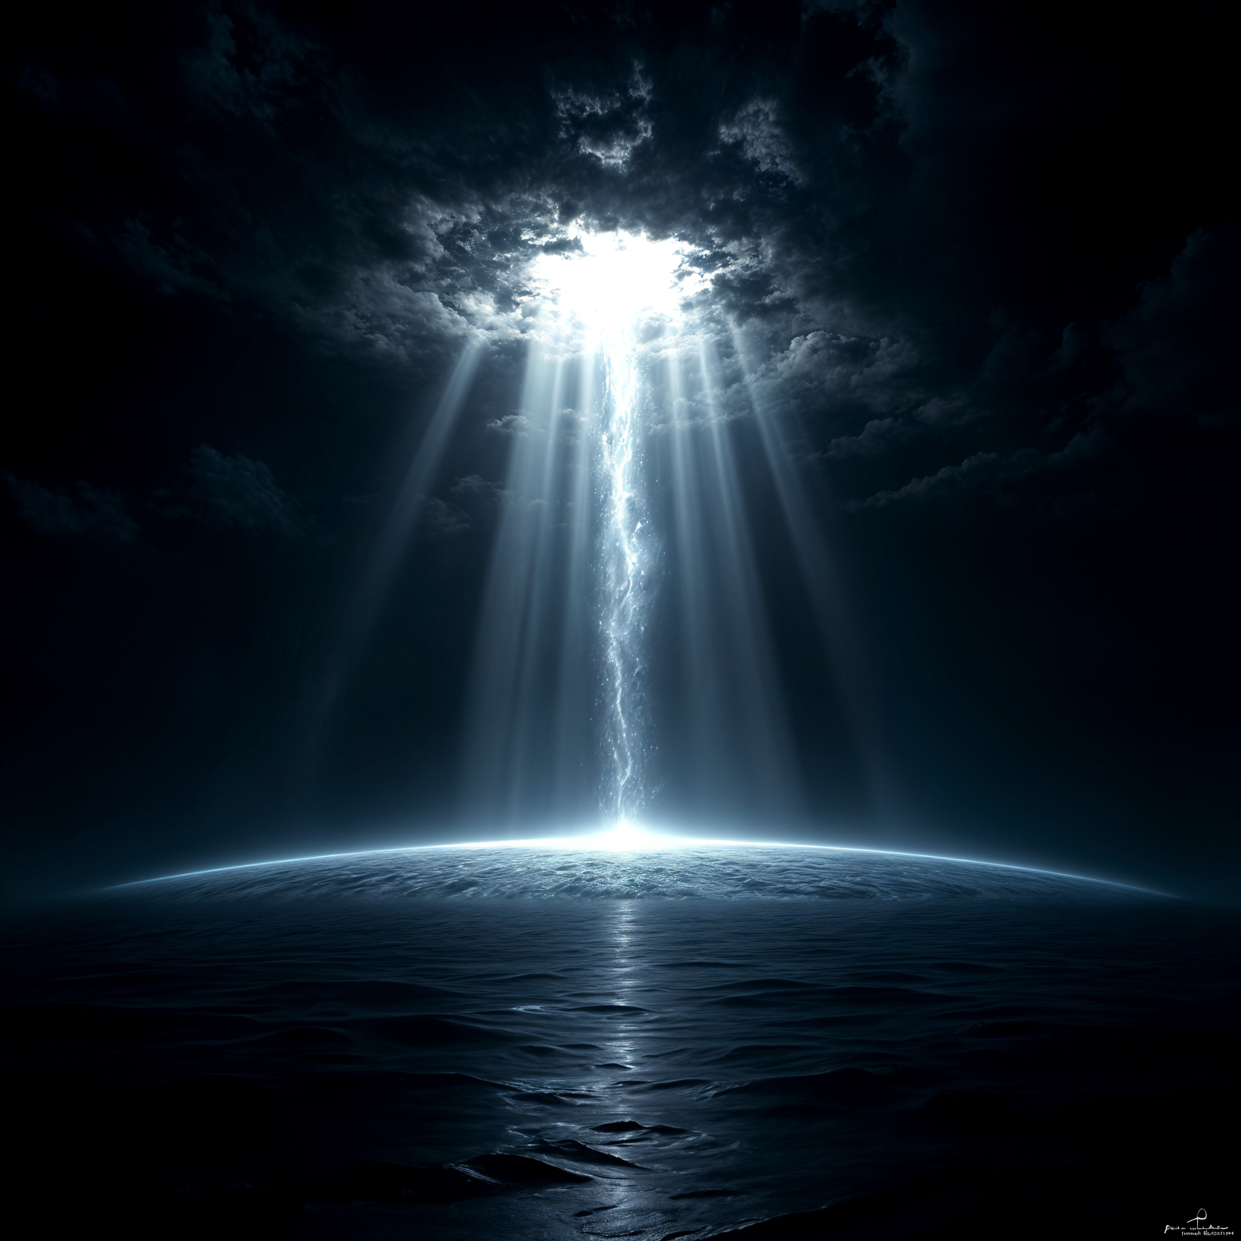

Cosmic Dawn
Separating Light From Darkness

Slide 2
“In the beginning God created the heavens and the earth. The earth was without form, and void; and darkness was on the face of the deep. And the Spirit of God was hovering over the face of the waters.”
“Then God said, “Let there be light”; and there was light. And God saw the light, that it was good; and God divided the light from the darkness.”
Genesis 1:1-3

Slide 3
In The Beginning
In the Beginning, it was God, who created all things.
The earth lacked beauty, it lacked order, it was in complete disarray; it “was without form and void”.
In the work of Creation, before God made any living thing, He made a line of demarcation between the light and the darkness, a distinction between these two opposing forces.
“For He spoke, and it was done; He commanded, and it stood fast.” Psalms 33:9
And the evening and the morning were the first day…

Slide 4
In The Beginning
The separation of light from darkness occurred on the first day, yet the sun, moon and stars were not created until the fourth day of Creation.
Genesis 1:14-19
The natural question to ask ourselves is, ‘what was the Light that shined on the first day if the sun, moon and stars were not created until the fourth day?’
Does the Bible give any clue to this apparent contradiction?
For it is God who commanded the light to shine out of darkness, who has shone in our hearts to give the light of the knowledge of the glory of God in the face of Jesus Christ.
2 Corinthians 4:6

Slide 5
The Agent of Creation
Q. Who Created all things?
A. God created all things. Revelation 4:11; Genesis 1:1
Q. Who did the work of Creation?
A. Jesus Christ
John 1:1-4, 10-11,14
Ephesians 3:8-9
Colossians 1:16-17
Hebrews 1:1-3
2 Corinthians 4:6

Slide 6
The End From the Beginning
The Bible tells us that God’s wisdom is extremely broad, His ways are not our ways, nor His thoughts our thoughts.
Who can know the ways of God? His mind is all knowing and our wisdom is foolishness in God’s sight.
Many of the events that we read of in Scripture having taken place in times past have a very practical application throughout all generations, especially to us living in these last days.
As it was in the beginning, so will it be at the end… the light of God’s glory shall again enlighten the whole world.

Slide 7
The End From the Beginning
Job 33:14
Isaiah 46:9-10
Ecclesiastes 1:9; 3:15
Luke 17:26,29-30
2 Peter 2:6
1 Corinthians 10:11
The history of the wilderness life of Israel was chronicled for the benefit of the Israel of God to the close of time. The record of God's dealings with the wanderers of the desert…. is fraught with warning and instruction for His people in all ages. The varied experience of the Hebrews was a school of preparation for their promised home in Canaan. God would have His people in these days review with a humble heart and teachable spirit the trials through which ancient Israel passed, that they may be instructed in their preparation for the heavenly Canaan. PP 293

Slide 8
Quick Recap
God created all things through His Son Jesus Christ.
There was a division/separation of the light from the darkness in the beginning. Light and Darkness cannot co-exist.
There was light shining upon the face of the earth, before the creation of the sun, moon and stars on the fourth day.
The earth was enlightened with God’s glory through His Son Jesus Christ.
History repeats itself.

Slide 9
Light In these Last DayS
"The three angels of Revelation 14 are represented as flying in the midst of heaven, symbolising the work of those who proclaim the first, second, and third angels’ messages.
All are linked together.
The evidences of the abiding, ever-living truth of these grand messages, that mean so much to the church, that have awakened such intense opposition from the religious world, are not extinct. Satan is constantly seeking to cast a shadow about these messages, so that the people of God shall not clearly discern their importance, their time and place; but they live and are to exert their power upon our religious experience while time shall last.”
Testimonies for the Church volume 6, page 17
“And this Gospel of the kingdom will be preached in all the world as a witness to all the nations, and then the end will come.” Matthew 24:14
Revelation 14:6-12- The Gospel of the Kingdom
This final message is God’s last warning to a dying world.
After this threefold message goes to all the world, we are told that Christ shall come.

Slide 10
Light In these Last DayS
1st Angel:
Calls us back to true Biblical worship, reverencing and fearing the King of kings, putting away of idolatry and all the false gods in our lives.
It brings to our minds, the judgement hour message, the need for victory over sin, the need for Christlikeness of character that our lights may shine, the need for spotless robes.
Christ is the Creator and the memorial of His works of Creation— The Sabbath.
The true Biblical Family.

Slide 11
Light In these Last DayS
2nd Angel:
Warns us of Babylon’s moral fall and apostasy.
Who/What is Babylon?
Am I a part of Babylon?
All peoples of the earth have been made drunk through Babylon’s apostasies.
Calls people out of Babylon—a message of separation.

Slide 12
Light In these Last DayS
3rd Angel:
If we reject the worship of God, by implication, we worship beast. A choice must be made.
Who is the beast and what is the image of the beast?
What is the mark of the beast?
Wrath of God.
Destruction/No rest, (State of the Dead).
God will have a faithful people at the end.—Saints.

Slide 13
Who are The Saints?
Revelation 14:12
Daniel 7:27
Ephesians 4:22-24
Colossians 3:9-10
2 Corinthians 5:17
1 John 3:2-3
Romans 8:14
Revelation 14:1
The Saints are the faithful followers of Christ in these last days, who obey His will and reflect the light of His glory in this dark and sinful world.
“You are the light of the world. A city that is set on a hill cannot be hidden. Nor do they light a lamp and put it under a basket, but on a lampstand, and it gives light to all who are in the house. Let your light so shine before men, that they may see your good works and glorify your Father in heaven.
Matthew 5:14-16

Slide 14
Light in these Last days
Isaiah 60:1-3
Isaiah foretells a time when the world will be covered yet again in darkness; not literal but spiritual darkness.
As it was in the days of Noah and Lot, so shall it be at this time. God reveals the end from the beginning.
The inhabitants of the world, for the most part have given themselves over to apostasy, idolatry, fornication, and a whole load of other abominations.
Yet God will cause His light to shine upon His people; His faithful few that remain.

Slide 15
Light in these Last days
Through them, God shall cause His light to shine amidst the gross darkness of this world.
His people have been fully transformed into the image of His Son Jesus Christ— They have been sanctified by the Holy Spirit and have been sealed.
Through them, the final warning message to come out of Babylon and to separate from its apostasies, shall be given.
God still has a people in Babylon, and it is through this final message, they shall be brought out. “The Gentiles shall come to thy light.” verse 3

Slide 16
Light in these Last days
Revelation 18:1-4
Once more, the earth shall be lightened with the glory of God. Through His people, the glory of Jesus, shall be shed abroad into all the world, as a witness to all nations before the end comes.
Through His saints, the message shall be given to “come out of Babylon.”
God’s sheep who are of the other folds, shall hear His voice and they shall separate from Babylon to unite with God’s faithful Commandment keeping people.
Then there shall be one Fold & one Shepherd.

Slide 17
Light in These Last Days
“Notwithstanding the spiritual darkness and alienation from God that exist in the churches which constitute Babylon, the great body of Christ's true followers are still to be found in their communion. There are many of these who have never seen the special truths for this time. [Many] are dissatisfied with their present condition and are longing for clearer light. They look in vain for the image of Christ in the churches with which they are connected. As these… [churches] depart further and further from the truth, and ally themselves more closely with the world, the difference between the two classes will widen, and it will finally result in separation. The time will come when those who love God supremely can no longer remain in connection with such as are “lovers of pleasures more than lovers of God; having a form of godliness but denying the power thereof.”
Great Controversy p.g 390

Slide 18
Light in These Last Days
Revelation 18 points to the time when, as the result of rejecting the threefold warning of Revelation 14:6-12, the church will have fully reached the condition foretold by the second angel, and the people of God still in Babylon will be called upon to separate from her communion. This message is the last that will ever be given to the world; and it will accomplish its work. When those that “believed not the truth but had pleasure in unrighteousness” (2 Thessalonians 2:12), shall be left to receive strong delusion and to believe a lie, then the light of truth will shine upon all whose hearts are open to receive it, and all the children of the Lord that remain in Babylon will heed the call: “Come out of her, My people” (Revelation 18:4).
Great Controversy p.g 390

Slide 19
“Then God said, “Let there be light”; and there was light. And God saw the light, that it was good; and God divided the light from the darkness.”
Genesis 1:3

Slide 20
CLosing
Today gross spiritual darkness is covering the people and Jesus is looking for saints today to reflect His image and glory in this sinful, dark, world.
Saints whose eyes are lifted up and looking unto Jesus and not upon the pleasures of this life.
Is that me? Is that you?
Only time will tell.
Let us pray to be a part of that faithful few whom God is desires to use in these last days to give the final warning to the inhabitants of the world and to shine the light of His glory to all men.
“For if the trumpet give an uncertain sound, who shall prepare himself for the battle?”
1 Corinthians 14:8

Slide 21






THANK YOU!
loudcrycompendium@gmail.com
@ThePropheticEye
www.loudcrycompendium.com
@loudcrycompendium

