Slide 1
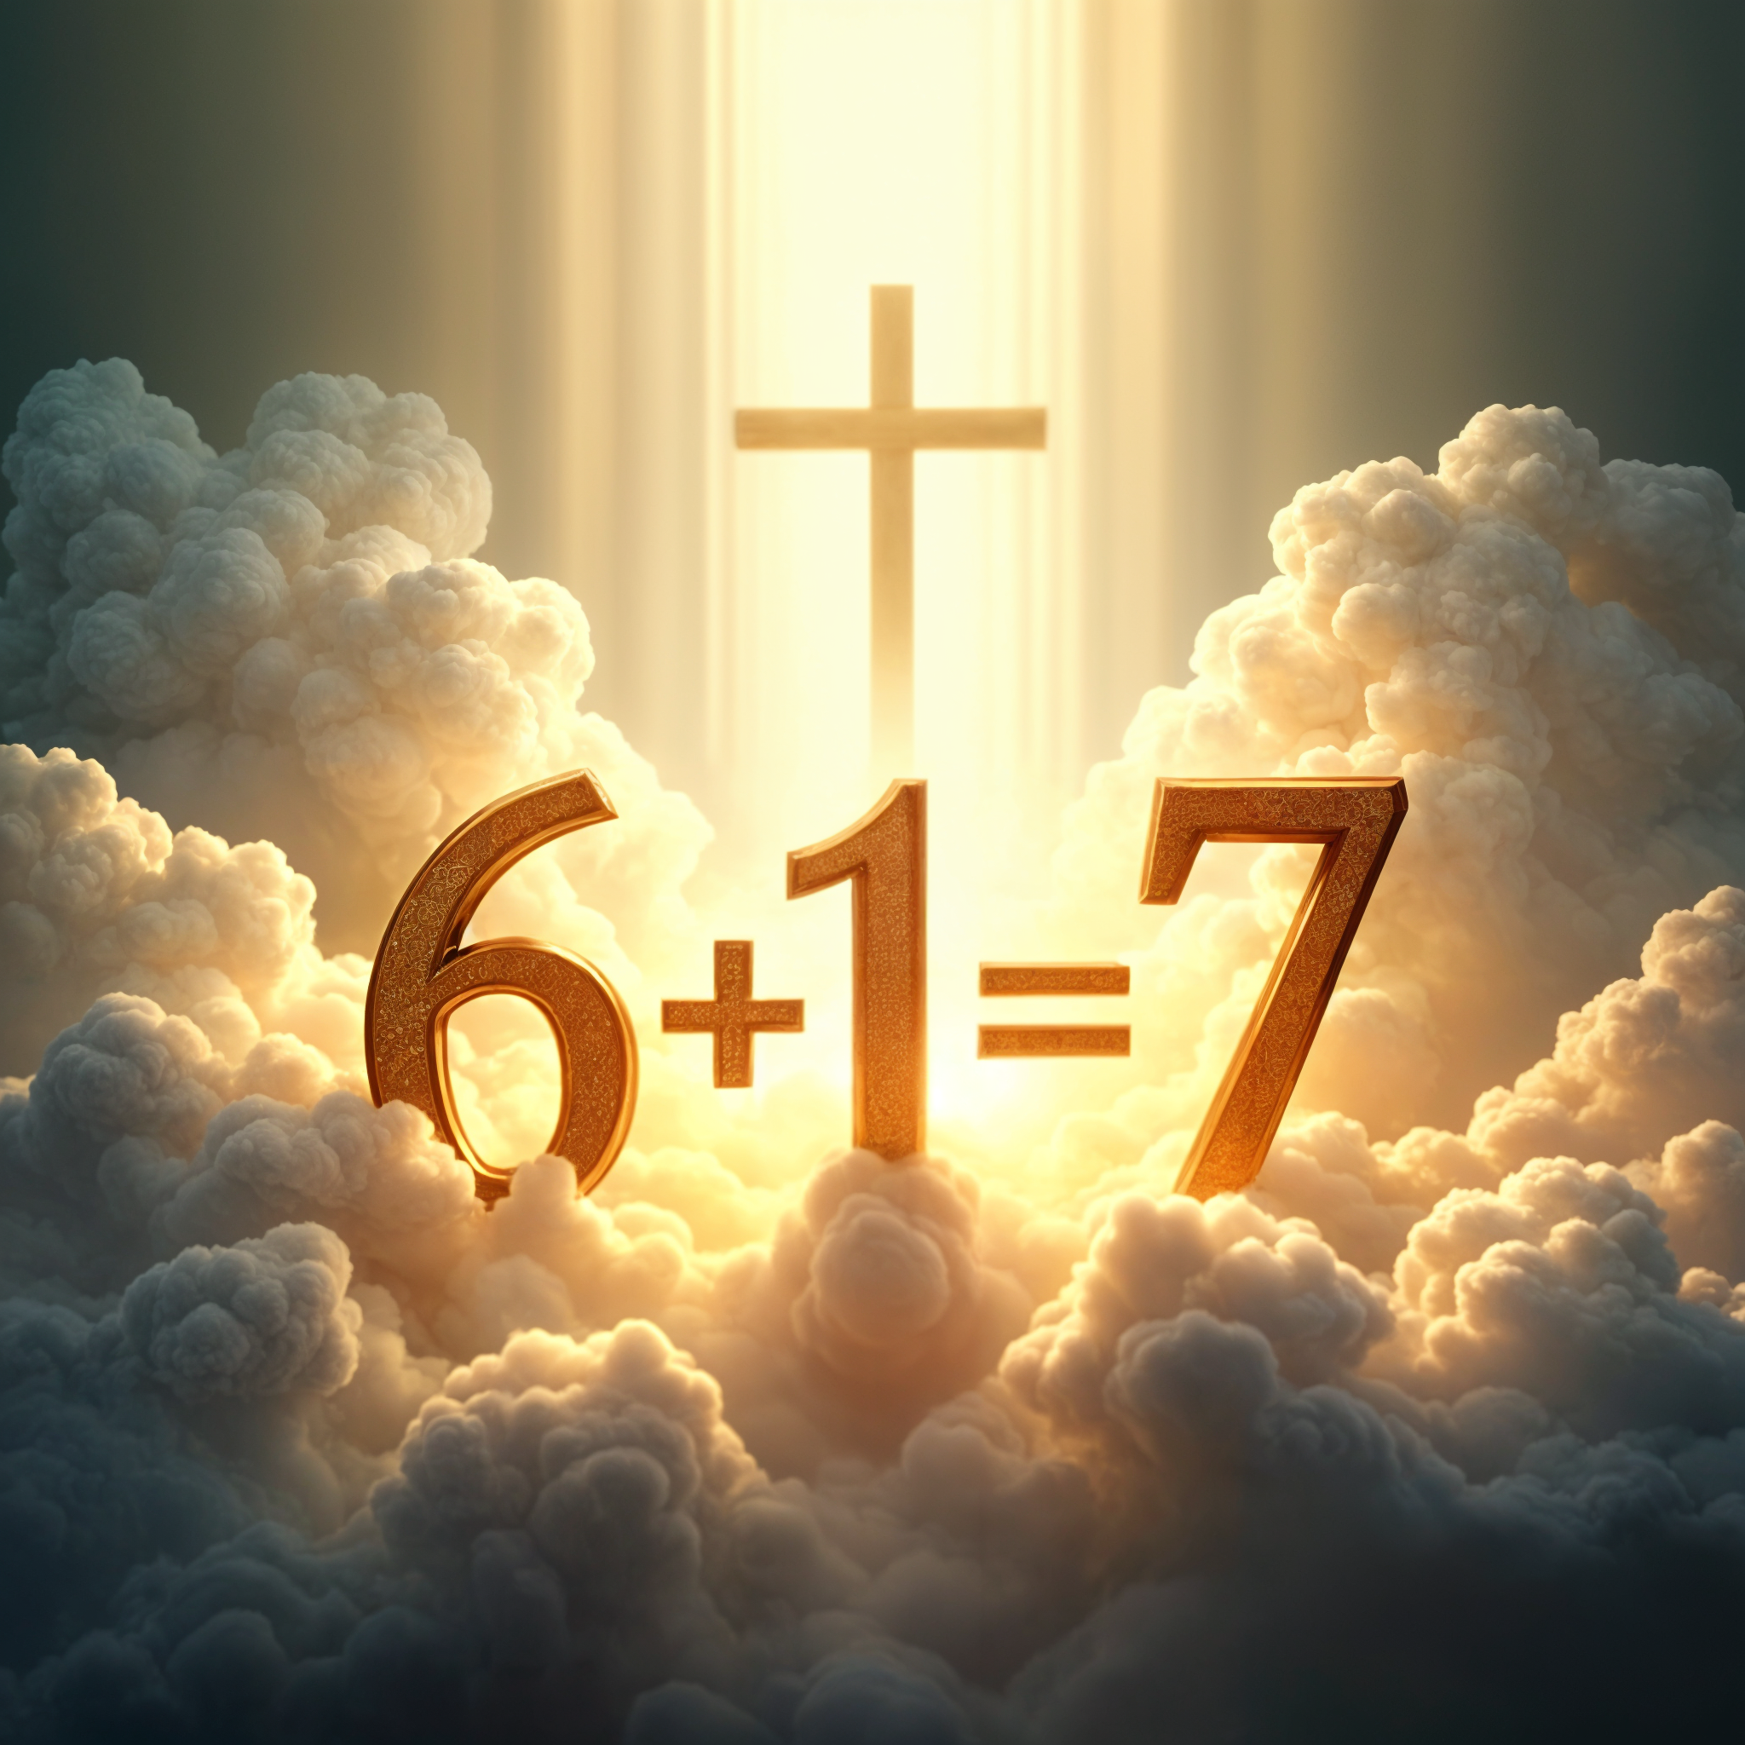
Six + One = Seven
The Divine Equation and The Christ Connection

Slide 2


Why Numbers?
No one can deny that numbers play a very important role in our day to days lives.
We practically use numbers every single day— in work time, leisure time, personal time, etc.
In Scripture, numbers too have a very significant role, in that they communicate.
That is, God uses numbers throughout His Word, to symbolically portray essential concepts which help us to better understand divine things.

Slide 3
Why Numbers?
It’s important to recognise, however, that repeated numbers aren’t random occurrences, but deliberate choices. They hold profound truths that demand our attention and even help us grasp, at least as much as our finite (limited) understanding allows, the nature of God’s mind and heart.
Having said this, it is obvious that none of us can ever hope to understand God fully, for we read:
“For My thoughts are not your thoughts, Nor are your ways My ways,” says the LORD. “For as the heavens are higher than the earth, So are My ways higher than your ways, and My thoughts than your thoughts.” Isaiah 55:8-9

Slide 4
Some Examples
1- Unity, Oneness- Deut. 6:4; John 10:30; Gen. 2:24
2- The Word- Hebrews 4:12; Zech.4:1-14. Rev. 11:3-4
3- The Godhead/Trinity- Isa. 6:3; Rev. 4:8; Matt. 28:9
3 ½- Persecution- Dan.7:25; Rev. 12:13-14
4- Universality- Matt. 24:31, Ezek. 7:1-2; Rev. 7:1
5- Teaching- 5 books of Moses, 5 wise & 5 foolish, 5 loaves
6- Mankind- Gen.1: 27,31; Rev. 13:18
10- Totality, Entirety- Ex.20; Matt. 25:1; Luke 17:17; 15:8
12- God’s People- Ezek.47:13; Matt. 10:1; Acts 1:15
40- Testing & Purification, Generation- Noah, Moses, Israel, Jesus

Slide 5
Seven (7)
But of all these numbers found in the Bible, none is more significant than the number 7; God’s number of perfection.
Used approximately 562 times in the Bible: 7,70,7000, etc.
Seven: days, feasts, years, candle-stick, stars, seals, horns, eyes, angels, trumpets, thunders, last plagues, 70 years captivity, 7000 faithful, etc.
What is even more significant is that the number 7 is usually preceded by a period of 6+1.
The question is why?
This will be the purpose of our study today, to ask why does 6+1=7.

Slide 6
Six + One = Seven
God reveals to us “the end from the beginning and from ancient times, the things that are not yet done.” Isaiah 46:9-10
Is it possible that there is something that God desires to teach us by this repeated principle of 6+1=7 found all throughout Scripture?
Let’s take a deeper look at some of the examples that we can find in the Bible on this principle.

Slide 7
Six + One = Seven
In the very beginning of the history of this planet, God created all things in 6 days and then He rested on the 7th day, the Sabbath. Six days of creation plus one day of rest. Genesis 1:1-2:3.
When the children of Israel entered the Promised Land, God had commanded them to farm the land for 6 years, and then the land should be rested in the 7th year. Exodus 23:10-11; Leviticus 25:1-4
If the children of Israel had a servant from amongst his own brethren (a fellow Israelite), that servant was to serve his master for 6 years and be set free in the 7th year. Exodus 21:1-2

Slide 8
Six + One = Seven
In the days of Joshua, the servant of Moses, the children of Israel surrounded the city of Jericho for 6 consecutive days, but on the 7th day, the walls of Jericho came tumbling down. Joshua 6:2-5
During each Hebrew year, there were 7 feasts which were connected to the Sanctuary; the first 6 feasts were then followed by a 7th , Tabernacles, which when it came to an end, signified the end of all things, for that year. It was a feast of celebration and joy for the final harvest had been gathered in. Leviticus 23:4-44/Deut. 16:13-15*

Slide 9
Six + One = Seven
Naaman the leper dipped 6 times in the River Jordan, and after the 7th dip he was made clean. 2 Kings 5:9,14.
King Solomon built the Temple for 6 years, and it was completed in the 7th year. In the fourth year of Solomon’s reign as king, he laid the foundation, and in the eleventh year of his reign as king, he completed the building of the temple. Therefore, 6 years of building, and after 1 year it was completed. 1 Kings 6:37-38
Elijah prayed for rain 6 times, and after the 7th prayer, the rains fell. 1 Kings 18:41-45
Samuel, the Prophet, journeyed for 6 days, and on the 7th day he arrived at Gilgal. 1 Samuel 13:8-13

Slide 10
Six + One = Seven
But why this constant repetition of 6+1=7, friends? Is God trying to teach us algebra? Or is there a lesson of the highest magnitude to be learnt here?
If you were to study the timeline of history from Adam to Abraham, you would notice that it covers a period of approximately 2000 years.
From Abraham to King David and then to Christ is also approximately 2000 years.
And from Christ to our day is also approximately 2000 years.
We do not have exact dates, but we know that approximately, the Bible teaches us that the earth is approximately or approaching 6000 years old.

Slide 11
Six + One = Seven
Notice a few interesting points.
The week in Scripture is very significant:
A Week of Days- Seen in Creation, Genesis 1
A Week of Weeks- Passover + 7 weeks = Feast of Weeks Lev. 23: 4-16
A Week of Months- Passover + 7 Months = Feast of Trumpets, Lev. 23:5,23-24
A Week of Years- Jacob served Laban and received his wife in the 7th year. Genesis 29:26-28
A Week of Decades- The Jubilee- 7 weeks of years. Leviticus 25:8-12

Slide 12
Six + One = Seven
A Week of Centuries- Seventy Weeks of Daniel 9, 490 years more were given to the Jewish nation, before the gospel would go to all nations. Daniel 9:22-27
A Week of Millenium- 6000 years of earth’s history and then for 1000 years the earth will rest. Rev. 20
Notice:
Athalia the Harlot Queen of Jerusalem reigned for 6 years, but in the 7th year she was dethroned and the true king, Joash, reigned. 2 Kings 11:1-3, 4,10-12
Moses dwelt with Aaron, his sons, and the 70 elders for 6 days, but on the 7th day, Moses ascended into God’s presence. Exodus 24:1-2, 9-10, 12, 16-18

Slide 13
Six + One = Seven
6 days had passed and on the 7th day, Peter, James and John ascended into the Presence of the glorified Christ. Matthew 16:27-28; Matthew 17:1-4
Not to mention that after the first 6 churches of Revelation, Christ comes in the days of the 7th Church, Laodicea.
After, the opening of the first 6 seals, Christ comes during the time of the 7th seal.
After the blowing of the first 6 trumpets, Christ comes during the time of the 7th trumpet.
After the first 6 plagues, the 7th plague ushers in the glorious appearing of Christ in the heavens.

Slide 14
Six + One = Seven
What is the significance of all these repetitions of the principle of 6+1=7?
Is it possible that the all wise, and all-knowing God, who reveals “the end from the beginning, and from ancient times, the things not yet done”, is it possible that He is showing us that the end of all things is nearer than we think?
Is it possible that NOW, it is high time to awake out of our sleep, for our salvation is nearer now than when we believed?
Can it be that, like Naaman, the leprosy of sin will soon be eradicated from amongst the people of God when the 6000th year is fulfilled.

Slide 15
Six + One = Seven
Can it be possible that God wants us to see that though the symbolic Athalia is now reigning upon the earth —the harlot of Bible Prophecy, the bride of satan— that her time is soon to come to an end and the Greater than Joash is soon to come to sit upon His throne— Jesus Christ the True King?
Can it be that soon and very soon, the elect of God are going to be taken up into the Mount—Mt. Zion—just as Moses, Peter, James and John all met with Him in the Mount after 6 days?
Can it be that we shall soon be finally set free from the assaults of the task master, satan? As the Hebrews were set free from their earthly masters after serving for 6 years and set free in the 7th?

Slide 16
Six + One = Seven
The fulfilment of this Divine formula, 6+1=7, is clearly soon to be fulfilled.
How soon, we do not know, for it is not appointed for man to know the day or the hour of Christ’s return.
But the signs of the times are fast fulfilling all around us.
Wars & rumours of wars, earthquakes, diseases in beast and in man, global immorality, apostasy, compromise and lukewarmness amongst God’s professed people, the union of the first and the second beast among many other signs are clear before us.

Slide 17
In ClosinG
Friends, what more evidence do we need?
Today, if you hear the Spirit speaking in that still small voice, do not harden your hearts, but repent and seek to be made right between you and your God.
“But as for me and my house, we will serve the Lord!”

Slide 18






THANK you
@ThePropheticEye
loudcrycompendium@gmail.com
www.loudcrycompendium.com
@loudcrycompendium

