Slide 1
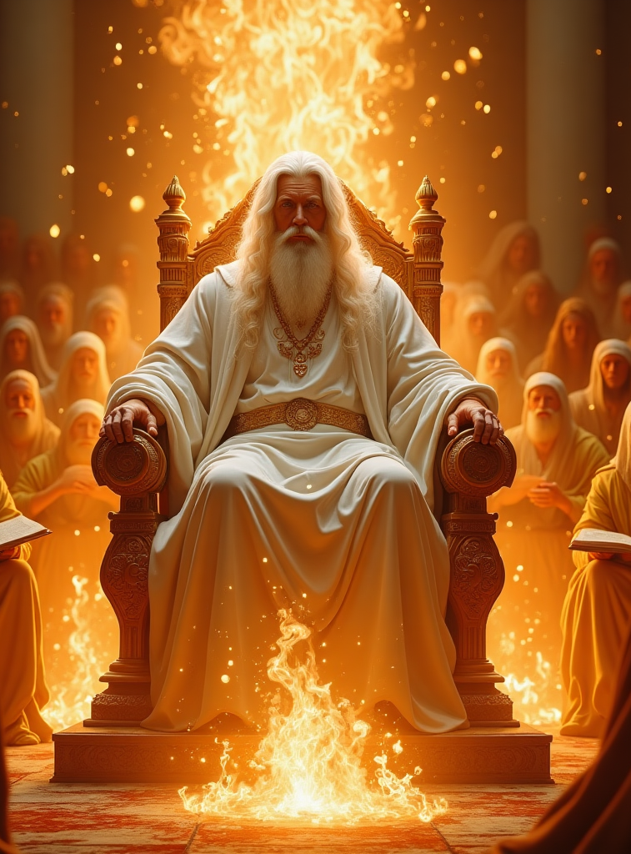

Does a Judgment Occur Before the Second Coming?
Or Have We Believed a Lie?

Slide 2
“Now the Spirit speaks expressly, that in the latter DAYS some shall depart from the faith, giving heed to seducing spirits, and doctrines of demons”
1 Timothy 4:1

Slide 3
FOUNDATION
The Spirit is clear, before Jesus comes again, there are many who are now called sheep of Christ, who will eventually go out from amongst the flock.
Various reasons will lead to this “falling away”, but one of the primary reasons is deception.
As Satan deceived in the beginning and caused believers to fall— angels & Eve— so will he cause many in the last days to depart from the faith through deception. Matthew 24:4-5,11, 24-25
One of these topics which causes much contention in the Church is the doctrine of a Judgement before Christ comes.

Slide 4
FOUNDATION
For the believer, there is no questioning whether there is a Judgment or not, the question is when that Judgment takes place.
I believe that the Bible does teach a Judgment before Christ comes—this is clear throughout the OLD TESTAMENT— but it is made even clearer in the Books of Daniel and the Revelation—The Books that Christians today generally don’t read.
These two books teach us that 1) There is a judgment for all who profess Christ and 2) There is a judgment for those who reject Christ. The Judgment has 2 stages as it were.
Ultimately, we must all appear before the Judgment Seat of Christ.

Slide 5
FOUNDATION
“For whatever things were written before were written for our learning…” Romans 15:4
“All these things happened to them as examples, and they were written for our admonition, upon whom the ends of the ages have come.” 1 Cor. 10:11
“That which has been is what will be, that which is done is what will be done and there is nothing new under the sun. Is there anything of which it may be said ,“See, this is new”? It has already been in ancient times before us.” Eccles. 1:9
The Bible teaches us that God in His wisdom allows history to repeat and God’s people are to learn from the events of the past.

Slide 6
JUDGMENT IN THE OLD TESTAMENT
Adam & Eve’s casting out of Eden- Genesis 3:9-13
Before the Great Flood- Genesis 6:1-7* (both righteous & wicked)
At the Tower of Babel- Genesis 11:5-7
Sodom & Gomorrah- Genesis 18:20-33* (both righteous & wicked)
During the Exodus Events- Exodus 2:23-25,7,9-10* (both righteous and wicked)
Before the 70-year Captivity- 2 Chron. 36:14-21
“… I am God…declaring the end from the beginning.” Isaiah 46:9-10

Slide 7
JUDGMENT IN THE NEW TESTAMENT
We see many references to a future judgment in the New Testament, whether it takes place before or after the 2nd Coming needs to be studied more deeply.
Matthew 12:36, 41-42
Acts 17:30-31*
Romans 2:5-6
2 Corinthians 5:10*
1 Peter 4:17/2 Peter 3:7
Revelation 14:7; 20:4,11

Slide 8
JUDGMENT BEFORE JESUS COMES
We will begin by briefly reviewing Daniel 2, bearing in mind that God always repeats and enlarges giving more detail overtime.
Review & Discuss Daniel 2.
Babylon → Medo-Persia → Greece→ Rome→ Divided Rome→ Coming Kingdom
Daniel 2 simply lays out the general outline of future events from Nebuchadnezzar's day.
Not much detail is given in this chapter, just a general broad overlay.
Compare with Daniel 7.

Slide 9
JUDGMENT BEFORE JESUS COMES
“Surely the Lord GOD does nothing, unless He reveals His secret to His servants the prophets.” Amos 3:7
Review & Discuss Daniel 7. ([1-14]; [15-22]; [23-27])
Babylon → Medo-Persia → Greece→ Rome→ Divided Rome→ Little Horn Rome→ Judgment→ Coming Kingdom
Daniel 7 gives us additional information that Daniel 2 doesn’t give us; it fills in the blanks.
According to Daniel 7, sometime after the period of Little Horn Rome but before the Coming Kingdom, there was to be a Judgment.

Slide 10
JUDGMENT BEFORE JESUS COMES
In Daniel 8, even more detail is given particularly about the Judgment.
Review & Discuss Daniel 8.
Babylon → Medo-Persia → Greece→ Political Rome (Empire/Divided) & Priestly Rome→ Cleansing of the Sanctuary→ Coming Kingdom
According to Daniel 8, The Judgment IS the Cleansing of the Sanctuary.
Daniel 8 tells us this Judgment or Cleansing of the Sanctuary was to take place after 2,300 years.
This event took place in the days of the children of Israel on the sixth Hebrew feast day called the Day of Atonement, 10th day of the 7th month.

Slide 11
DAY OF ATONEMENT- IN BRIEF
Sixth of the Seven Hebrew Ceremonial sabbaths— 10th day of the 7th Hebrew Month.
It was a solemn time only for those who were called children of Israel.
A ceremonial or annual sabbath— a day of fasting, praying, putting away of sin, getting right with God.
All those who professed the Name of God, yet who were not found in repentance and sorrow for sin, and who did not seek to be right with God, were cut off from the children of Israel.
It was a day where only the High Priest was to enter into the Most Holy Place, to make atonement for the people and for the sanctuary.

Slide 12
DAY OF ATONEMENT- IN BRIEF
A time when all the sins which were confessed by faith into the sanctuary throughout the year, were to be cleansed symbolically and blotted out from all those repenting saints.
Symbolically, sin moved from the repentant sinner, to the lamb, to the shed blood, taken into the sanctuary by the priest who now bore the blood. The Sanctuary now contained the record of sin of all God’s people.
Symbolically, it needed to be Cleansed, i.e., A judgement of God’s People had to take place and those who were in true repentance had their sins blotted out and were able to now partake of the Feast of the Harvest also called the Tabernacles. More information on Daniel 8 and the 2300 days can be found on our platforms.

Slide 13
JUDGMENT BEFORE JESUS COMES
In Daniel 9, Gabriel comes to give Daniel additional insight regarding what was spoken regarding the 2,300 day/years. Daniel 9:22
We are told that the 2,300 day/years begins at a particular point in history. Daniel 9:24-27. More information on Daniel 9 and the 70 weeks can be found on our platforms.
Babylon → Medo-Persia (2300 days begins) → Greece→ Rome in all its stages (ends in 1798)→ (2300 days ends)Cleansing of the Sanctuary/ Judgment of The Saints→ Coming Kingdom

Slide 14
JUDGMENT BEFORE JESUS COMES
In the Book of Revelation, God reveals even more insight to the Prophet John, who builds upon and fills in additional details not seen in Daniel, regarding this Judgment.
For the next few slides, we will notice John the Revelator’s additional details.
Daniel 7 shows us 4 beasts which eventually lead into the little horn, Revelation 13 shows us the little horn revealed as 1 beast, with the characteristics of the 4 beasts of Daniel 7.
Daniel 7:8,20, 21,25 → Revelation 13:5-7 → Daniel 8:24-25

Slide 15
JUDGMENT BEFORE JESUS COMES
In the Book of Revelation, the little horn (the beast), is also called a Harlot by John. Notice the same persecuting characteristics- Revelation 17:1,6
Notice that John refers to the Second Coming as a Great Harvest (feast of Harvest/Tabernacles— takes place after the Day of Atonement/Cleansing of the Sanctuary/The Judgment). Revelation 14:14-15; Leviticus 23:33-34,39; Deut.16:13
What important 3-fold message do we see taking place in Revelation 14 before this Great Harvest takes place?

Slide 16
JUDGMENT BEFORE JESUS COMES
The Three Angel’s Messages take place just before the Second Coming.
These Messages, highlight the fact that the Judgment HAS come and therefore God’s people should be “preparing to meet their Maker”. Revelation 14:6-7
In other words, at some point in prophetic time, AFTER the deadly wound of the little horn Rome, but BEFORE the Second Coming of Christ, there would be a message that would be preached by a particular group of people, to every kindred, nation, tongue and people, warning the world that the period of Judgment foretold by the Prophets of old, had indeed finally come— The Day of Atonement had begun— The Cleansing of the Sanctuary above.
In their time, the Judgement would be a present reality, and no longer a future event as it was in the days of Daniel or John.

Slide 17
JUDGMENT BEFORE JESUS COMES
The Three Angel’s Messages, could not have been preached at any other time in history. It had to be preached only during the time of the Judgment, for only then could it be said, “the hour of His Judgment IS come.”
Judgment begins with the house of God first, 1 Peter 4:17, and it is only when that Judgment of God’s Church has taken place, then shall Christ come for His Bride— only after the Judgment, could the “harvest of the earth be ripe.”
Leviticus 21:14- The Priest only marries a Virgin, not a Harlot.
These three angel’s messages, prepare all who accept them by faith as the everlasting gospel, TO STAND in the Day of Christ’s Glorious return.

Slide 18
THE ENTIRE PICTURE
Babylon → Medo-Persia → Greece→ Rome→ Divided Rome→ Little Horn Rome→ Judgment of the Church/Cleansing of the Sanctuary (the 3 A.M preached)→ Coming Kingdom [2nd Coming]→ Millenium→ Judgment of the Wicked & Hell fire→ New Heavens & New Earth

Slide 19
IN CLOSING
My Question to you in closing is this?
Does a Judgment occur before the 2nd Coming or have we believed a lie?
“For we did not follow cleverly devised myths when we made known to you the power and coming of our Lord Jesus Christ.” 1 Peter 1:16
“For the time is coming when people will not endure sound teaching but having itching ears they will accumulate for themselves teachers to suit their own passions, and will turn away from listening to the truth and wander off into myths.” 2 Timothy 4:1

Slide 20
IN CLOSING
“Several books were before Him, and upon the covers of each was written in letters of gold, which seemed like a burning flame of fire, “Ledger of Heaven.” One of these books containing the names of those who claimed to believe the truth was then opened. Immediately I lost sight of the countless millions about the throne, and only those who were professedly children of the light and of the truth engaged my attention….
Another book was opened, wherein were recorded the sins of those who professed the truth… As I beheld, I was filled with inexpressible anguish, and exclaimed, Who can be saved? who will stand justified before God? whose robes are spotless? who are faultless in the sight of a pure and holy God?...
The names of all who professed the truth were mentioned. Some were reproved for their unbelief, others for having been slothful servants. They allowed others to do the work in the Master's vineyard, and to bear the heaviest responsibilities, while they were selfishly serving their own temporal interests….
The Judgment pg. 41

Slide 21







THANK YOU
@ThePropheticEye
loudcrycompendium@gmail.com
www.loudcrycompendium.com
@loudcrycompendium

