Slide 1
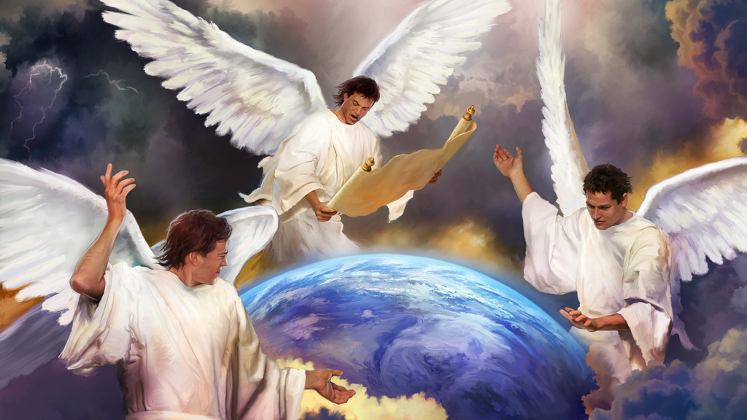

Trumpeting Truth
Last Call To Humanity

Slide 2
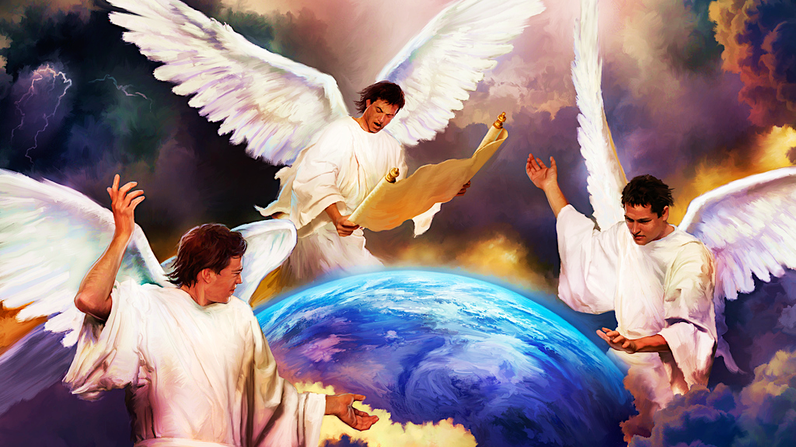

Slide 3
Laying the Foundation
“If the foundations are destroyed, What can the righteous do?” Psalm 11:3
Throughout the Bible, we can always find that before God pours out judgments, there is always a message of warning sent via a messenger.
Think about Noah, Lot, Moses, Jonah, Isaiah and Jeremiah… last of all think Christ Himself, to the Jews of His day.
With this in mind, should we not expect that before the culmination of this world’s history, God will, in the same way, have a message of warning that comes to the inhabitants of this world, before Christ comes again the Second Time?
“For I am the LORD, I do not change…” Malachi 3:6

Slide 4
Laying the Foundation
The Bible does indeed teach that God will have a message that will go to “every kindred, nation, tongue and people”, that all may be warned of the Coming of the Messiah that we may be “prepared to meet our Maker.”
A careful study of the books of Daniel and the Revelation, point out a clear flow of events from the Days of Daniel down to the Second Coming of Jesus Christ.
And from this flow of events, God’s last day message to a dying world is revealed.
It is imperative that we—those who profess to be a part of God’s Covenant keeping people— understand this message, so that we can be those “messengers”, whom God will use to give His “message” in these last days.

Slide 5
Flow of Events According To Daniel & Revelation
Babylon [Daniel’s day]
Medes & Persians [2300 Days & 70 Weeks Begins-457BC]
Greeks
Rome A [Empire; 70 Weeks Ends-34AD; John’s day]
Rome B [Divided Rome; 10 toes/horns]
Rome C [Papal Rome; Church/Civil Power; 538-1798]
Sanctuary Cleansed/Time of Judgment for God’s People[Final Work of H.P/2300 Days ends/ Oct.22.1844]
It is during this time period of Judgment, that God’s Final Message to Humanity is given.
Latter Rain [Poured Out Upon the Sealed, Final ingathering, Probation closed]
High Priest finishes His Final Work [Plagues Fall]
Jesus Returns

Slide 6
Some Questions To Consider
Why is that God gives warnings before judgments?
Micah 7:18; Ezekiel 33:11; John 3:16
He is merciful and long suffering, not wishing that any should perish, but that all should inherit eternal life in Christ.

Slide 7
Some Questions to consider
What does God say to us— His people—concerning warning the wicked?
We are watchmen, called to hear the word from His mouth and give the people warning.
Ezekiel 3:17-19; Luke 12:42-43
We are to give the people meat in due season, crying aloud and lifting up our voices like trumpets…. But why?
“For if the trumpet makes an uncertain sound, who will prepare for [the] battle?” 1st Corinthians 14:8
However, today we have become, as Isaiah warns us— blind watchmen.
“His watchmen are blind, they are all ignorant; they are all dumb dogs, they cannot bark; sleeping, lying down, loving to slumber.” Isaiah 56:10

Slide 8
The Message
Read Matthew 24:14 and Revelation 14:6-12
We are told that this final message is the “Everlasting Gospel” that must go to all nations before the end of the world. It will go to every nation, every kindred, every tongue and tribe upon the earth.
No one will have the opportunity to say that they did not know, or they never heard it. Jesus tells us that it will be “a witness unto all nations” or people.
This message, we are told, is proclaimed to the world during a period in the history of the world, where it would be evident that, “the hour” or time of God’s Judgment had begun.
As with all things in the plan of Redemption, they begin according to God’s prophetic time.
“I, Jehovah, will bring it to past in its time.” Isaiah 60:22

Slide 9
The Messengers
Revelation 14 tells us that the message is given by angels.
OT- Malak/NT-Aggelos- ANGEL=MESSENGER
Seeing that the word angel literally means “messenger”, it is fitting that God uses three angels to symbolise the proclamation of this final message. This reminds us that divine and super-natural power will accompany the preaching of these messages.
It is clear then that during this period, when the Judgment begins—when Christ is performing His final great and solemn work, in the Most Holy Place—He MUST have a people upon the earth, proclaiming “with a loud voice”, that indeed the has Judgment begun.
In order to give this Message at its appointed time, God MUST have Messengers raised up at and during the appointed time.

Slide 10
The First Part of The Message
What 4 major points does the First Angel’s Message cover?
The Fear of God- Reverencing God, being in awe of His holiness; looking upon Him with love, trust, & respect, eager to do His Will. “By the fear of the Lord, men depart from evil”, Proverbs 16:6. Fearing God keeps us from partaking of evil. Solomon tells us, “Fear God & keep His Commandments, for this is the WHOLE DUTY of man”, Ecclesiastes 12:13, John 14:15
Give God Glory- To give God glory is simply to give Him the honour, and the praise, and the worship that His reputation demands. There is no way we can make God any more glorious than He already is, but what we can do is to hold Him in the highest regard, giving Him the transcendent praise of which He alone is worthy. See: 1st Corinthians 6:19-20;10:31

Slide 11
The First Part of The Message
3. Judgement- The final work of the Great High Priest has commenced. The Sanctuary is being cleansed in Heaven, and the Church is being purified; the chaff will be sifted out and the wheat shall remain. The Day of Atonement, Sanctuary Message, Holiness and putting away of sin. Ephesians 5:25-27,32
4. The Creator & Creation- It points us back to True Worship. Acknowledging God as the Creator of all things and as a result it leads us back to the Sabbath truth, which is the sign that He is our Creator, Redeemer, Provider & Sanctifier. It also reveals the Health Message and proper diet and proper dress. Genesis 2:1-3; Exodus 20:11; Deut. 5: 14-15; Ezekiel 20:12; Genesis 1:29, Genesis 3:12-19 (Leviticus 11)

Slide 12
The Second Part of The Message
What does the 2nd Angel tell us about Babylon? What does the angel of Revelation 18:1-4 urge all to do?
The Second Angel states that “Babylon is Fallen” and because “Judgment must begin at the House of God”, the voice from Heaven, urges all His People to come out of Babylon at once, so that they will not continue to partake of Babylon’s sins and thus be destroyed along with it. See:1 Peter 4:17, 1 Timothy 3:15*, Ezekiel 9:6
Jesus has many people in Babylon; “And other sheep I have, which are not of this fold: them also I must bring, and they shall hear My voice; and there shall be One-Fold, and One Shepherd.” John 10:16— One Shepherd & One Flock.
Babylon and all that unite with her, will ultimately be destroyed and God is calling ALL to come out of her and return to true Bible based Christianity, not the apostate, worldly Christianity that is so prevalent today. Revelation 18:21; Jeremiah 6:16-19

Slide 13
The Third Part of The Message
Against what does the third angel solemnly warn in Rev. 14:9-10?
The third angel’s message warns people against worshipping the beast (harlot, little horn, Babylon, the man of sin, etc.) and of receiving the mark of its authority in their forehead or hand. The first angel commands true worship and calls us back to the Creator God, the third angel warns of the tragic consequences connected with false worship.
In order to know what is the mark or the image or number, we must first know who or what is the beast, and the third angel’s message calls us also to a deep study of the prophecies of Daniel & the Revelation, something that many Christians today sadly neglect.

Slide 14
The Third Part of The Message
What are the distinguishing characteristics of those Messengers who give these all-important messages in these last days?
They will be Commandment keepers, possessing the testimony of Christ, which is the gift of Prophecy, and they will have the faith of Jesus Christ.
They are raised up specifically AFTER the beast receives its “deadly wound” in 1798, but BEFORE the Second Coming of Christ, during the Judgment of the “Church of the living God.”
This Message could not be proclaimed at any other time in history—it could only be proclaimed at the appointed time by a specific people.
The Patriarchs, The Prophets, The Apostles, even The Reformers, could not proclaim this message—because it was not for their time.

Slide 15
The Third Part of The Message
Revelation 12:17; Revelation 19:10; Revelation 14:12
They are patient, persevering, enduring, faithful amidst hardships and persecution until the end.
They are saints, or “holy ones” who are fully on the side of God. They “follow the Lamb wherever He goes”.
They obey His Commandments, not because they save us, for we are “saved by grace, through faith” in Jesus alone, but they keep His Commandments because they love Him and want to be obedient. John 14:15; Ephesians 2:8-9
They have the faith of Jesus. Fully trusting and believing in His eternal word and promises. Their house is built upon the eternal Rock and not the sifting sand; there is oil in their vessels. Matthew 7:24-27; Matthew 25:8-9
She will be purified and cleansed, a pure Virgin, without whoredom or harlotry awaiting her Husband. Leviticus 21:13-14

Slide 16
Summarising
The Three Angel’s Messages are God’s final message to this dying world. It is a message of mercy, of love and of judgment. It calls us back to true Bible based Christianity, built upon the Commandments of God and not the doctrine of man.
It warns us of the moral fall of Babylon and all her associates. It warns us against false worship and against receiving the mark of the beast which, if one is paying attention to current events in the world today, will see that it is making its way in darkness, swiftly across the world.
It admonishes us to receive the Seal of God in our foreheads else we will receive the mark of the beast in our forehead or righthand. There is a just reward for either party.
God is a God of mercy and a God of justice and in love He warns all of humanity, that they may have an opportunity to make a choice for themselves. We as Seventh Day Adventist, who profess great light and who have been tasked with giving this final message to the world have a great work to do in these last days. (Luke 12:47-48)

Slide 17
Summarising
“In a special sense Seventh-day Adventists have been set in the world as watchmen and light bearers. To them has been entrusted the last warning for a perishing world. On them is shining wonderful light from the word of God. They have been given a work of the most solemn import—the proclamation of the first, second, and third angels’ messages. There is no other work of so great importance. They are to allow nothing else to absorb their attention.
It is not a small matter that the counsels and plans of God have been so clearly opened to us. It is a wonderful privilege to be able to understand the will of God as revealed in the sure word of prophecy. This places on us a heavy responsibility. God expects us to impart to others the knowledge that He has given us. It is His purpose that divine and human instrumentalities shall unite in the proclamation of the warning message.” Testimonies, vol. 9, pg. 19

Slide 18
Summarising
"The three angels of Revelation 14 are represented as flying in the midst of heaven, symbolising the work of those who proclaim the first, second, and third angels’ messages.
All are linked together.
The evidences of the abiding, ever-living truth of these grand messages, that mean so much to the church, that have awakened such intense opposition from the religious world, are not extinct. Satan is constantly seeking to cast a shadow about these messages, so that the people of God shall not clearly discern their import[ance], their time and place; but they live and are to exert their power upon our religious experience while time shall last.”
Testimonies for the Church volume 6, page 17

Slide 19






THANK YOU & BE BLESSED!
@ThePropheticEye
loudcrycompendium@gmail.com
www.loudcrycompendium.com
@loudcrycompendium

