Slide 1
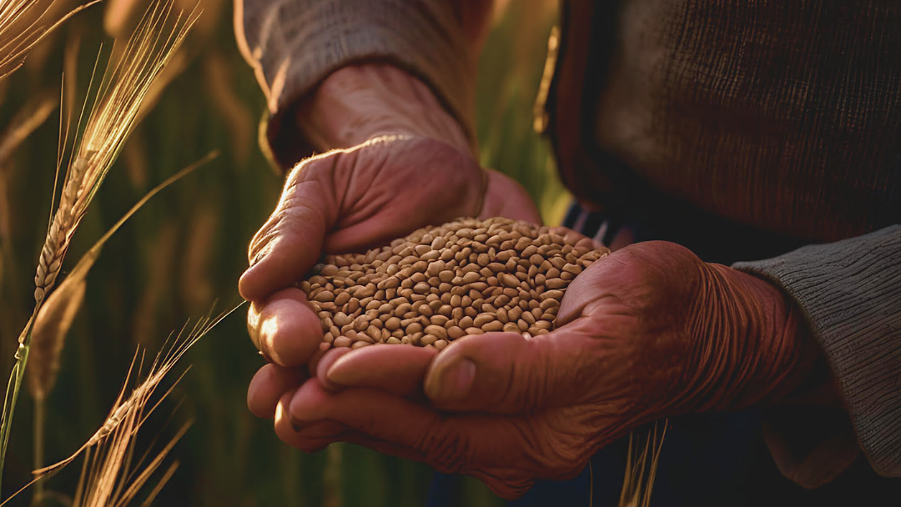

Break Up Your Fallow Ground
A Sower Went Forth to Sow

Slide 2
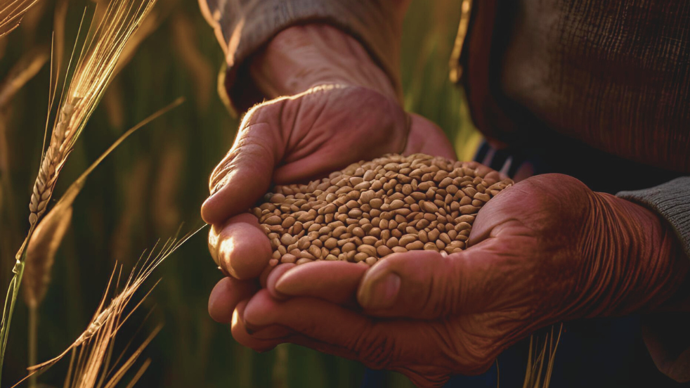
FOUNDATION
“The Redeemer of the world generally chose the open air in which to give His lessons of instruction, rather than to be enclosed in walls. He could make his teachings more impressive when surrounded with the beauties of nature…..that He might illustrate important truths of the kingdom of God, by the works of God in nature.” The Review and Herald, July 25, 1871
There is much to be learnt about the plan of salvation for mankind as seen in the operations of nature.

Slide 3
FOUNDATION
“By the parable of the sower, Christ illustrates the things of the kingdom of heaven, and the work of the great Husbandman for His people. Like a sower in the field, He came to scatter the heavenly grain of truth.” Christ’s Object Lessons, pg. 33
With this in mind, today we will study Christ’s parable of the Sower and the Seed, to see what Spiritual lessons can be learnt and applied to our lives in these final days.
Matthew 13:1-9,18-23; Mark 4:1-20; Luke 8:4-15

Slide 4
PARABLES
To those who hunger and thirst after righteousness, Jesus says:
“…blessed are your eyes for they see, and your ears for they hear”
Matthew 13:16
“Then He spoke many things to them in parables…” Matthew 13:3
Why did Jesus choose Parables as a means of teaching?
Read Matthew 13:10-11; Mark 4:10-12
The mysteries of the kingdom are not for them that are “without”, viz. those outside of the kingdom of God.
It is only those who hunger and thirst after righteousness who can expect to be filled.
But the natural man does not receive the things of the Spirit of God, for they are foolishness to him; nor can he know them, because they are spiritually discerned.
1 Corinthians 2:14

Slide 5
A SOWER
Read Matthew 13:3-8
Notice a few observations:
A Sower
Seed
Wayside
Stony Places
Thorny Ground
Good Soil

Slide 6
A SOWER
From the natural seed cast into the soil, Christ desires to lead our minds to the gospel seed, the sowing of which results in bringing man back to his loyalty to God. He who gave the parable of the tiny seed is the Sovereign of heaven, and the same laws that govern earthly seed sowing govern the sowing of the seeds of truth.
Christ’s Object Lessons, pg. 33.1
Q. Who is the Sower and what is He sowing?
A. Jesus and He sows the Word.
“He who sows the good seed is the Son of Man.” Matthew 13:37
“The Sower, soweth the Word.” Mark 4:14
“The Seed is the Word of God.” Luke 8:11
So, Christ, the heavenly Sower, went forth to sow…He went forth, a suffering, tempted man; went forth in solitude, to sow in tears, to water with His blood, the seed of life for a world lost.
Ibid, pg. 36.1

Slide 7
BY THE WAYSIDE
Those by the wayside are the ones who hear; then the devil comes and takes away the word out of their hearts, lest they should believe and be saved.
Luke 8:12
“And as he sowed, some seed fell by the wayside; and the birds came and devoured them.” Matthew 13:4
As the Sower, Jesus goes forth to sow the seed in the soil of our hearts. He uses ministers of the gospel, evangelistic series, bible studies, camp meetings, even one to one talks, but like a devouring bird, satan is there to snatch up the seed so that we do not hear, understand and apply it to our lives that we might be saved.

Slide 8
BY THE WAYSIDE
While Christ is drawing the soul by His love, Satan tries to turn away the attention of the one who is moved to seek the Saviour. He engages the mind with worldly schemes. He excites criticism, or insinuates doubt and unbelief. The speaker's choice of language or his manner may not please the hearers, and they dwell upon these defects. Thus, the truth they need, and which God has graciously sent them, makes no lasting impression.
Ibid. pg. 44
The seed sown by the wayside represents the word of God as it falls upon the heart of an inattentive hearer…. Men hear the word but understand it not. They do not discern that it applies to themselves. They do not realize their need or their danger. They do not perceive the love of Christ, and they pass by the message of His grace as something that does not concern them.
As the birds are ready to catch up the seed from the wayside, so Satan is ready to catch away the seeds of divine truth from the soul…. He fears that the word of God may awaken the careless and take effect upon the hardened heart. Satan and his angels are in the assemblies where the gospel is preached. While angels of heaven endeavour to impress hearts with the word of God, the enemy is on the alert to make the word of no effect.
Christ’s Object Lessons, pg. 44
“Today, if you hear His voice…..”
Hebrews 3:7

Slide 9
STONY GROUND
And these are they likewise which are sown on stony ground; who, when they have heard the word, immediately receive it with gladness; And have no root in themselves, and so endure but for a time: afterward, when affliction or persecution ariseth for the word's sake, immediately they are offended*.
Mark 4:16-17
OFFENDED:
Then shall they deliver you up to be afflicted and shall kill you: and ye shall be hated of all nations for my name's sake. And then shall many be offended….
Matthew 24:9-11
“Some fell on stony ground, where it did not have much earth; and immediately it sprang up because it had no depth of earth. But when the sun was up it was scorched, and because it had no root it withered away.” Mark 4:5-6
Many neglect the importance of a deep-rooted system. The roots are they which sustain the plant that we see above the soil.
Christ continues to sow the seed, and some falls upon soil that has not been properly prepared. It is full of rocks and stones, with little depth for the roots of the plant to grow deep that they may pull moisture from deep within the earth and thus sustain the plant through an intense spell of heat.
The plant may spring up quickly, but it cannot withstand the heat of the mid-day sun. Eventually it will wither and die.

Slide 10
STONY GROUND
Many who make a profession of religion are stony-ground hearers. Like the rock underlying the layer of earth, the selfishness of the natural heart underlies the soil of their good desires and aspirations. The love of self is not subdued. This class may be easily convinced, and appear to be bright converts, but they have only a superficial religion.
Christ’s Object Lessons pg. 46
In the heart that has not been properly prepared to receive the Gospel, the individual initially accepts the message of Salvation with joy, but because they do not count the costs, because they do not consider what the word of God requires of them, they do not bring it face to face with all their habits of life and as a result, they do not yield themselves fully to its control and make a full surrender to Christ.
Subsequently, when fiery trials arise, which are meant to purify our characters and transforms us into the image of Christ, the stony ground hearers, endure for a time, but ultimately wither and die spiritually, departing from the faith, plucked up by the roots.
…he who “hath not root in himself,” “endureth for a while”; but “when tribulation or persecution ariseth because of the word, by and by he is offended.” Many receive the gospel as a way of escape from suffering, rather than as a deliverance from sin. They rejoice for a season, for they think that religion will free them from difficulty and trial. While life moves smoothly with them, they may appear to be consistent Christians. But they faint beneath the fiery test of temptation. They cannot bear reproach for Christ's sake.
Ibid 47.2
Are you rooted in Christ?

Slide 11
SOWN AMONG THORNS
He also that received seed among the thorns is he that heareth the word; and the care of this world, and the deceitfulness of riches, choke the word, and he becometh unfruitful.
Matthew 13:22
And some fell among thorns, and the thorns grew up, and choked it, and it yielded no fruit. Mark 4:7
There must be no competition for growth in the life of the plant. The plant must have adequate space for its roots to grow and spread and must have an ample supply of nutrients.
Thorns, cause competition. Thorns choke the plant and prevents it from growing and ultimately leads to little to no fruit.
Likewise, the old nature must be crucified, old habits put away, the former life of sin and the pleasures of this world must be given up if we desire to bring forth much fruit for God, for “herein is My Father glorified, that you bear much fruit, so shall ye be my disciples.” John 15:8
And these are they which are sown among thorns; such as hear the word, And the cares of this world, and the deceitfulness of riches, and the lusts of other things entering in, choke the word, and it becometh unfruitful.
Mark 4:18-19
And that which fell among thorns are they, which, when they have heard, go forth, and are choked with cares and riches and pleasures of this life, and bring no fruit to perfection.
Luke 8:14

Slide 12
SOWN AMONG THORNS
The thorns of sin will grow in any soil; they need no cultivation; but grace must be carefully cultivated. The briers and thorns are always ready to spring up, and the work of purification must advance continually. If the heart is not kept under the control of God, if the Holy Spirit does not work unceasingly to refine and ennoble the character, the old habits will reveal themselves in the life. Men may profess to believe the gospel; but unless they are sanctified by the gospel their profession is of no avail. If they do not GAIN THE VICTORY OVER SIN, THEN SIN IS GAINING THE VICTORY OVER THEM. The thorns that have been cut off but not uprooted grow apace, until the soul is overspread with them.
Christ’s Object Lessons p.g 50
Ask yourself this question:
Have I any thorns in my heart?
What is preventing me from growing FULLY into Christ’s image?

Slide 13
PREPARATION OF GOOD SOIL
Christ represents the different results of the sowing as depending upon the soil. In every case the sower and the seed are the same. Thus, He teaches that if the word of God fails of accomplishing its work in our hearts and lives, the reason is to be found in ourselves. But the result is not beyond our control….the power of choice is ours, and it rests with us to determine what we will become. The wayside, the stony-ground, the thorny-ground hearers need not remain such.
The garden of the heart must be cultivated. The soil must be broken up by deep repentance for sin. Poisonous, satanic plants must be uprooted…. The evil tendencies of the natural heart can be overcome only by earnest effort in the name and strength of Jesus.
The Lord bids us by His prophet, “Break up your fallow ground, and sow not among thorns” Jeremiah 4:3…. This work He desires to accomplish for us, and He asks us to co-operate with Him. Christ’s Object Lessons pg. 56

Slide 14
GOOD GROUND
And other fell on good ground, and sprang up, and bare fruit an hundredfold. Luke 8:8
Once the soil has been adequately prepared—the fallow ground broken up, the stones removed and the thorns and tares pulled up from the roots, then the soil is ready for planting.
There is enough depth of soil for the roots to grow deep, there is no competition from weeds, the birds find no wayside seed which they can devour.
It is in this type of soil that the Sower desires to sow His Seed, because He knows it will bring forth abundant fruit and give a profitable return on His investment.

Slide 15
GOOD GROUND
So is the kingdom of God, as if a man should cast seed into the ground; And should sleep, and rise night and day, and the seed should spring and grow up, he knoweth not how. For the earth bringeth forth fruit of herself; first the blade, then the ear, after that the full corn in the ear. But when the fruit is brought forth [ripe], immediately he putteth in the sickle, because the harvest is come. Mark 4:26-29
The good ground produces the harvest for which the Son of Man desires. “The Husbandman waiteth for the precious fruit of the earth and hath long patience for it, until he receive the early and the latter rain.” James 5:7
Those who possess the good soil of the heart are they which shall receive of the early and latter rain and produce abundant fruit for God.
“For herein is My Father glorified, that ye bear much fruit.”

Slide 16
GOOD GROUND
Of those who possess the good soil of the heart Jesus says:
…he who received seed on the good ground is he who hears the word and understands it, who indeed bears fruit and produces: some a hundredfold, some sixty, some thirty.” Matthew 13:23
But that on the good ground are they, which in an honest and good heart, having heard the word, keep it, and bring forth fruit with patience [perseverance]. Luke 8:15 [ cf. Rev.14:12,14-15]
He has an honest heart who yields to the conviction of the Holy Spirit. He confesses his guilt and feels his need of the mercy and love of God. He has a sincere desire to know the truth, that he may obey it. Christ’s Object Lessons pg. 56

Slide 17
GOOD GROUND
“The good-ground hearer receives the word “not as the word of men, but as it is in truth, the word of God.” 1 Thessalonians 2:13. Only he who receives the Scriptures as the voice of God speaking to himself is a true learner…. He opens his understanding and his heart to receive it…. The Holy Spirit is given to open to them the rich treasures of the truth…. The good-ground hearers, having heard the word, keep it. Satan with all his agencies of evil is not able to catch it away.”
However, merely to hear or to read the word is not enough. He who desires to be profited by the Scriptures must meditate upon the truth that has been presented to him. By earnest attention and prayerful thought, he must learn the meaning of the words of truth, and drink deep of the spirit of the holy oracles.” Ibid 59

Slide 18
GOOD GROUND
The word of God received into the heart will show forth itself in good works.
Its results will be seen in a Christlike life and character.
“By their fruits ye shall know them” and “faith without works is dead also.” Matthew 7:20; James 2:26
Can our works save us? God forbid, for we are saved by grace, through faith in the Gospel of Jesus Christ, it is a gift from God and not of our works, lest any man should boast.
Nevertheless, when we are truly converted, and the old man of sin is crucified, then we become Christ’s workmanship, created in Him unto good works, which God has ordained that we should walk in those works.
These works have Christ at the centre and not self. Christ works in us, both to will and do of His pleasure.

Slide 19
OF A GREAT NECESSITY
“…he who received seed on the good ground is he who hears the word and understands it, who indeed bears fruit and produces: some a hundredfold, some sixty, some thirty.” Matthew 13:23
Do you want to bear fruit?— John 15:8
We need to go through the pruning process. Without it, there is no Heaven or eternal reward.
See John 15:1-2
The Father- Vinedresser/Husbandman
The Son- True Vine
Holy Spirit- The ‘Sap’ that flows through the branches
Church- Branches—Fruitful and Unfruitful
Unfruitful branches- John 15:2,6; Matthew 3:10; Matthew 13:41-42
Fruitful Branches- John 15:2,5,8 ——>Rom.6:22

Slide 20
“And every branch that beareth fruit, He purgeth [pruneth] it, that it may bring forth more fruit.” From the chosen twelve who had followed Jesus, one as a withered branch was about to be taken away; the rest were to pass under the pruning knife of bitter trial… The pruning will cause pain.
….The excessive foliage that draws away the life current from the fruit must be pruned off. The overgrowth must be cut out….
The husbandman prunes away the harmful growth, that the fruit may be richer and more abundant.
…The life of Christ in you produces the same fruits as in Him. Living in Christ, adhering to Christ, supported by Christ, drawing nourishment from Christ, you bear fruit after the similitude of Christ. DA 676-677

Slide 21
GOOD GROUND*
If we lay hold of the divine nature, through Christ “we shall be brought into captivity to Jesus Christ. We shall no longer live the common life of selfishness, but Christ will live in us. His character will be reproduced in our nature. Thus, shall we bring forth the fruits of the Holy Spirit—“some thirty, and some sixty, and some an hundred.”
Christ’s Object Lessons pg. 61
The good ground hearers in these last days will come forth to reflect fully the righteous image of Christ; they have been through the pruning process.
Jesus is working in us TODAY, should we make a full surrender, moulding, pruning, refining & shaping us into His precious image. His character must become our character, His will must become our will, and this work which He has begun in us, He will complete it…..IF we allow Him.
The Husbandman is waiting patiently, with longing desire for the manifestation of Himself in His Church. “When the character of Christ, shall be perfectly reproduced in His people, then, He shall come to claim them as His own.”

Slide 22
IN CLOSING
Today we looked at the parable of the Sower & the Seed. A simple parable but one of immense truth for these last days.
As we close, reflect upon your life, your habits, your daily choices, and ask your self, which type of soil are you?
By God’s grace may we all be transformed into good soil.
But remember, there is a pruning & refining process that is necessary to ensure that we may bare “more fruit” and thus is the Father glorified.
Look unto Jesus, the Author and Finisher of your faith and through the power of His Spirit and your complete surrender, your heart will be changed and transformed that you may bare much fruit, “some thirty, some sixty and some a hundred fold.”
“Break up your fallow ground, for it is time to seek the Lord…
Hosea 10:12

Slide 23






THANK YOU!
loudcrycompendium@gmail.com
@ThePropheticEye
www.loudcrycompendium.com
@loudcrycompendium

