Slide 1
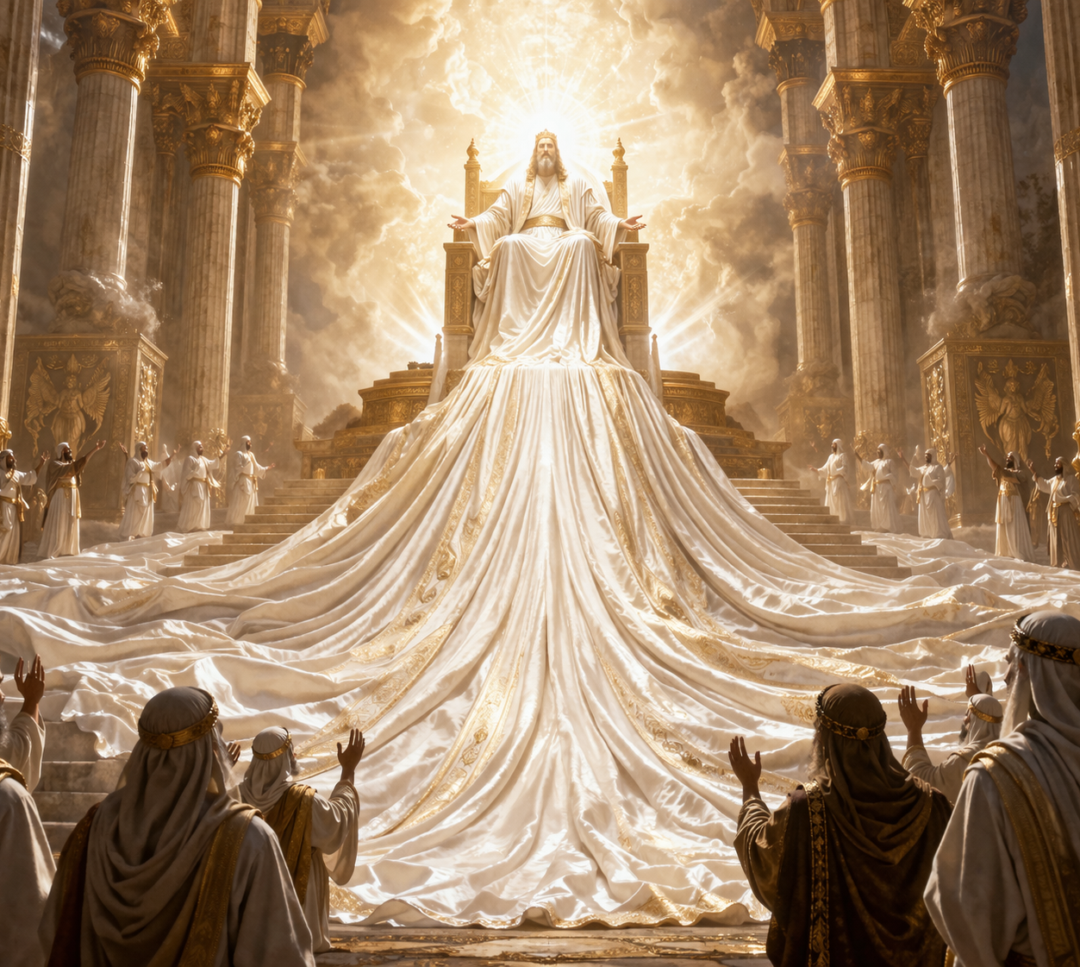

The Divine Son
Is Jesus really God?

Slide 2

What does the Bible teach regarding the Divine Nature of Jesus Christ?

Slide 3
Was He Just A Historical Figure?
The vast majority of the world’s religions, outside of the Christian faith, all accept Jesus as a historical figure, but they do not accept His divinity.
Islam: Muslims state that Jesus is one of the highest-ranking prophets in their writings, yet they strictly deny His crucifixion or that He is the ‘Son of God’— to say this is blasphemy.
Judaism: Mainstream Judaism, teaches that Jesus, though a historical person, was a false prophet. They reject that He is the Messiah and teach that He does not fulfil the Old Testament prophecies which pertain to the Messiah.
Hinduism: Teaches that Jesus was a real person who lived at some point in history, and that He was a sadhu— a holy man and a great teacher.
Buddhism: Some Buddhist believe that Jesus was a ‘bodhisattva’— someone who has attained a high level of spiritual enlightenment.

Slide 4
Was He Just A Historical Figure?
Some “Christians” even reject the divinity of Jesus outright.
Outside of organised religion, thoughts of Jesus usually focus on His impact as a social and historical figure.
Many secular historians and non-believers view Him as a radical Jewish teacher, who challenged the power structure of His time and was “executed as a political rebel”.
Others admire His moral teachings, such as the Sermon on the Mount and His messages of love for one’s enemies.
In modern media, Jesus is frequently portrayed as a hero or a champion for the oppressed, many times stripped of His Divinity, to please secular values.
Some even believe He never even existed and is just a mythological figure— a mere figment of one’s imagination.

Slide 5
What Does Scripture Say?
For the most part, everyone seems to believe that Jesus was a real Man and that He lived at some point in history. Therefore, for the next few slides, let us see what we can learn from the Bible regarding the Divine Nature of Jesus.

Slide 6
What Does Scripture Say?
The Bible presents Jesus’ divinity through multiple converging lines of evidence. There is no conjecture in the Scriptures— it is very clear.
“In the beginning God (ĕlôhı̂ym) created the heavens and the earth.” Genesis 1:1
Moses tells us that in the very beginning, it was God who created the universe.
However, Moses does not use the word for God in the singlular—“ĕl”—rather, he uses the word, ĕlôhı̂ym, referring to God in the plural.
This means that in the beginning, when God the Father created, He wasn’t alone— There was another or others involved.
Verse 2 tells us that The Spirit “hovered over the face of the waters”, so we know that the Holy Spirit was also involved.

Slide 7
What Does Scripture Say?
The Apostle John, one of the twelve, comments on this in John 1:1-3.
Let’s read it.
John tells us that in the beginning, when God created ‘the heavens and the earth’, The Word was also there in the beginning with Him.
This means that “in the beginning” when God made the universe, The Father was present, The Word was present and The Spirit was present.
God— ĕlôhiym— made the heavens and the earth.
John also tells us that The Word was God and in verse 14, he says, The Divine Word took on human nature— He became flesh and blood.
“ And the Word became flesh and dwelt among us…” verse 14.

Slide 8
What Does Scripture Say?
The question then is who is the Word?
Speaking of the Second Coming of Jesus in glory, this same John says, "He was clothed with a robe dipped in blood, and His name is called The Word of God.” Revelation 19:13
He also says of the The Word, “He has on His robe and on His thigh a name written: KING OF KINGS AND LORD OF LORDS.” verse 16
About this same Word John says, “For there are three that bear witness in heaven: the Father, the Word, and the Holy Spirit; and these three are One.”
The Bible teaches us here in these few verses that Jesus is Divine— He is the Divine Word, that become flesh to die as a man for fallen humanity, for as God He could not die, He is immortal.
He was with the Father and Spirit in the beginning, at the work of creation.
“These three are One”—of one mind, in harmony, without dissent.

Slide 9
What Does Scripture Say?
The Apostle Paul makes it even clearer.
“For by Him [Jesus] all things were created that are in heaven and that are on earth, visible and invisible, whether thrones or dominions or principalities or powers. All things were created through Him and for Him. And He is before all things, and in Him all things consist.” Colossians 1:16-17
“God….has in these last days spoken to us by His Son, whom He has appointed Heir of all things, through whom also He made the worlds; who being the brightness of His glory and the express image of His person and upholding all things by the word of His power.” Hebrews 1:1-3
Not only did God make all things through Jesus Christ— the Word— but Paul tells us that Jesus is the image or ‘χαρακτήρ-charakter’ of the Father.
In other words, Jesus has a Divine character, for He has the same character as the Father and the Father Himself is divine.
See also Ephesians 3:9

Slide 10
What Does Scripture Say?
In Isaiah’s commission of Isaiah 6:1-10, Isaiah saw the “the Lord sitting upon a throne high and lifted up” of which even the Seraphim praised and glorified the Lord, saying “Holy, Holy, Holy is the LORD of hosts…”
This vision ends with Isaiah receiving a heavenly appointed mission to give a stern message to the apostate Jewish nation in his day, verse 9 & 10.
If we compare this with John’s Gospel, John tells us that the “the Lord” whom Isaiah saw, was in fact Jesus Christ.
Read John 12:37-41.
Isaiah saw the glory of the Divine Son, when He saw the Lord sitting upon His throne.
“For mine eyes have seen the King, the Lord of hosts.” Isaiah 6:5

Slide 11
What Does Scripture Say?
Jesus Himself confirmed, that Moses saw His glory at the burning bush.
Exodus 3:4-5,13-14
When Moses asked God what was His name, He responded to Moses that He was the “I AM”.
Note the words of Jesus to the disbelieving Pharisees.
“…Jesus said to them, “Most assuredly, I say to you, before Abraham was, I AM.” Then they took up stones to throw at Him…” John 8:56-59
Jesus declared to the the Pharisees that He was indeed the “I AM” who appeared to Moses, existing even before their beloved ancestor Abraham.
For this they took up stones to kill Him, because in their eyes, Jesus was speaking blasphemy, making Himself to be God.
But was He really speaking blasphemy?

Slide 12
What Does Scripture Say?
“I and My Father are One.” John 10:30
“are One”—of one mind, in harmony, without dissent.
They also share the same nature or character, as we saw earlier.
“He who has seen Me has seen the Father…” John 14:9
How is this possible? Because The Father and the Son ‘are One’— in nature, in purpose, in character. Therefore, if we know Jesus and His character as revealed in His Word, then we likewise know the Father, for the Son came into the world to reveal the Father’s nature to fallen, sinful humanity.
No man can see God in His glorified form and live, so the Son of God, became the Son of Man, to reveal God’s nature to us, that we may know what God is like and make a decision to serve Him as Lord.
John 1:18

Slide 13
What Does Scripture Say?
John 5:18- The Jews sought to kill Jesus because He claimed God was His Father, therefore making Himself equal with God.
John 20:28- When Jesus appeared to Thomas the Apostle after the resurrection, his response to Jesus was “My Lord and my God!”
Isaiah 9:6- Almost 700 years before Christ comes into the world in flesh and blood, Isaiah said that He would be born of a virgin. This indeed occurred and was confirmed by the Gospel writers, Matthew 1:18-23; Luke 1:31-35.
Psalms 45:6- David tells us that God’s throne endures forever and ever. The Apostle Paul attributes this verse spoken by King David to Jesus, the Divine Son in Hebrews 1:8
Colossians 2:8-9- Tells us that in Christ dwells all the fulness of Divinity in bodily form. In other words, the entire fulness of God’s divine nature dwelt in Jesus’ body when He came as a Man. He is God and He is Man.

Slide 14
What Does Scripture Say?
The crux of the matter is this.
It is not whether Jesus literally existed as a person. The problem people have is with Jesus’ Divine Nature—they deny it.
What are the chances of the major religions of the world, outside of Christianity, the atheists and agnostics included, all somehow reject Jesus’ Divine nature?
Is it possible perhaps, that this teaching has a common source?
Is it possible that this may be a demonic doctrine, conjured up by the adversary himself, satan—the deceiver?
Why is it that in popular culture and media, the only name that is blasphemed and mocked is the name of Jesus Christ?
Why do we not hear the gods of the other religions mocked or blasphemed?
Why is it ALWAYS Jesus’ name?

Slide 15
What Does Scripture Say?
“But even if our gospel is veiled, it is veiled to those who are perishing, whose minds the god of this age has blinded (satan)—who do not believe— lest the light of the gospel of the glory of Christ, who is the image (character) of God, should shine on them.” 2 Corinthians 4:3-4
The devil has blinded the majority of the world and most of the world believes a lie or rather a half truth.
Yes, Jesus lived on this earth as a Man—He was a real historical figure— but it goes much deeper.
“Even from everlasting to everlasting, Thou art God” Psalm 90:2
He is God, coequal and coeternal with the Father and the Spirit.
There has never been a time where He has not existed.
All things were made by Him and through Him all things consists.
He is 100% God and 100% Man.

Slide 16
What Does Scripture Say?
Satan knows that if he can deceive the world into rejecting Jesus’ Divinity, he would have succeeded in causing their eternal demise, for “no man cometh unto the Father” but through Jesus.
“He who has the Son has life, and He who does not have the Son of God does not have life.”
Our salvation hinges on this very important point—do we accept Christ’s divinity or not— it is a life and death matter.

Slide 17
Closing Reflection
“How can it be that the helpless babe in Bethlehem’s manger is still the divine Son of God? Though we cannot understand it, we can believe that He who made the worlds, FOR OUR SAKES became a helpless babe. Though higher than any of the angels, though as great as the Father on the throne of heaven, He became one with us. In Him God and man became one, and it is in this fact that we find the hope of our fallen race. Looking upon Christ in the flesh, we look upon God in humanity, and see in Him the brightness of divine glory, the express image of God the Father. As a member of the human family, He was mortal, but as God He was the fountain of life to the world. He could, in His divine person, ever have withstood the advances of death, and refused to come under its dominion; but He voluntarily laid down His life, that in so doing He might give life and bring immortality to light.... What humility was this! It amazed angels. The tongue can never describe it; the imagination cannot take it in. The eternal Word consented to be made flesh! God became man!”

Slide 18






THANK YOU
@ThePropheticEye
loudcrycompendium@gmail.com
www.loudcrycompendium.com
@loudcrycompendium

