Slide 1

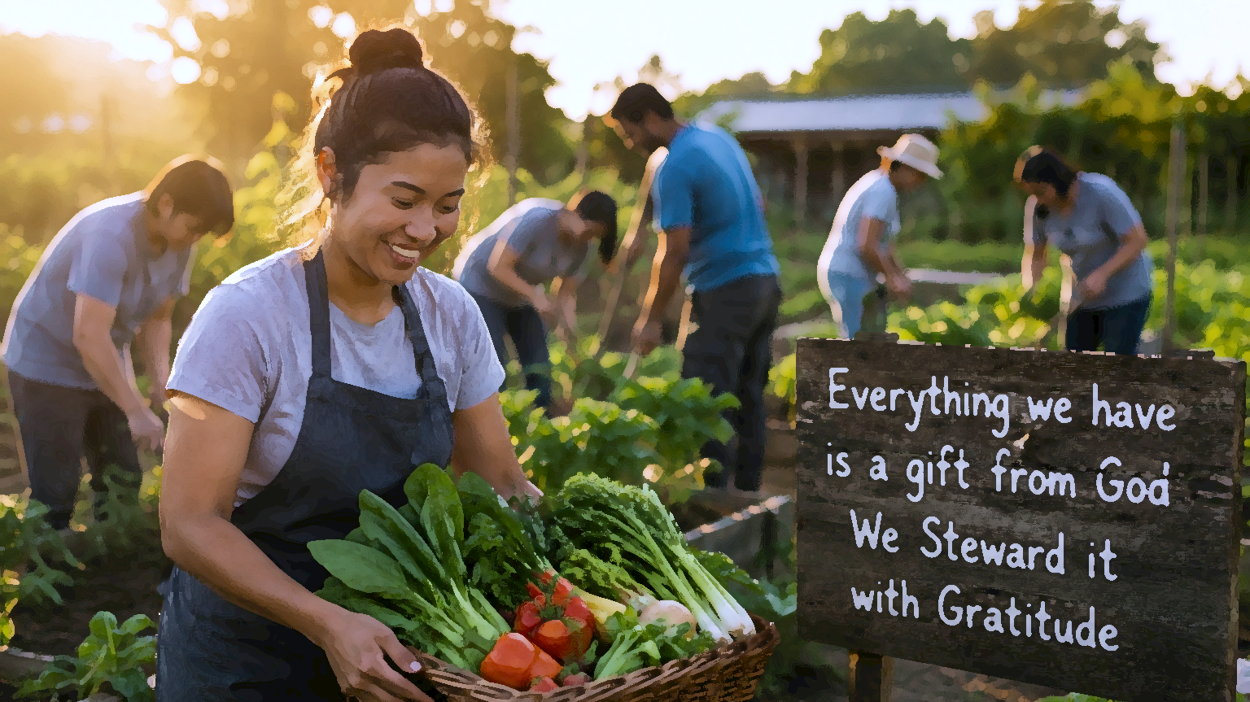
From Ownership To Stewardship
Occupying Until HE Comes

Slide 2
“Steward”
A person responsible for managing, supervising or caring for something that DOES NOT belong to them.

Slide 3
The Basics
God is the Owner and Provider of all things. Scripture roots stewardship in this foundational conviction—believers manage His resources, never their own.
Nothing we hold is truly ours. Followers of Jesus are entrusted with what belongs to God and charged with managing it faithfully.
Sovereignty, ownership, and grace are the pillars of stewardship. Embracing them deepens our understanding of how God’s love is at work in human life.

Slide 4
The Basics
Stewardship as a principle traces back to the beginning of time.
Having brought order out of chaos across six days of creation, God formed humanity last of all.
Everything was already prepared beforehand; Adam & Eve then received the mandate to subdue creation and exercise dominion over it.
Genesis 1:26-28
Psalms 8:3-8

Slide 5
The Basics
By virtue of being The Creator, EVERYTHING belongs to God—humanity included.
Our purpose on this earth is to manage all of God’s Creation, that is, to serve as His stewards.
“The earth is the LORD’s, and all its fullness, The world and those who dwell therein.” Psalm 24:1
Since God made all things, mankind included, whatever we claim to “own”, rightfully belongs to Him—we truly own nothing.

Slide 6
The Basics
Our Lives – Body and Mind
Our Spouses & Children
Possessions – Houses, Land, Car, Job, Clothing
Finances – Savings, Salary, Investments, Inheritance
Time
Talents- Spiritual gifts and Natural gifts.
Every one of these belongs to God.

Slide 7
The Basics
Because everything belongs to Him, it becomes an essential duty to use all things for His glory—not for self.
True stewardship means managing every resource under God’s leadership— the Owner of it all.
The one requirement placed on stewards is to remain FAITHFUL in managing what God has entrusted.
“Let a man so consider us, as servants of Christ and stewards of the mysteries of God. Moreover, it is required in stewards that one be found FAITHFUL.” 1 Corinthians 4:1-2

Slide 8
The Basics
Faithfulness was a central theme in Jesus’ ministry.
A faithful and wise steward gains authority over the master’s household; unfaithfulness forfeits it.
See Luke 12:42-46
Material possessions and personal abilities belong to God—our management of them carries accountability.
How well are we handling what God has entrusted to us?
ACCOUNTABILITY
“…to whom much has been committed, of him they will ask the more.”
Luke 12:48

Slide 9
The Basics
We rely on God for everything while He relies on us for nothing; faithful stewardship therefore springs from GRATITUDE, not obligation.
Every need is met without partiality – Matthew 5:45
Seasons arrive faithfully each year– Genesis 8:22
Daily bread and clothing are supplied – Luke 11:3; 12:28
Our needs are known before we even ask – Matthew 6:32
Such generosity gives rise to an obligation on our part— to honour and worship God with all He has given. We and everything we possess belongs to God, on whom we are dependent and to whom we owe a debt that we can never repay.

Slide 10
TIME
Scripture presents time as a sacred gift demanding intentional stewardship—drawing a sharp line between those who invest it purposefully and those who squander it through idleness.
In Ephesians 5:15 and Colossians 4:5, Paul warns us to “redeem the time!”
Put simply, the time God has granted us demands purposeful use—all the more so as believers.
Seize every occasion to do good, direct life toward God’s will, and regard time as something precious that must not be wasted.
This is God’s time; we are simply His stewards.

Slide 11
TIME
Getting caught up in gossip & idle talk
Losing hours to social media, tv & video games
Drifting into laziness & procrastination
Not preaching & teaching the messages for the hour!
Life is temporary & fleeting; distractions grow while opportunities for good remain limited. Intentional living is urgent because the prophetic clock draws ever closer to midnight.
“I must work the works of Him that sent Me while it is day; the night cometh when no man can work.” John 9:6

Slide 12
TIME
Act on opportunities for good as they come.
Speak truth at every turn—a seed may take root.
Serve others; let self die.
Lost opportunities may NEVER return.
Psalm 90:12
James 4:14
2 Thessalonians 3:10
2 Timothy 2:16
“The Bible gives no endorsement to idleness. It is the greatest curse that afflicts our world.” Christ’s Object Lessons, pg. 343

Slide 13
OUR BODIES
How we treat the human body reveals our grasp of stewardship, for it is a sacred trust from God.
1 Corinthians 6:19-20
Our body is God’s Temple, where the Spirit resides— “we are not our own”—We are managing what belongs to God.
We are therefore called to glorify God through both body and mind.
Caring for our physical health is itself an act of worship— even what we eat honours God.
Romans 12:1; 1 Corinthians 10:31; Daniel 1

Slide 14
OUR BODIES
Health stewardship requires taking responsibility for the body and meeting its needs through:
Diet; Exercise; Rest; Water; Sunlight; Self Control; Fresh Air; Trust in the Power of God
Unfaithful stewardship: Drunkenness; Gluttony; Intemperance; Self harm & Self Abuse, among others.
“Transgression of physical law is transgression of the moral law; for God is as truly the author of physical laws as He is the author of the moral law. His law is written with His own finger upon every nerve, every muscle, every faculty, which has been entrusted to man. And every misuse of any part of our organism is a violation of that law.” Christ’s Object Lessons, pg. 347
“Returning to the subject of human bodily existence, we can say that one function of the mind, working precisely in & through our body and its bodily functions, is to develop character… And it is character alone that can be taken to heaven.”
Frank .M. Hasel, The Nature of the Human Body in Christian Theology, 2020

Slide 15
MONEY & Wealth
God holds us accountable for how we handle the material wealth He has placed in our care, whether much or little.
Money is a tool—a tool meant to be used. When money is using us we become its slaves and it becomes what we look to for security.
Scripture contrasts the rich young ruler to the widow who offered her last two mites.
Is money evil in itself?—Of course not!
What Scripture warns against is the love or obsessive desire for money.
That desire is the root of all kinds of evil. 1 Timothy 6:9-11;Hebrews 13:5
“…Children, how hard is it for them that trust in riches to enter into the kingdom of heaven.”
Mark 10:24

Slide 16
MONEY & Wealth
Whenever we prove unfaithful with the wealth granted to us—being used— letting it use us rather than using it for good—it reshapes what we depend on, and what we depend on dictates what we worship.
Wealth can quietly take God’s place as our provider as opposed to Jehovah Jireh.
“No man can serve two masters!” Matthew 6:24
Do we trust in Jehovah Jireh, like the widow who gave her last two coins into the treasury, or in our wealth, salaries, savings, and investments, like the rich young ruler?

Slide 17
MONEY & Wealth
The rich fool in the parable of Luke 12:13-21 was not condemned for possessing wealth, but for the belief that his riches secured his future without God.
He trusted in his wealth rather than in the God who gave him “the power to get wealth” Deuteronomy 8:18
Rather than blessing others with God’s goods, he hoarded them up to serve self.
“To live for self is to perish” Christ’s Object Lessons, pg.259
How are you using God’s money and wealth?

Slide 18
The Parable of the Talents- Brief Look
Matthew 25:14-30
The master distributes talents according to each servant’s ability. Two servants put their gifts to work at once, doubling the return. They heed the command to “occupy” until the Master comes; engaging actively with what was entrusted.
Both receive the master’s commendation as “good and faithful” servants—faithfulness in small things yields greater responsibility and entry into the master’s joy.
Through this, Jesus underscores the premium He places on faithfulness from those awaiting His return— the faithful not only enter the kingdom but are given responsibilities within it.

Slide 19
The Parable of the Talents- Brief Look
By contrast, the 3rd servant buries his talent. When the master returns, the servant hands back what was given—yet proves unfaithful by doing NOTHING with the OPPORTUNITY he received.
The master labels him “wicked & lazy”
His talent is taken away and given to the faithful servant.
The unfaithful steward loses his reward and is separated from the master’s household into outer darkness.

Slide 20
In Closing
God freely bestows gifts on all people; faithful stewardship means investing those gifts for His glory. When we neglect that calling, the gifts entrusted to us pass from the unfaithful steward and are given to the faithful.
How we steward determines not only our heavenly reward but our place in the Master’s Kingdom.
We see it in the Church on earth, how much more the Church in Heaven?
1 Corinthians 4:1-2; Ephesians 4:8
Are we proving to be faithful stewards? How are we managing those gifts for God’s glory?

Slide 21






Thank You
@ThePropheticEye
loudcrycompendium@gmail.com
www.loudcrycompendium.com
@loudcrycompendium

